Slide 1
WELCOME
Recovery Innovations

Slide 2
Faces & Voices of Recovery
Karla Castro-Soto
Director, Helpline Services
Maurizio Guerrero
Associate Director, Spanish Language Content
Recovery Leadership Summit-- 2023

Slide 3
Who we are?
Families are in urgent need of help, but where do they turn?
Partnership to End Addiction is the nation’s leading nonprofit serving families impacted by substance use.
We are dedicated to helping families access information and resources on addiction prevention, treatment and recovery. We are a diverse community of researchers, advocates, clinicians, communicators and more.

Slide 4
Objectives
A Case Study: Development and Implementation of the Spanish OSC
Substance Use and the Latinx Community
Discussion
New York State Needs Assessment: Implementation and implications
Lessons learned from
the 2022 National
Latinx Behavioral Health Conference

Slide 5
Substance Use and the Latinx Community

Slide 6
The problem
By the time teens are seniors in high school:
61.6% have tried alcohol
40.7% have tried vaping of any kind (nicotine, flavoring or marijuana)
38.3% have tried marijuana
13.2% have tried illicit substances excluding marijuana
Source: Monitoring the Future (NIDA), 2022

Slide 7
Overdose and substance use epidemic
Nationwide
Hispanics
From 2019 to 2020, the overdose death rates (number of drug overdose deaths per 100,000 people) increased by 23% for Hispanics.
Most people who died by overdose had no evidence of substance use treatment before their deaths. In fact, a lower proportion of people from racial and ethnic minority groups received treatment compared with White people.
Over one million individuals died from overdoses between 1999 and 2021. The majority of overdose deaths involved opioids.
2022 was the third year in a row with a record number of overdose fatalities, with more than 107,000 until last August. That is compared to 106,000 for the whole of 2021.
6 Source: Centers for Disease Control and Prevention

Slide 8
Disparities in prevention and intervention services among Latinxs
91%
of Latinx individuals in the United States who need SUD services do not receive them.
Diminished access to and utilization of SUD treatment among Latinx individuals is present across:
Modality of treatment (i.e., medication-based or psychotherapeutic)
SUD diagnosis (i.e., alcohol use disorder and opioid use disorder),
Lifespan from youth to older adulthood.
Latinx patients with co-morbid SUDs and other mental and behavioral health disorders, as well as patients with intellectual disabilities and serious mental illness
7 National Survey of Drug Use and Health (NSDUH), 2018

Slide 9
They are less likely than white individuals to complete treatment across both medication-based and psychotherapeutic modalities.
What about the 9% who access health services?
During the COVID-19 pandemic, Latinx individuals were more likely to experience disruptions to SUD treatment and harm reduction services than white individuals.
8 Source: Saloner B, Lê Cook B. Blacks and Hispanics are less likely than whites to complete addiction treatment, largely due to socioeconomic factors. Health Aff (Millwood). 2013;32(1):135-145.

Slide 10
What is the need?
Early action
Teen substance
use disorder increases risk and probability of adult use/misuse
Brain development concerns
Prevalence rate of substance use among
Connection
Familismo
Faith
Stigma
Friction of cultures
Gap in treatment/services
Lack of family involvement
Lack of Spanish services
adolescents

Slide 11
Current Project founded by
Partnership to End Addiction conducted in 2021 a needs assessment of Spanish-speaking families and SUD and mental health providers across New York State
The goal was to understand the barriers and challenges the Spanish-speaking community faces accessing behavioral health services related to substance use
The focus was how do these barriers manifest across the full spectrum of prevention, intervention, treatment, and recovery.

Slide 12
Needs assessment methodology
We collected the data between September and December 2021
We surveyed 103 individuals and 30 organizations
Questionnaire was delivered via an online survey and took about 15 minutes to complete
Participants were incentivized with $200 for organizations, and $45 for individuals
Surveys were delivered in both English and Spanish, with 94% answering it in English

Slide 13
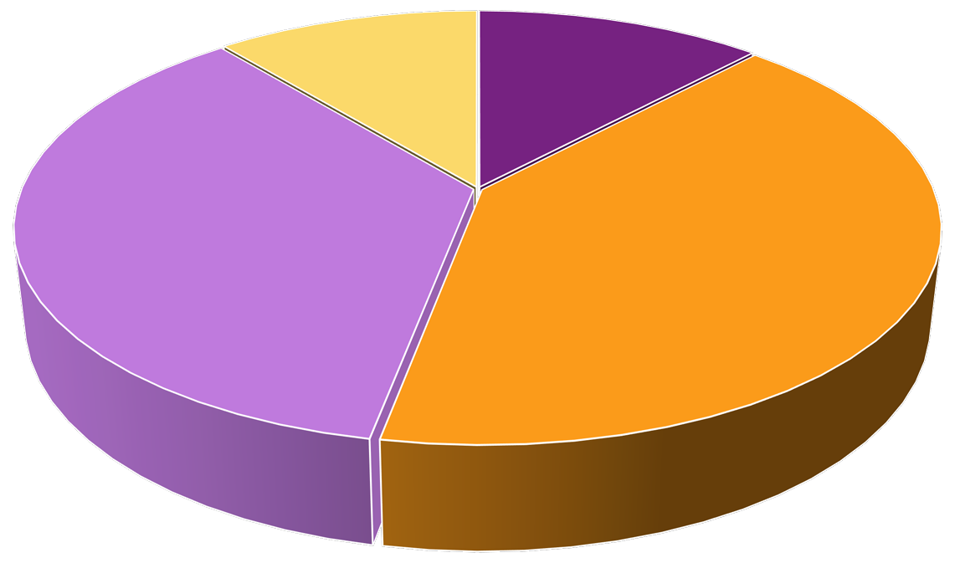
Family survey – loved one’s need state
Regular use, in treatment 11%
Have not used 12%
Have not used Occasional use
Regular use, not in treatment Regular use, in treatment
Occasional use 41%
Regular use, not in treatment
36%

Slide 14
Was there ever a time when you thought your should receive substance misuse services,
but they didn’t?
49% answered
YES

Slide 15
Was there ever a time when you thought you should receive substance misuse services to help you address your ’s substance use behaviors,
but you didn’t?
46% answered
YES

Slide 16
Barriers to accessing care
Language
Lack of clinicians who speak Spanish
Lack of translation of clinical intake documents
Lack of educational materials about SUD prevention, treatment and recovery
Stigma
Related to seeking/receiving mental healthcare
Agencies don't have full [and] well-rounded Spanish-speaking treatment services. [There are] issues finding Spanish- oriented programs.
Survey participant

Slide 17
Barriers to accessing care
Discrimination
Fear of unfair treatment because of race/ethnic background
Fear of deportation
Structural barriers
Poverty/lack of insurance or transportation
Inflexible or multiple jobs.

Slide 18
What are we doing at The Partnership?
Helpline or Línea de Ayuda
Bilingual specialists trained to provide support and resources
Monday to Friday: 9:00 AM – 8:00 PM ET
Weekends/Holidays: 12:00 PM – 5:00 PM ET
Ayuda y Esperanza
Automated text messages in Spanish that are customized to the loved one's situation.
Messages contain information, encouragement and hope.
Text CONECTAR to 55753 to access the service.

Slide 19
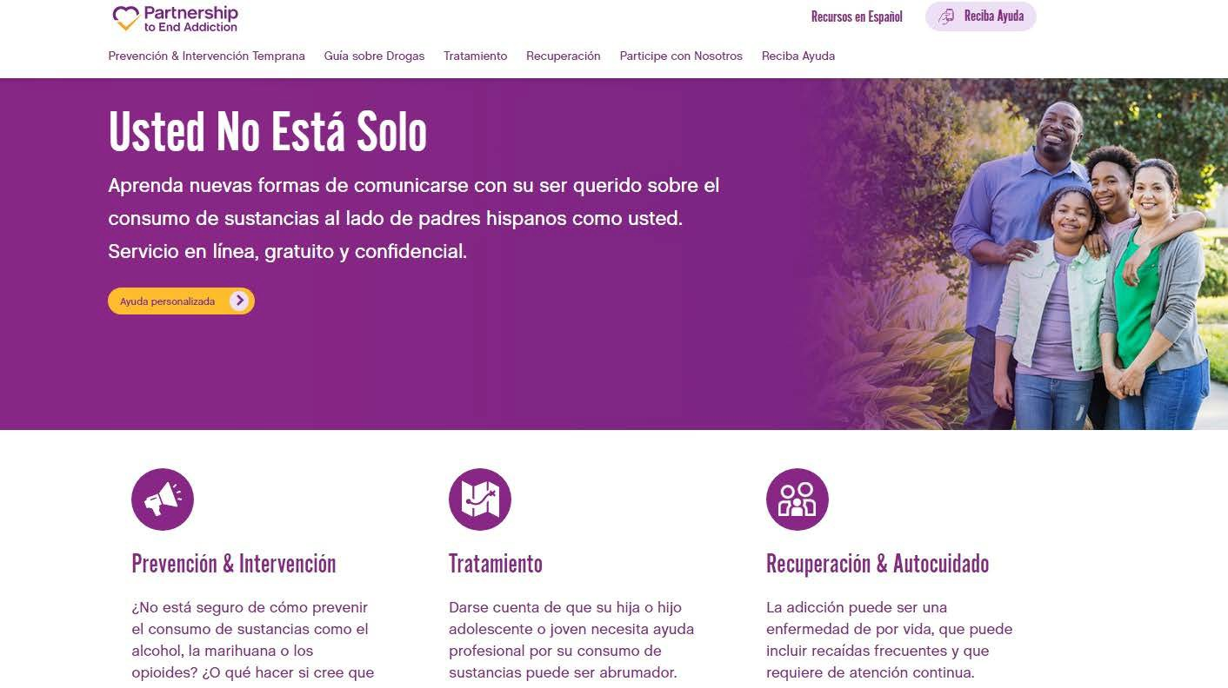
What are we doing at Partnership?
Recursos en Español
Dozens of educational
articles on our website,
organized in three different sections:
Prevention & Early Use
Treatment
Recovery
We also have guides
offering information about
some of the most popular
substances and their effects.

Slide 20
Some of our articles originally written in Spanish
Most of the articles are acculturated from our English section, which means we translate and adjust them for the Latinx community. This year, we also started publishing content attending to the specific situation of the Latinx community, for example:
Risk factors for addiction and what risk factors are specific for Hispanics, such as acculturation issues, discrimination, fear of deportation and uncertainty about immigration status.
Immigration-related trauma and how families can help themselves and their loved ones to cope with harrowing journeys when emigrating to the United States and, once in this country, anti-immigrant policies and structural barriers because of undocumented status.

Slide 21
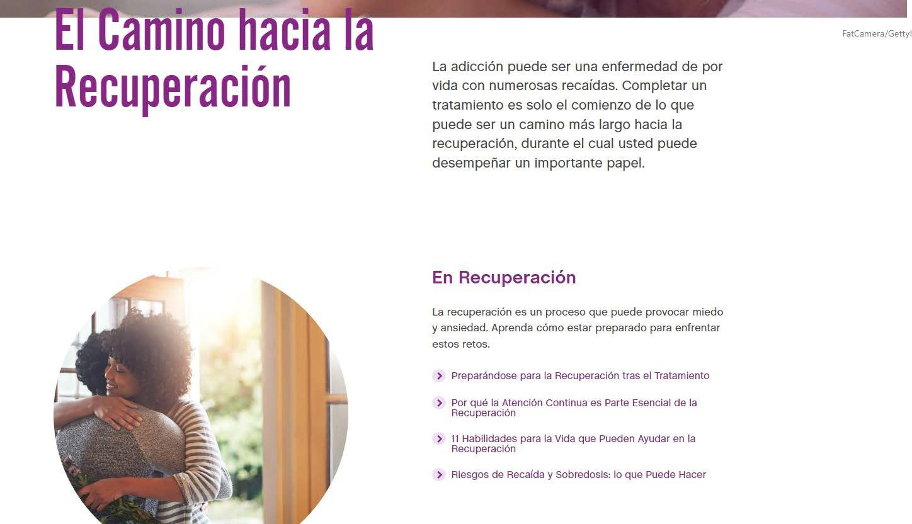
Our recovery page in Spanish
In our section on recovery in Spanish, we include articles about supporting our loved ones in what can be a long journey. We also offer articles on self- care, stressing that in order to help a loved one, it is essential to take care of ourselves.

Slide 22
Other services in Spanish!
Personalized Feedback – a brief survey followed by individualized feedback
Safe Locator – a search engine where people can find local treatment and support options
Parenting Skills Course – 8 short videos focusing on helping parents improve their communication with their children
Parent Coaches – parents with lived experience are trained to support other parents looking for support from the Partnership.
Risk Assessment Tool – a survey assessing what are your child's risk for developing problematic substance use.
And…

Slide 23
A Case Study: Apoyando a Nuestras Familias
Spanish OSC

Slide 24
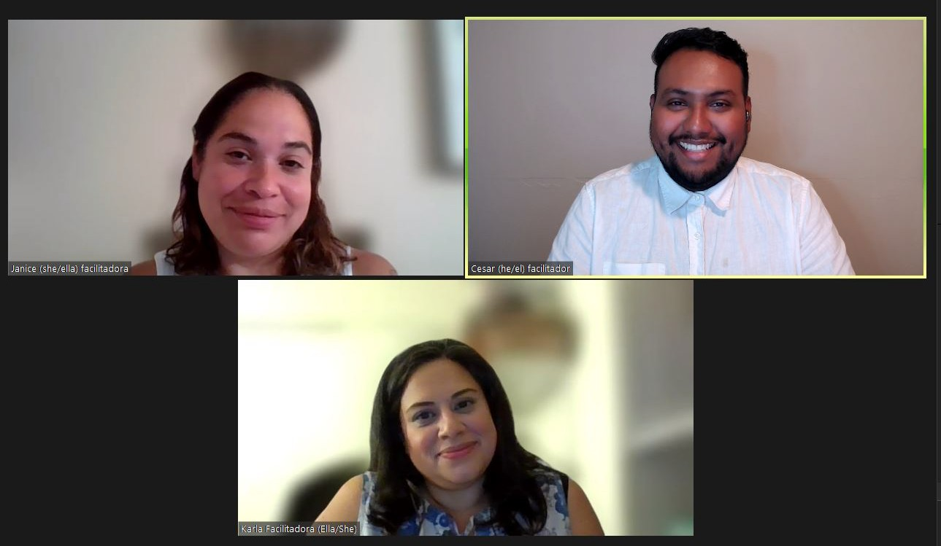
Agenda
Who we are?
Need for Spanish services
Development of our Online Support Community (OSC) pilot
Launch of our OSC
Assessment and future
Questions

Slide 25
Creating an Online Support Community group for Spanish-speakers
What elements of the English-speaking OSC will work with Spanish- speaking family members?
What elements will not work?
How do we acculturate for Latinx families?
We are still learning and discovering the answers to these questions ̶ it's a pilot!

Slide 26
Meditation Minute

Slide 27
How does our Spanish OSC differ from English OSC?
Evaluation for any gaps to content (STIGMA)
Cultural humility
Translation and acculturation of our lessons
Participant shared a realization about meditation
Vergüenza
Reminding families that silence is also a way of participating

Slide 28
How are we connecting with our participants?
Confianza/Trust
Personalismo
Respeto
Facilitators reviewed the structure for OSC meetings
Facilitators continue to have an ongoing conversation on the type of environment/experiences we hope to provide our participants
Invite our families to share feedback

Slide 29
Our Structure
Greeting
Norms-Recordatorios
Meditation
Topic facilitated
Activity: open-ended questions
Closing

Slide 30
Our Training Process and Experience
We established a cohort of
three bilingual helpline specialists (HLS) to facilitate groups
Training was provided by coach facilitator(s)/mentor who are also parent coaches for English-speakers
HLS were introduced to the online group and observed/
shadowed four OSC live meetings
During six subsequent meetings roles were assigned to each HLS
Opening-up communication & back pocket ideas
Debrief after each OSC meeting with coach facilitator and cohort.

Slide 31
Marketing efforts for OSC group
Helpline specialists invite a CSO/familia they are working with currently to join
Emails sent out to Spanish-speakers who have contacted us over the past year
Spanish-speakers attending the OSC groups in English
Collaboration with other agencies serving Spanish-speakers to promote group
Presentations
June NYC faith community presentation (Spanish pastors/chaplains)
Podcast
Facebook Live

Slide 32
Launch of our Online Support Community
34

Slide 33
Red Light / Green Light

Slide 34
Obstacles Faced
Families expressed interest and signed up for OSC email invites
However, this DID NOT translate to participant attendance
Availability: What time/day works for the families that want to connect?
Potentially losing a participant during the live OSC meeting
Higher risk for a crisis-situation

Slide 35
How did we try to improve?
Administrative level
Sent out a survey inquiring about preferred meeting options
Adjusted meeting time
Removed registration process
Additional reminders of upcoming meetings
Clinical Considerations
Held weekly meetings for facilitators to prepare for OSC meetings
Changed the order of the lessons
Debriefed facilitators
39

Slide 36
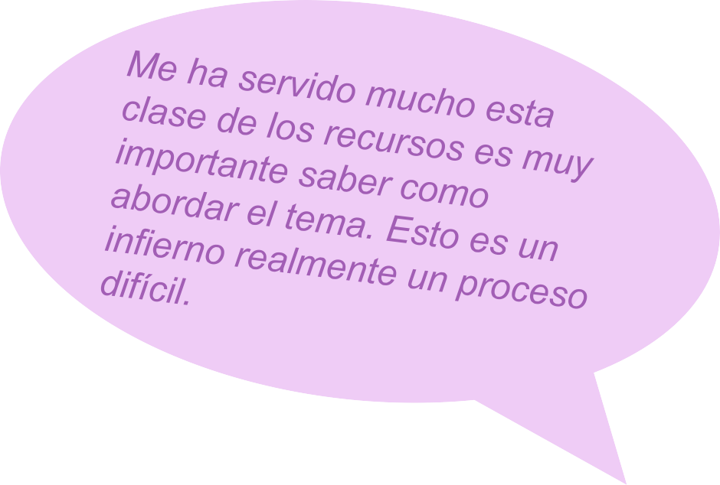
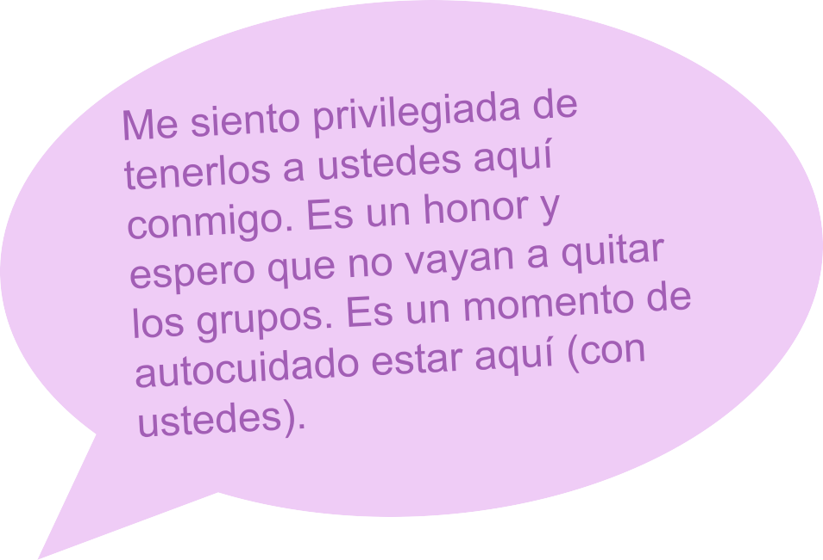
Families are saying...

Slide 37
Assessment and Future
4
1

Slide 38
How do we measure success?
Measure success:
# interested (registered)
# served (attended)
Weekly survey
Qualitative feedback
Flexibility to needs

Slide 39
What is next?
Continued Spanish OSC
Digital Peering Spanish (recently launched)
More Skill Builder Spanish videos
Risk Assessment Tool
Prepare for the next OSC group!

Slide 40
Questions, comments and/or feedback?
46

Slide 41
drugfree.org
© 2022 Partnership to End Addiction

Slide 42
