Slide 1
WELCOME
Recovery Innovations

Slide 2
Growing Crisis & Recovery Centers in Rural Idaho “A Marriage Made in Heaven”
DarrelL Keim, founder and Director, Latah recovery center
Joyce Lyons, Ph.D., Crisis Center Project Manager

Slide 3
Rural Challenge
2 Programs
Replicable Model
Rural Area-Local Demographics

Slide 4
Unique Rural Issues
Definition - Rural
open countryside
- Rolling hills – farming
- prairies – farming logging
- wilderness
population less than 500 People per square mile
places with fewer than 2,500 people
Notes:
What rural looks like on the Palouse

Slide 5
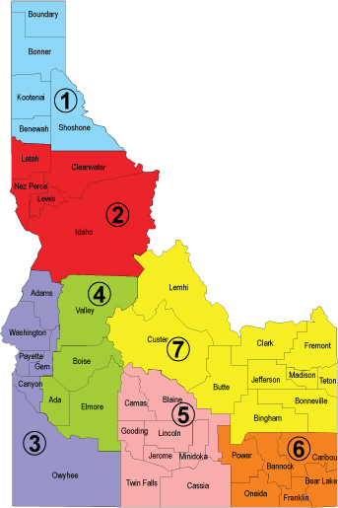
Unique Rural Issues
5 Counties
13500 Square miles – Washington to Montana
111,000 people (2020)
8.22 people per square mile
Socio-economic diversity
Native American Tribe
Notes:
What rural looks like on the Palouse

Slide 6
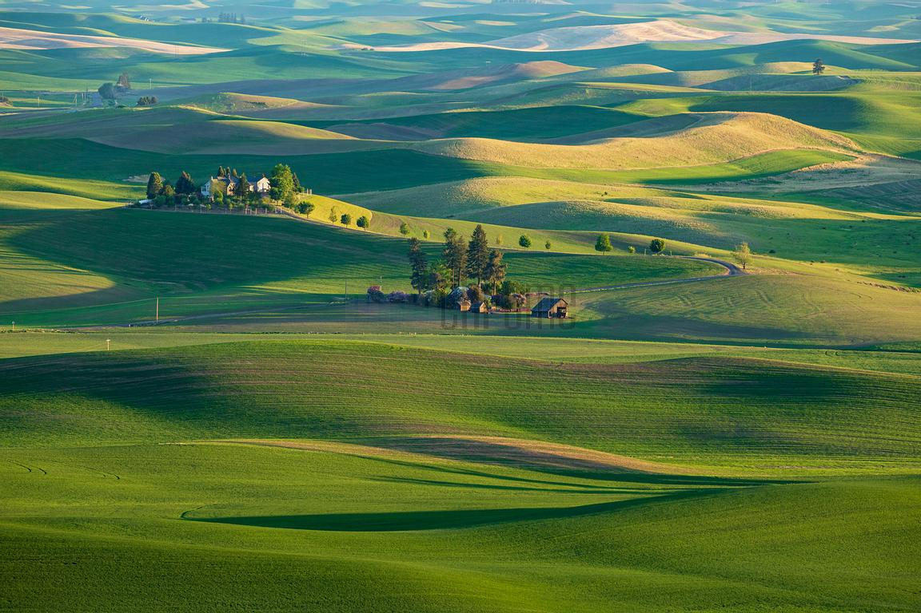
Unique Rural Issues
Palouse Hills

Slide 7
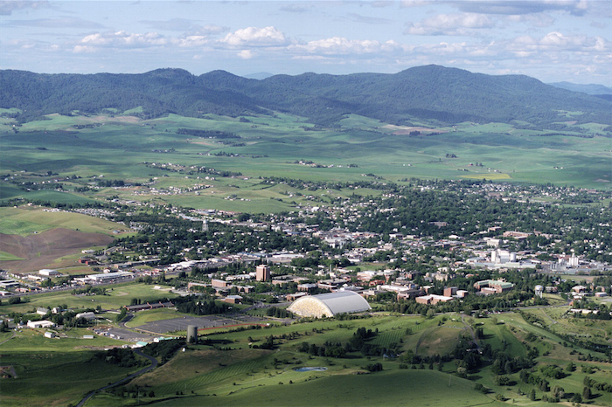
Unique Rural Issues
Moscow, ID

Slide 8
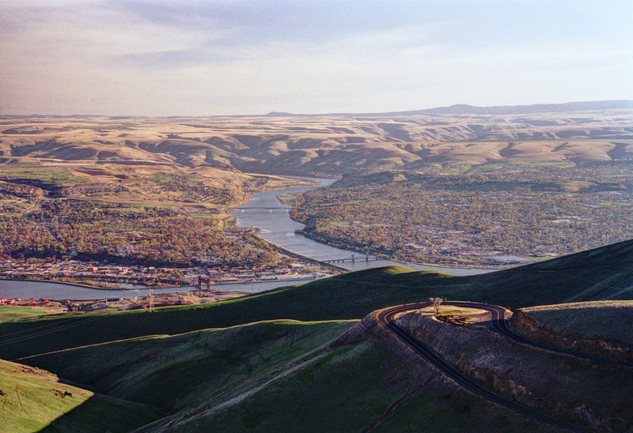
Unique Rural Issues
Lewiston, ID
Notes:
Talk to how the LRCC got started
Talk to how the Crisis Center is governed

Slide 9
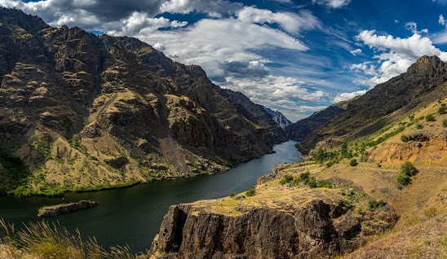
Unique Rural Issues
Hells Canyon

Slide 10
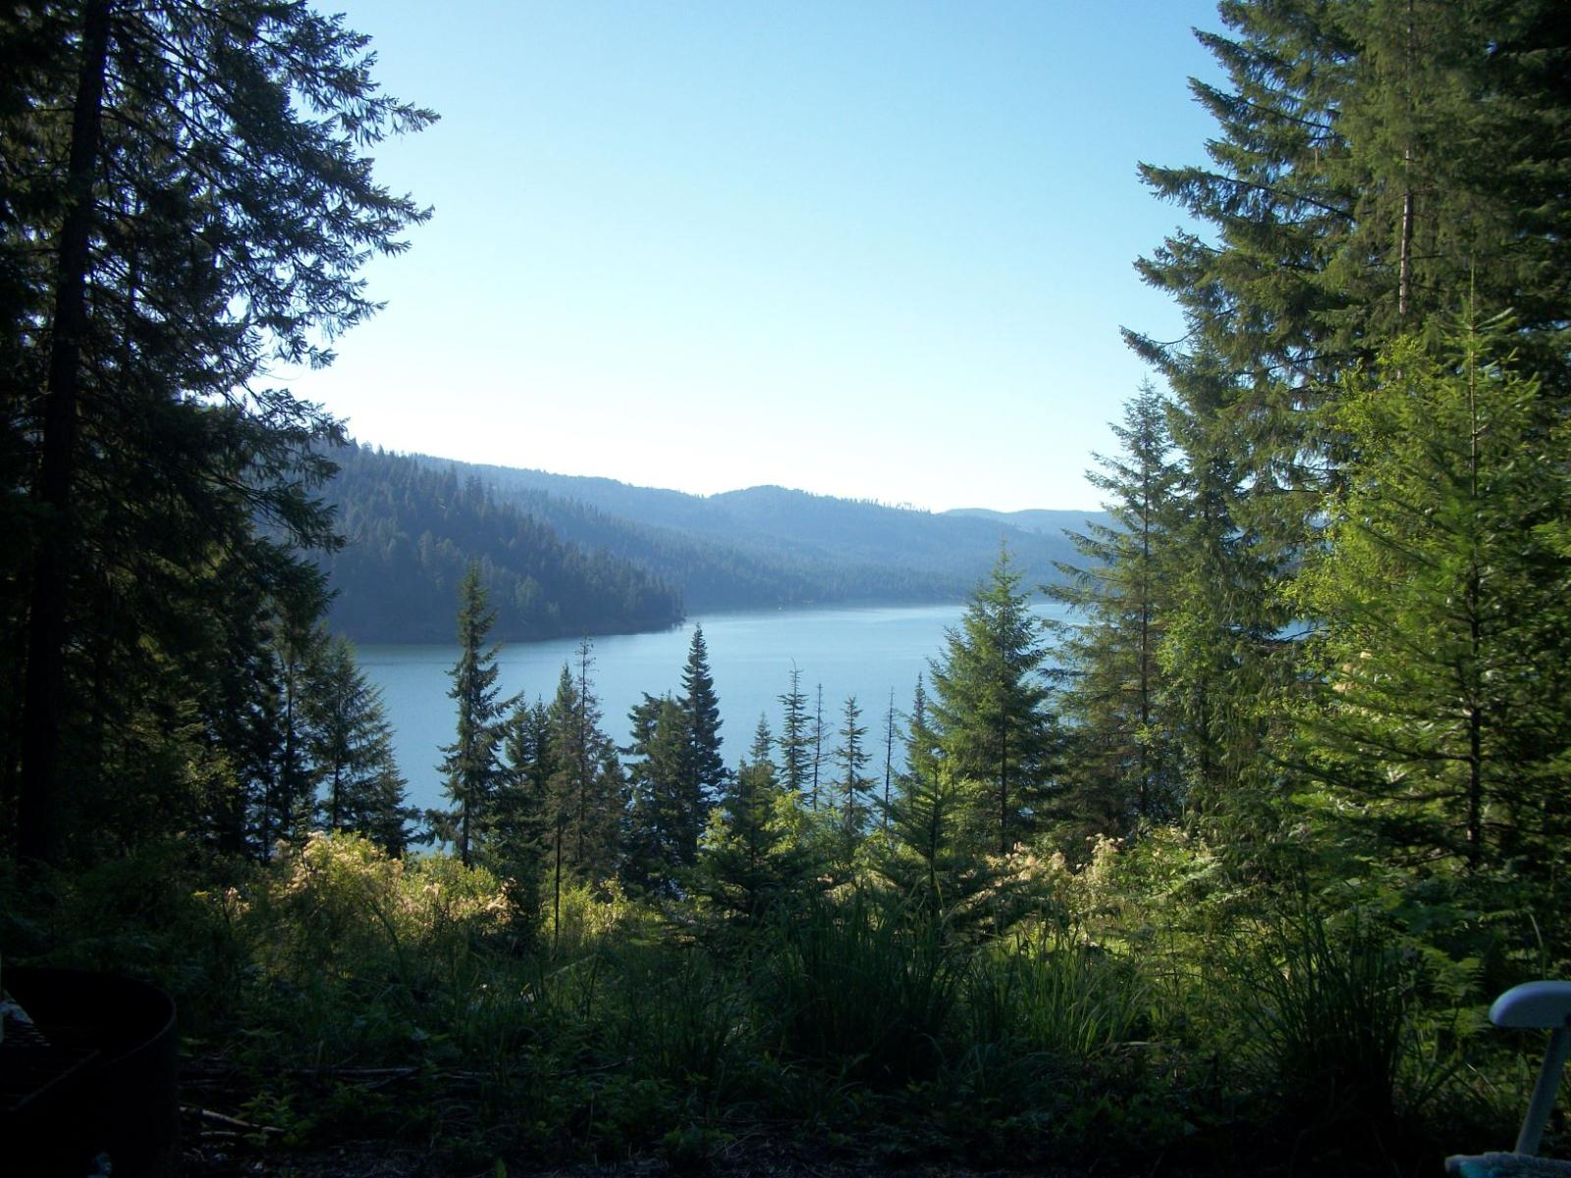
Unique Rural Issues
Dworshak Reservoir, ID

Slide 11
Unique Rural Issues
Transportation
Access to Health Care – Frontier Classification
Professional Shortage
Education and Prevention
Paradigm Shift
Notes:
Talk issues unique to rural mental health and addiction services

Slide 12
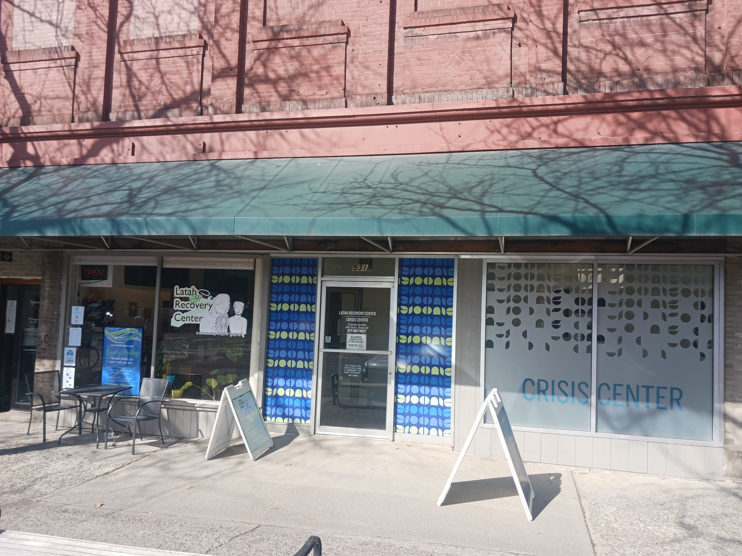
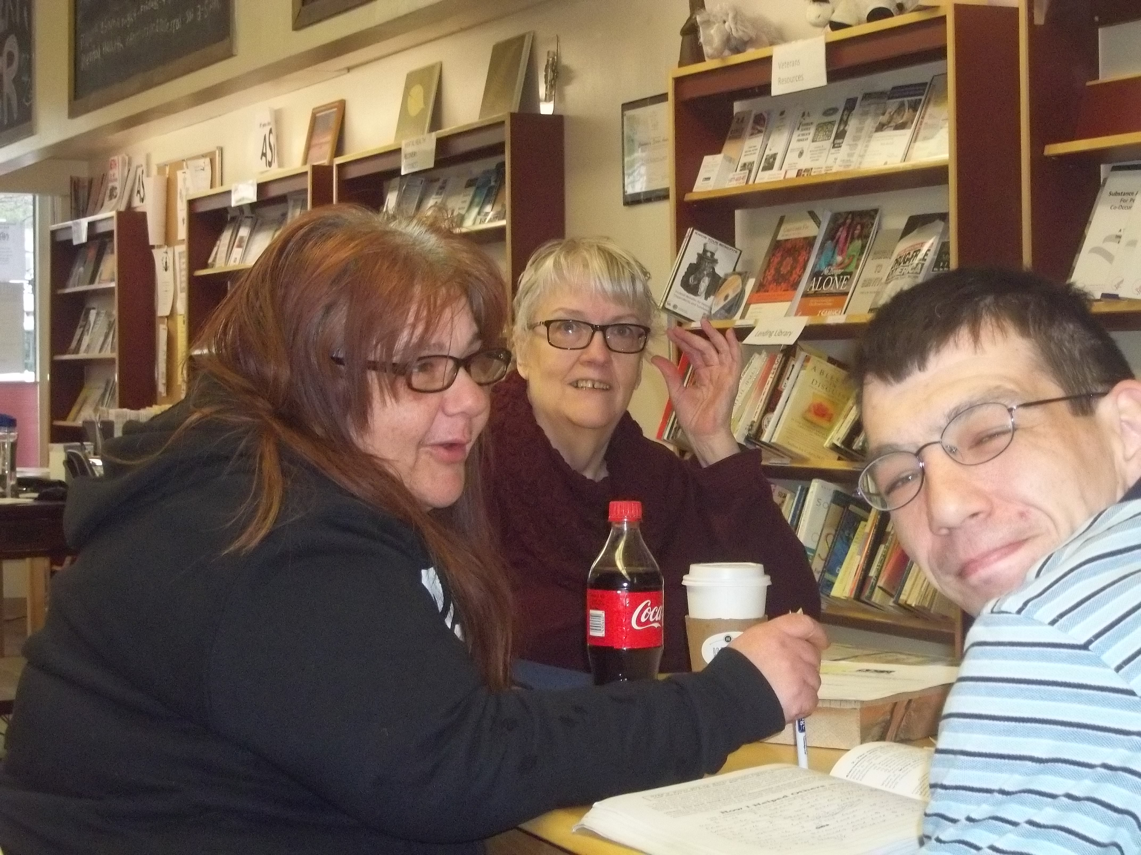
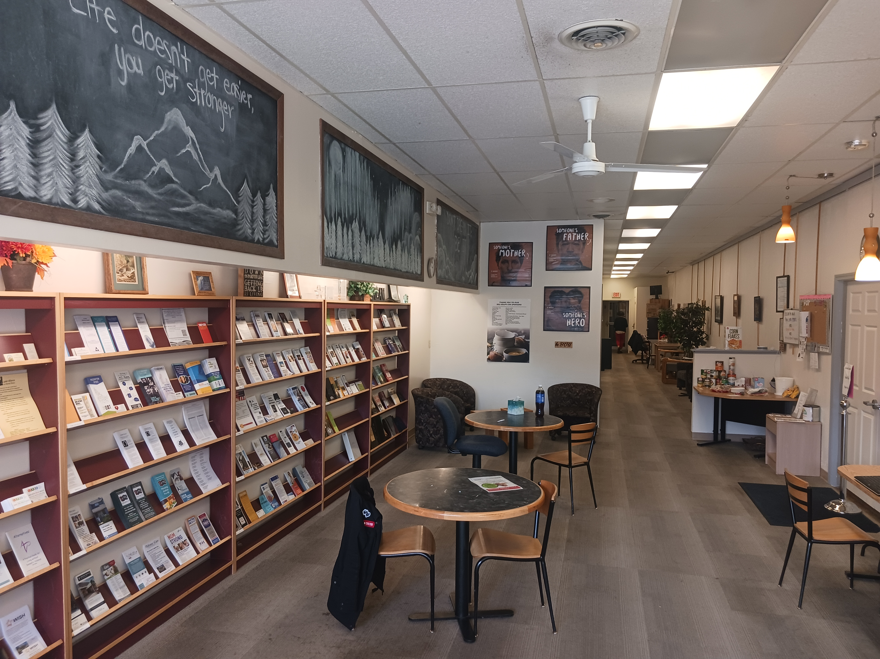
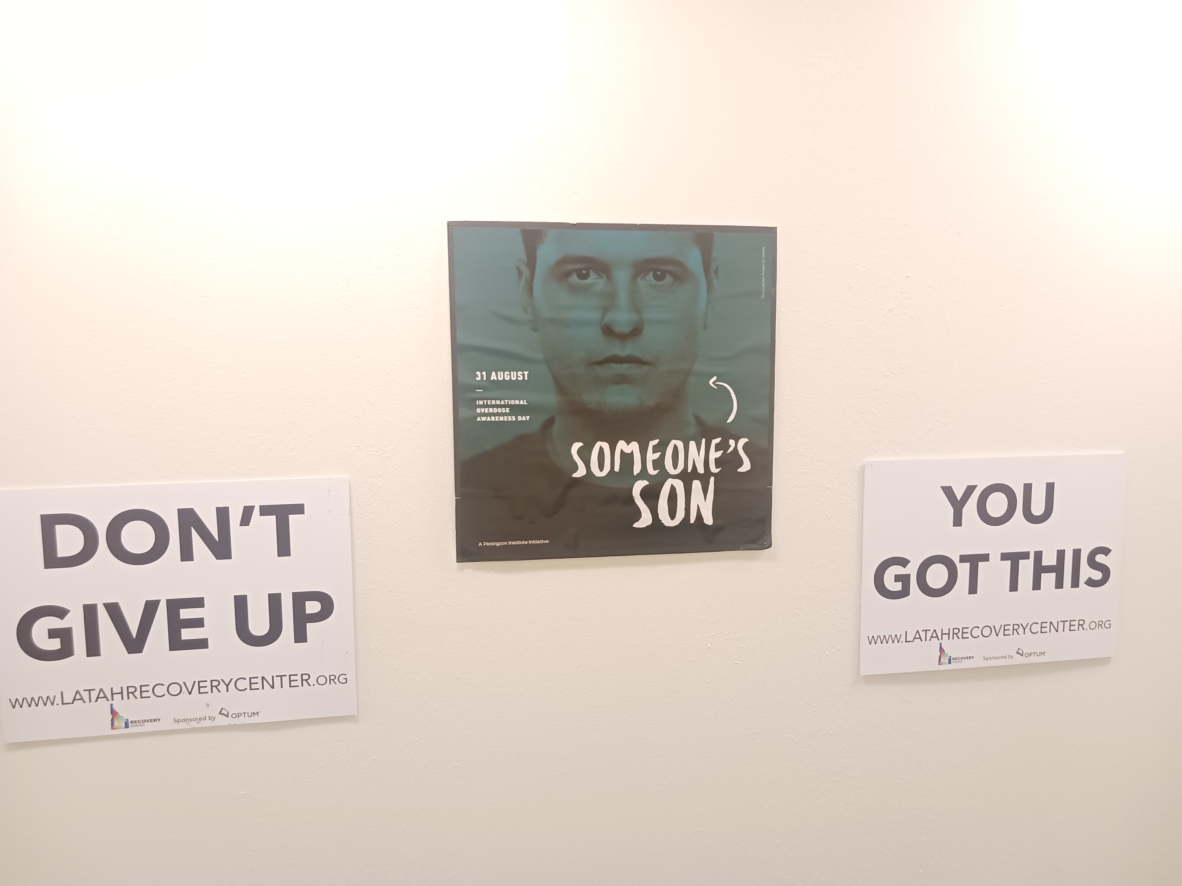
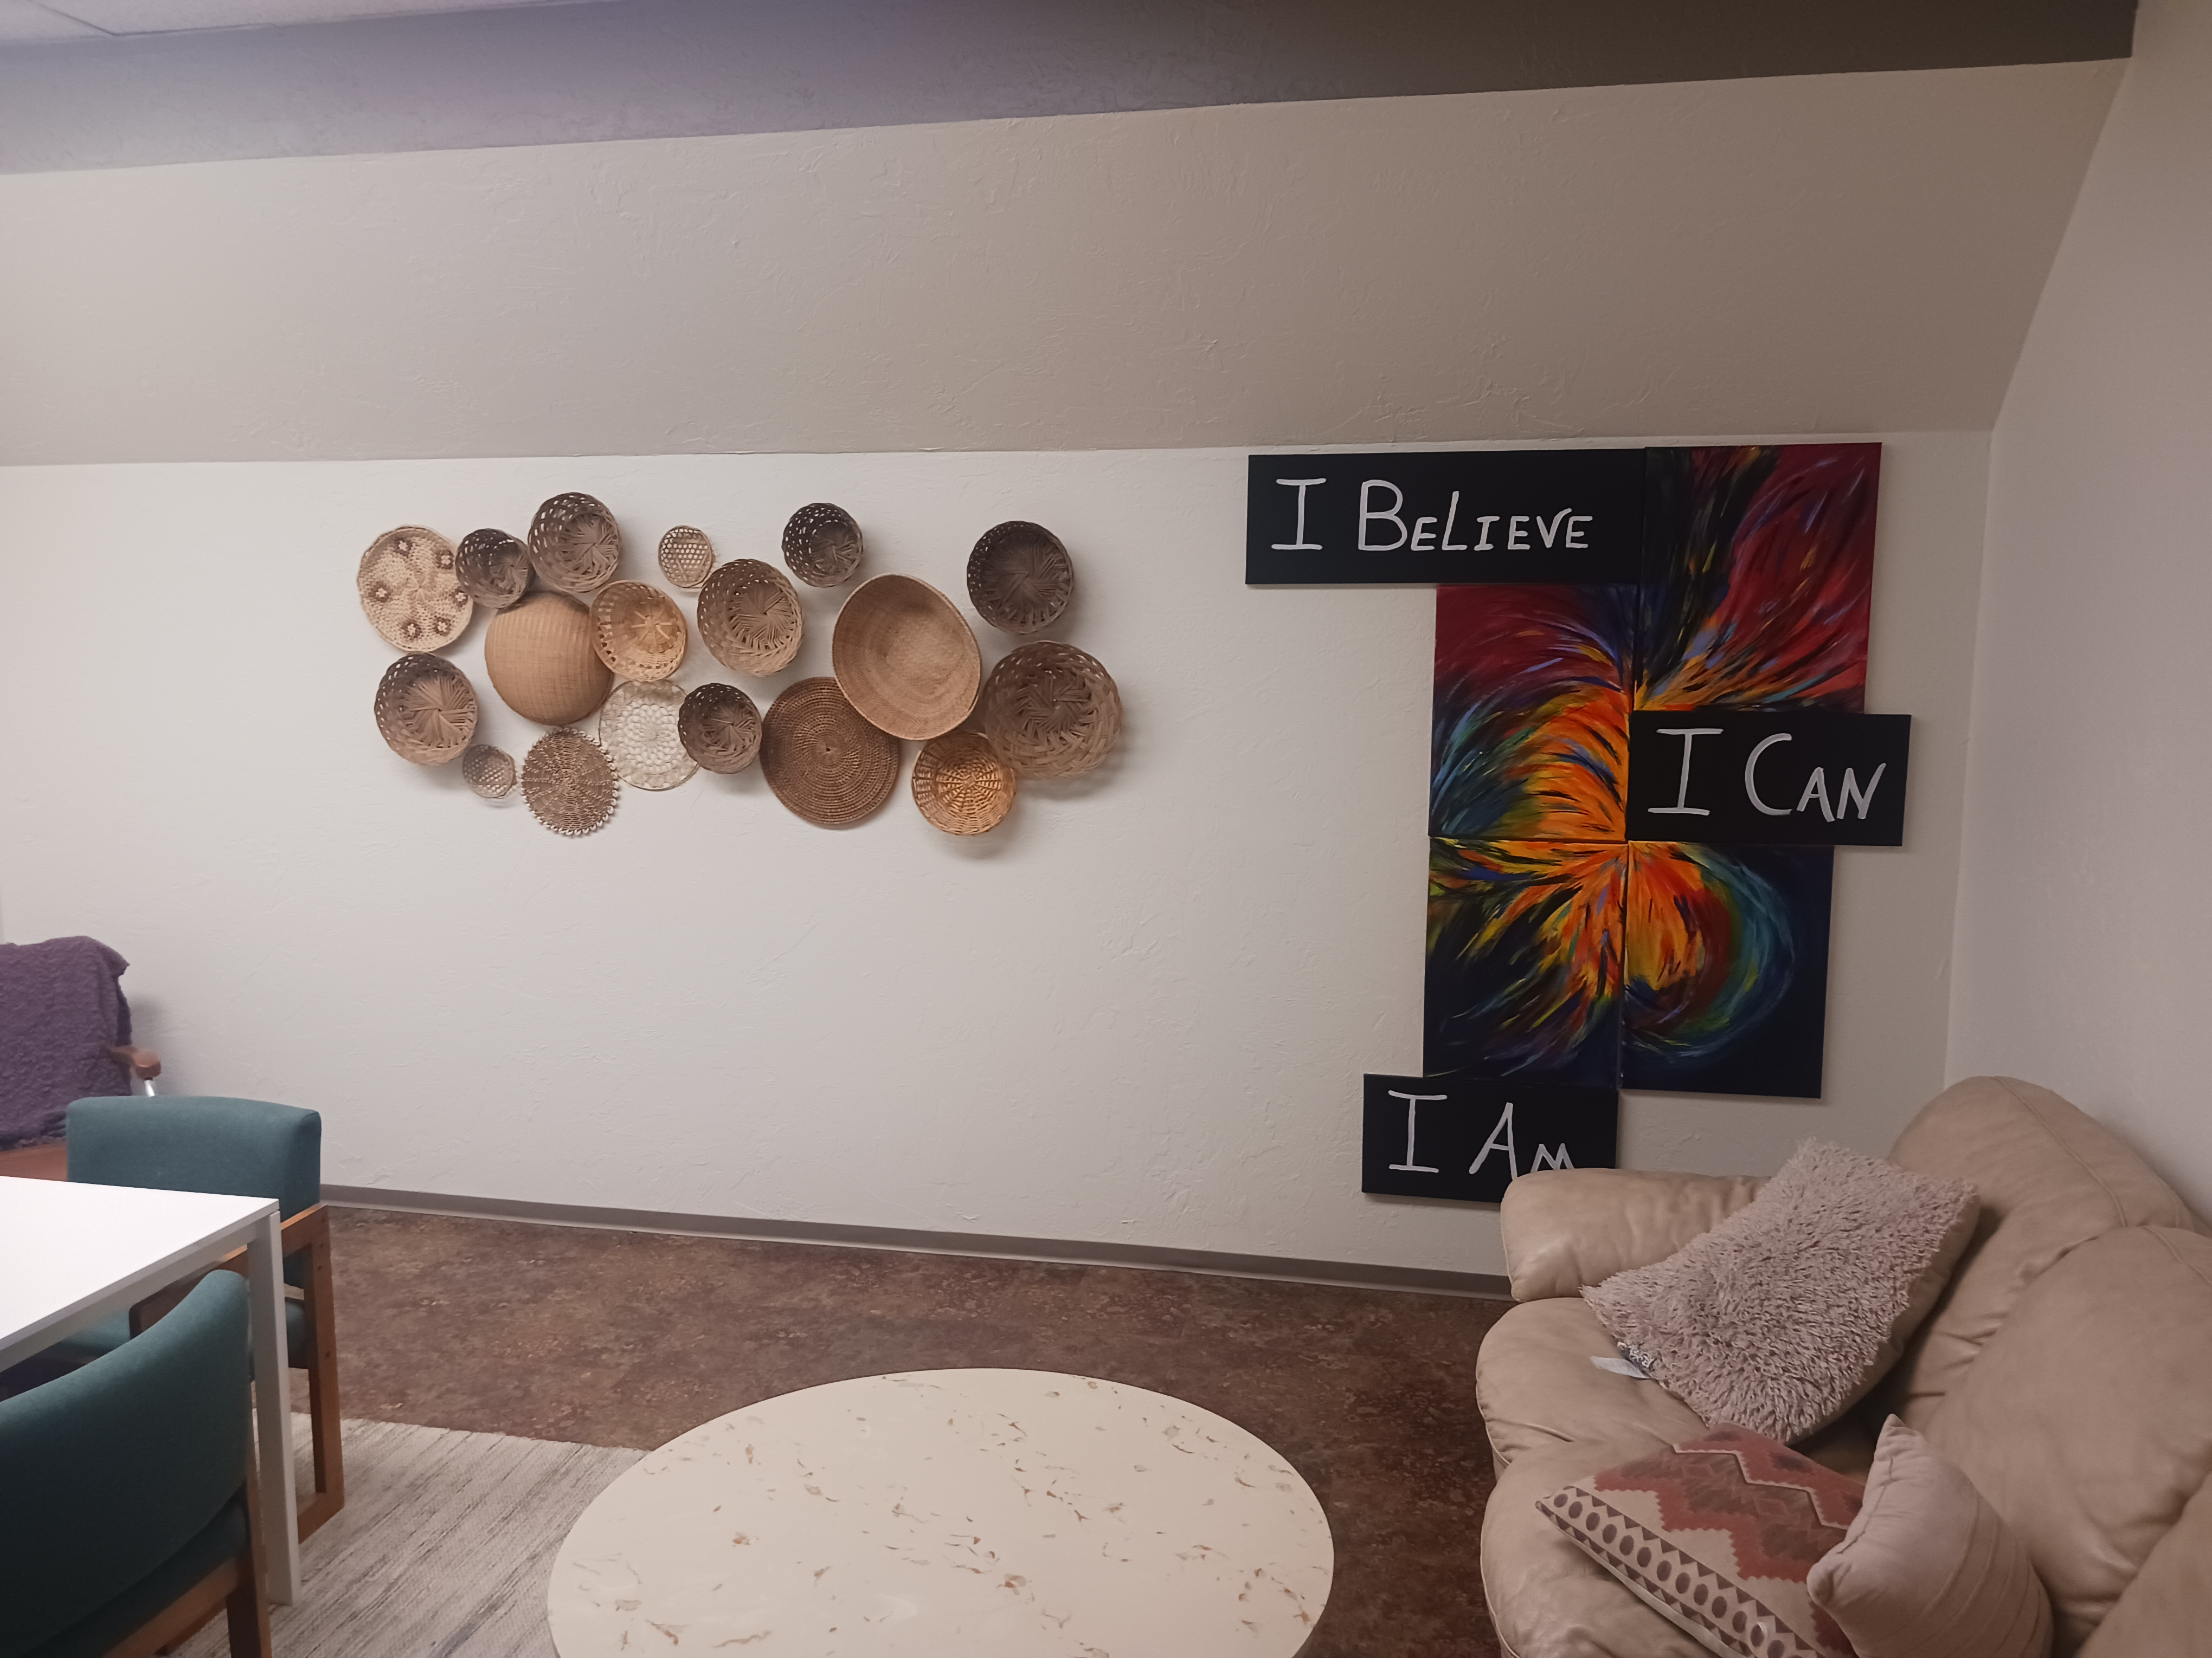
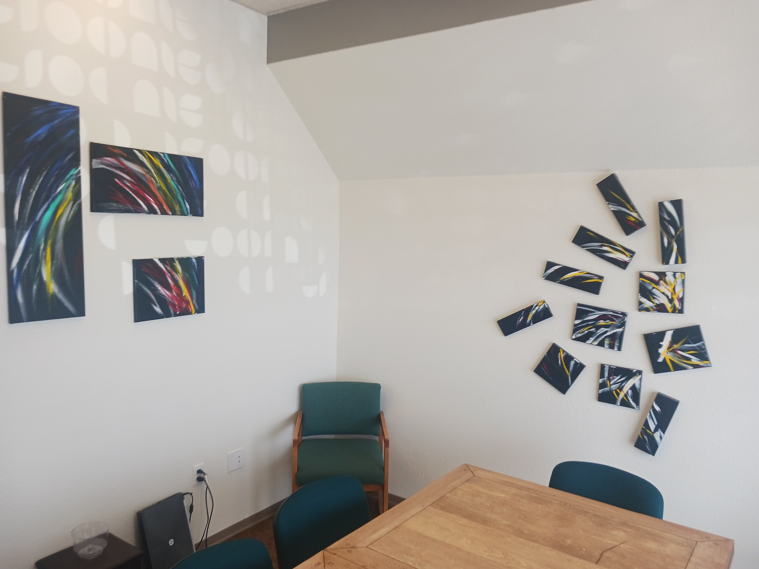
What’s Novel - Facility
“It’s a marriage made in Heaven”
Peer Run/Volunteer Based Organization
Out-Patient Clinic
Notes:
Talk to how the LRCC got started and is governed
Talk to how the Crisis Center is governed
Talk how they both achieve synergy by partnering

Slide 13
What’s Novel – Recovery Community Center
Peer Run Organization
Political
Research Models
Specific Grant Funding
Business Plan
Public Meetings
Notes:
Describe unique LRC issues

Slide 14
What’s Novel – Recovery Community Center
Peer Run Organization
Trained Peer Volunteers
Staff/“Lived Experience”
Programs Offered:
Recovery Coaching/Peer Support
University, and Veteran Outreach
Jail Reentry
Service Referrals
Wide Variety of Weekly Life Skills, Anonymous and Social Groups
Oxford House
Harm Reduction/SSP
Notes:
Describe issues unique to LRC

Slide 15
What’s Novel – Crisis Center
“Just In Time Inventory”
Solutions are in your communities
Flexible Public Health Model
Create a Continuum of Care
Reduce Risk
Increase Protections
Notes:
Describe unique RCCN issues

Slide 16
What’s Novel – Crisis Center
“Just In Time Inventory”
Agency Partnerships
Funding
Recruiting Interns
Sustainability
Notes:
Describe unique crisis center issues

Slide 17
Contact Information
Darrell Keim, Director
Latah Recovery Center
531 S. Main
Moscow, ID 83843
latahrecoverycenter@gmail.com
208-883-1045
Joyce A. Lyons, Ph.D., Project Manager
Rural Crisis Center Network – Idaho District 2
215 10th Street
Lewiston, ID 83501
jlyons@phd2.Idaho.gov
208-660-6721

Slide 18
