Slide 1


Slide 2
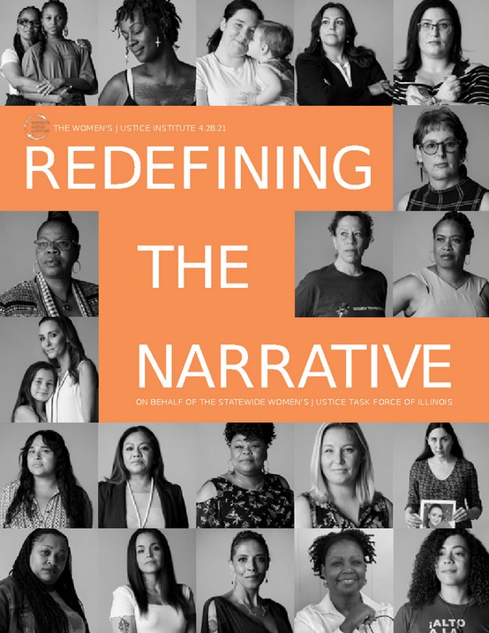
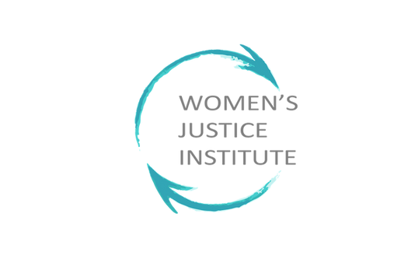
Health and Wellbeing
Public Health and Restoration vs.
Incarceration
Presented by
The Women’s Justice Institute (WJI)
Elizabeth “Liz” Cruz MA, CADC, CODP-I, QMHP

Slide 3
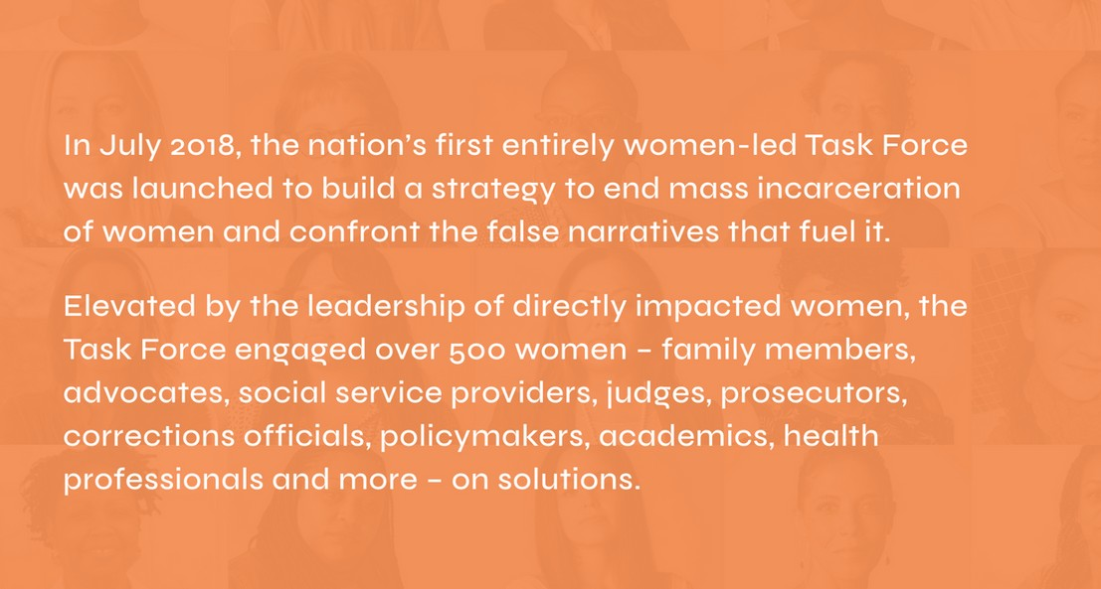

Slide 4
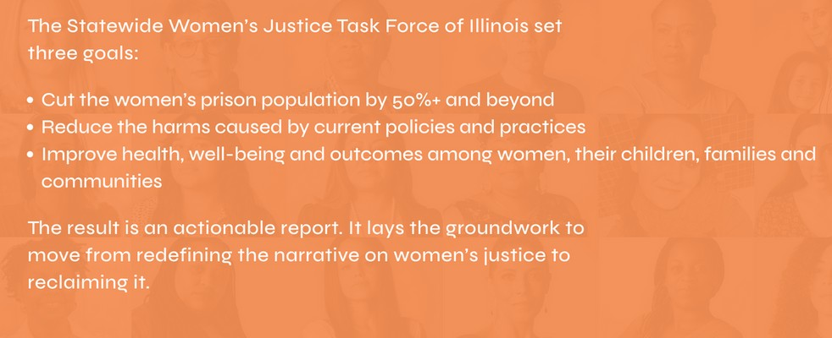

Slide 5
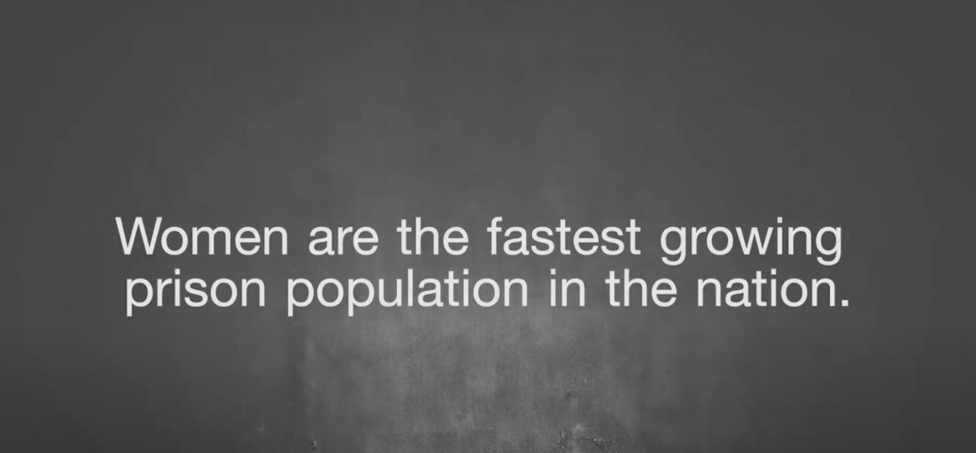

Slide 6
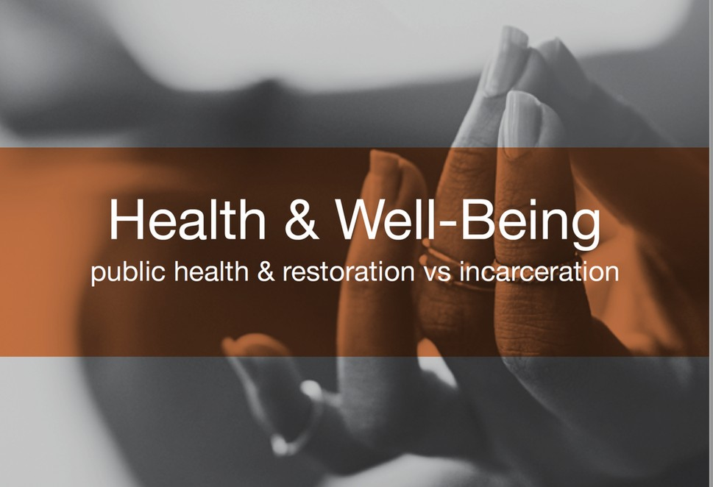

Slide 7

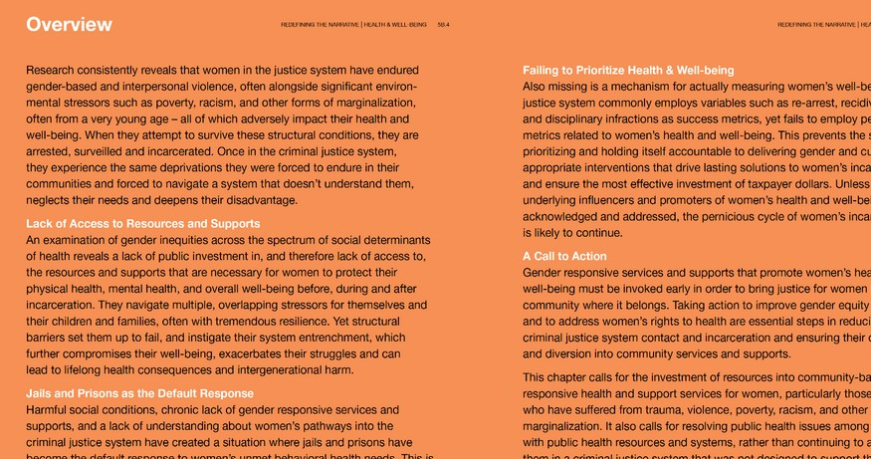
What Do We Know?

Slide 8
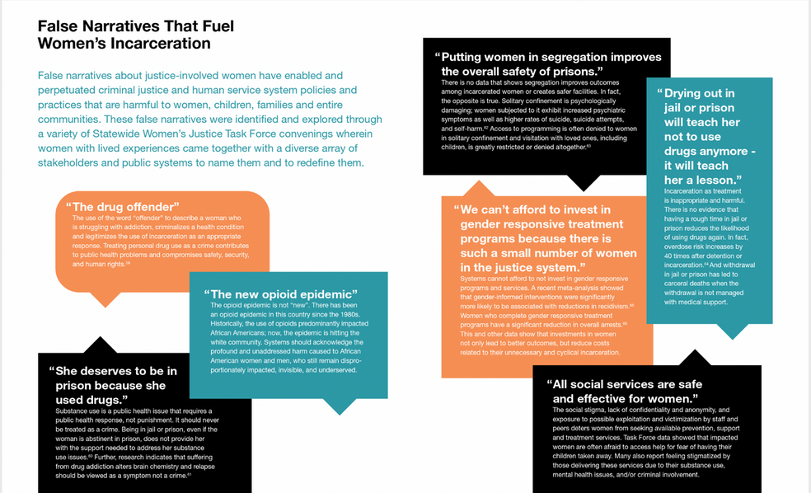
False Narrative Fuel Mass Incarceration of Women

Slide 9
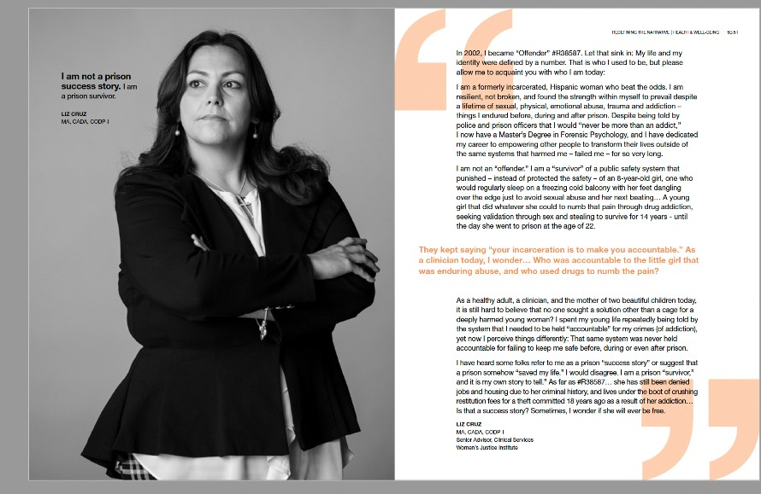
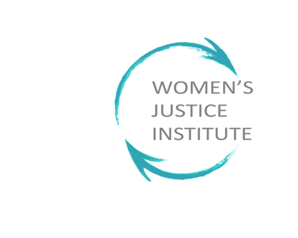

Slide 10
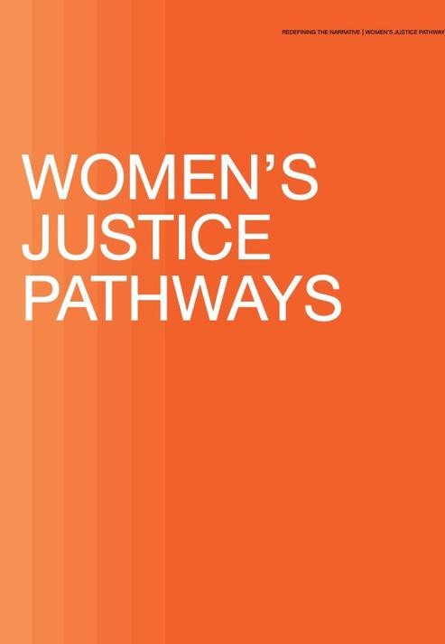
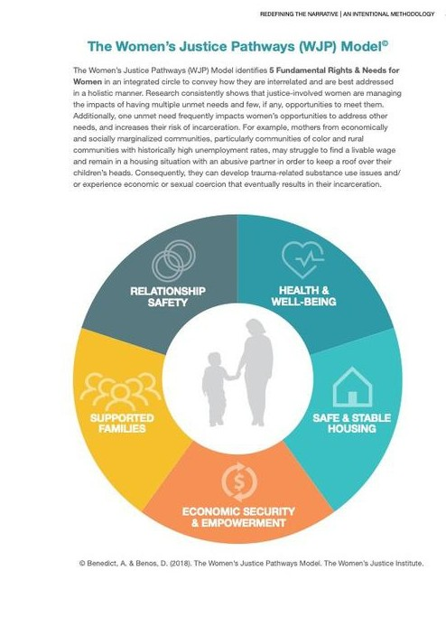

Slide 11
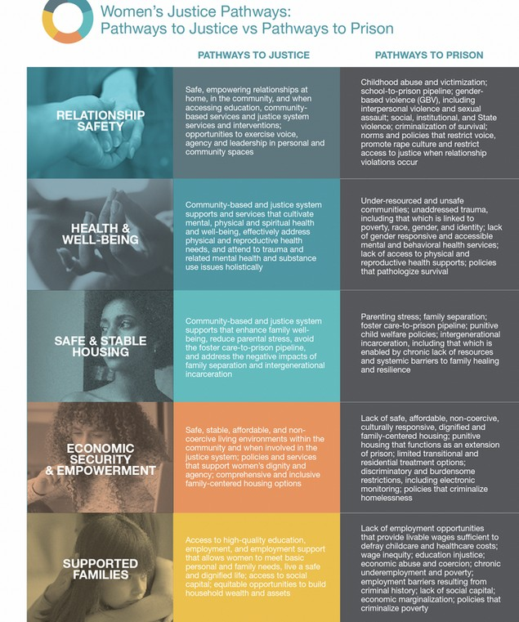

Slide 12
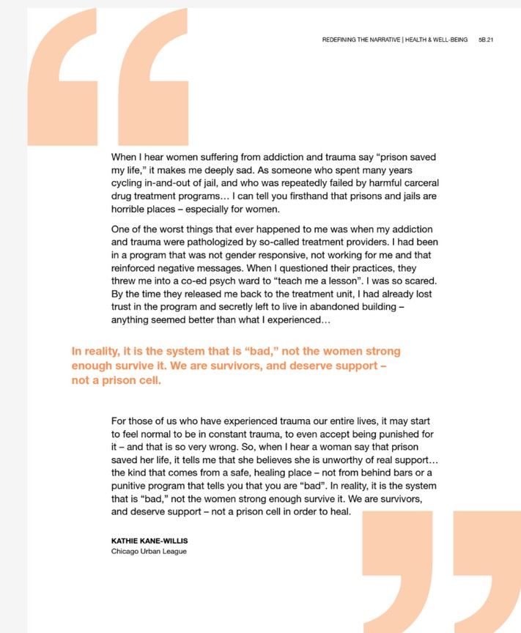


Slide 13


Slide 14
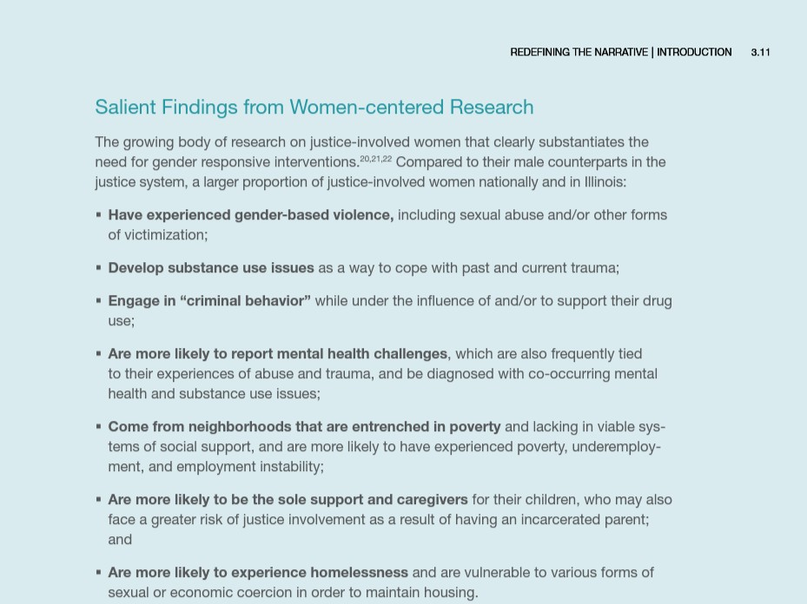

Slide 15
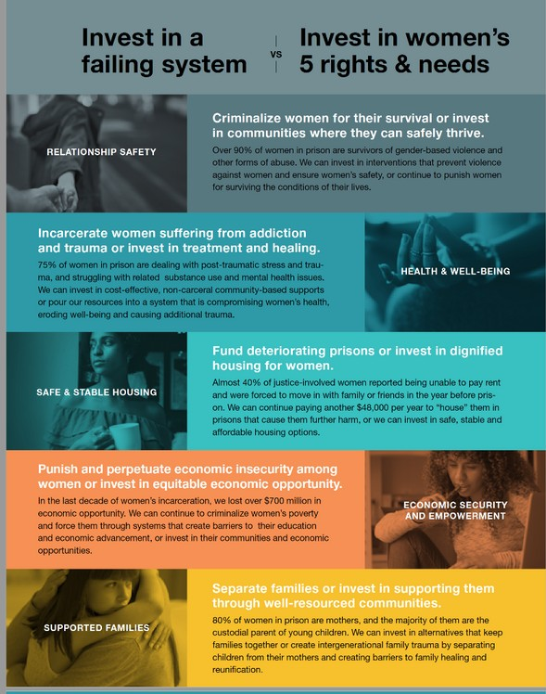

Slide 16
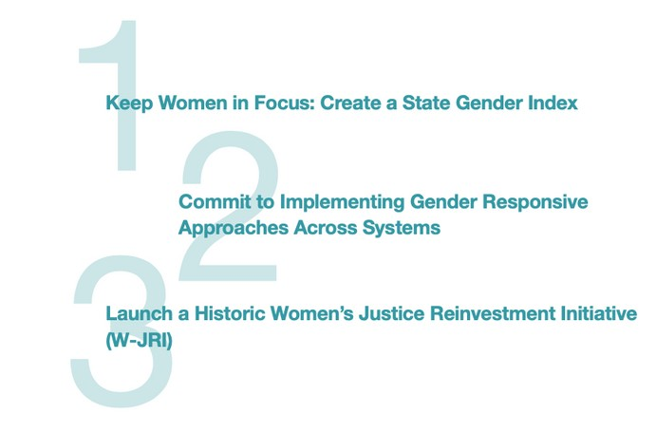
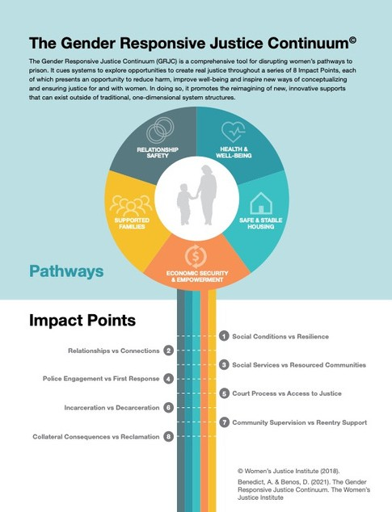
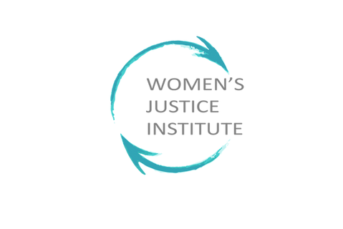

Slide 17
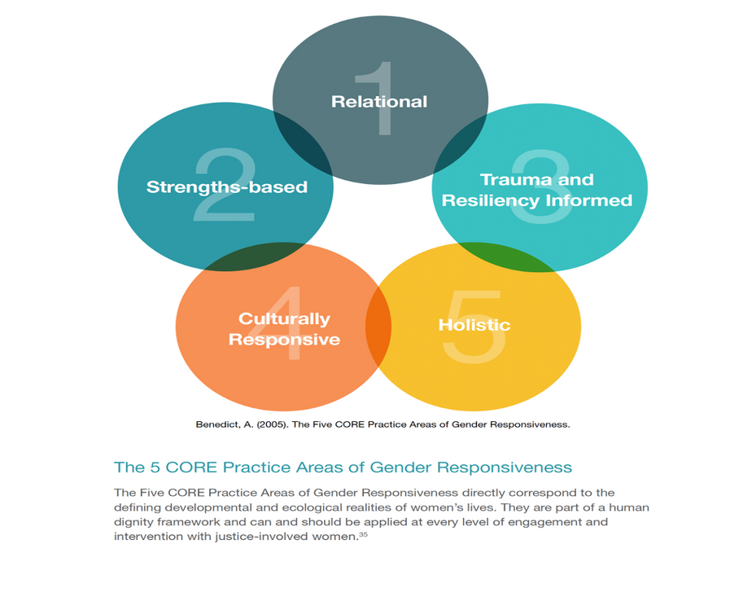
Gender Responsiveness as the Key to System Transformation

Slide 18
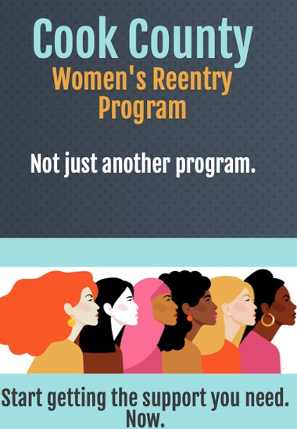
Cook County Health Women’s Reentry Initiative
SAMHSA grant 2020-2025 to serve up to 500 women
Partnership with CCH, IDOC, Haymarket and WJI (recent additions include Cook County Sheriff, Cook County Courts and Probation)
Implementation Phases & Goals: Triage
Stabilize and operationalize GR
Coaching, sustainability and growing systems capacity
Identify & Remove Barriers to Accelerated Release, Credits
Create Parole Diversion Opportunities & Reduce violations
WJI comprehensive training and coaching (GR, CR/2, SPiN-W Assessment, GR Web-based Case Management Tool (CCW-W), Moving On)
WJI GR Model Design & Peer-Led Care Coordination Model Development

Slide 19
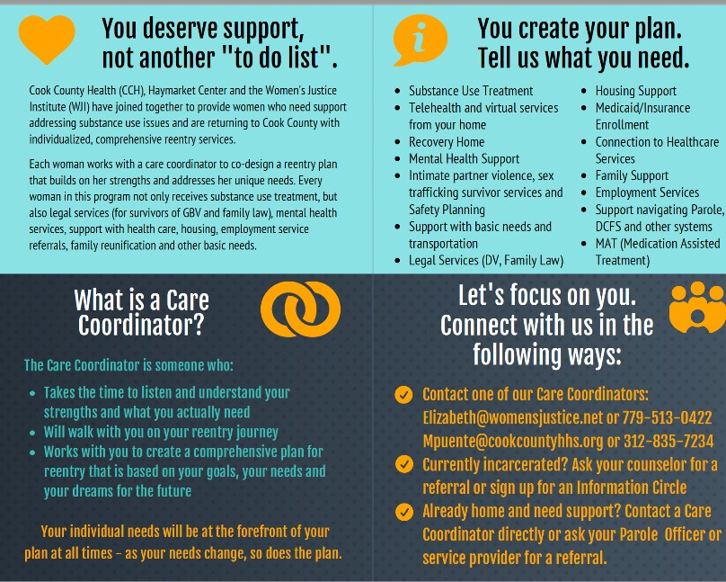

Slide 20
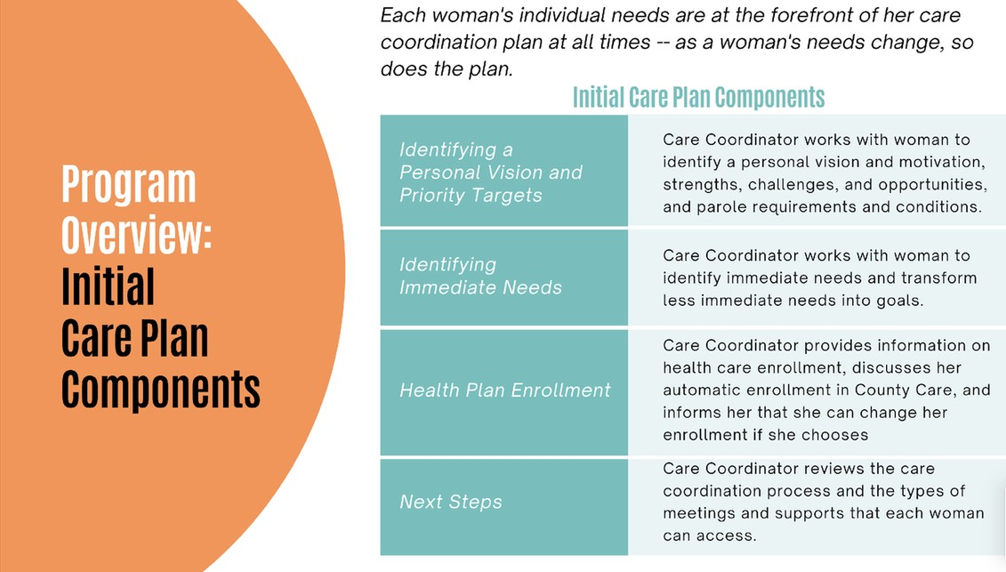

Slide 21
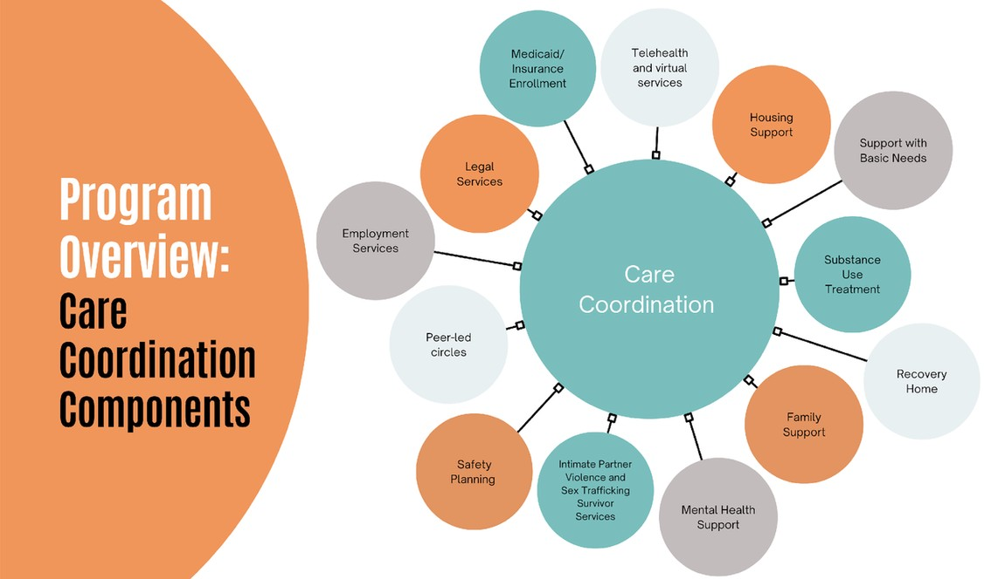

Slide 22
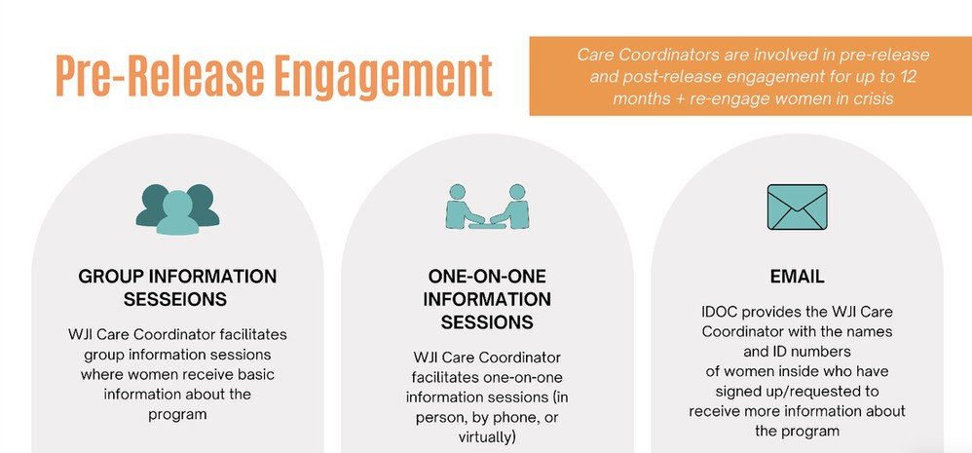

Slide 23

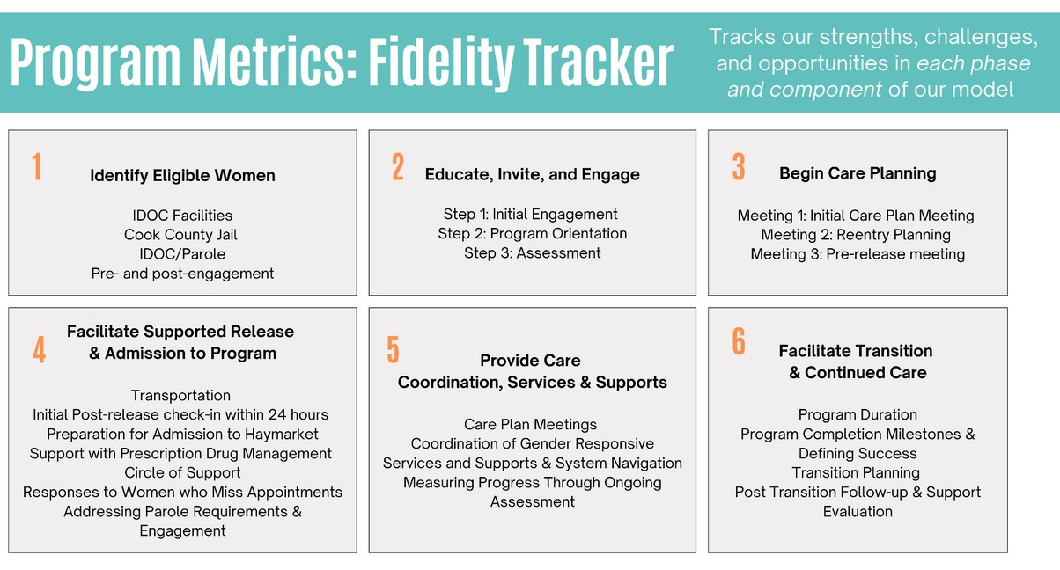

Slide 24
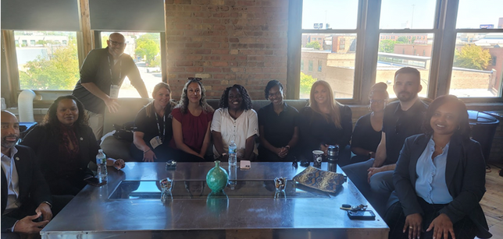
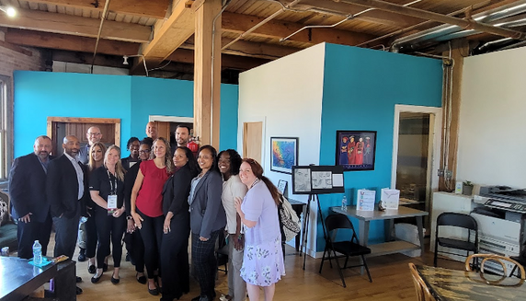
Gender Responsive Parole Unit

Slide 25
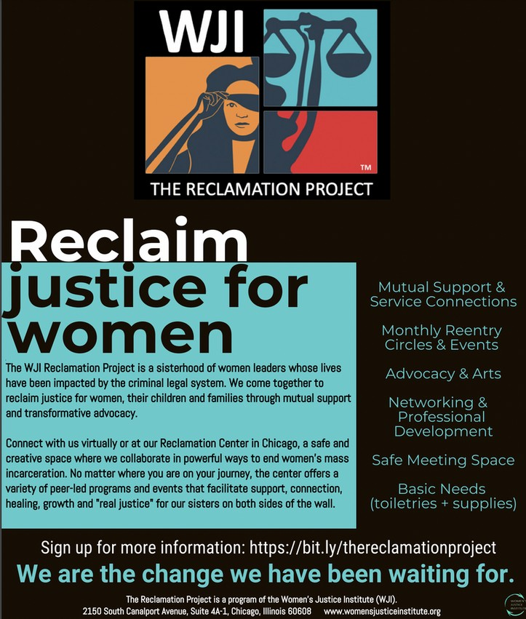

Slide 26
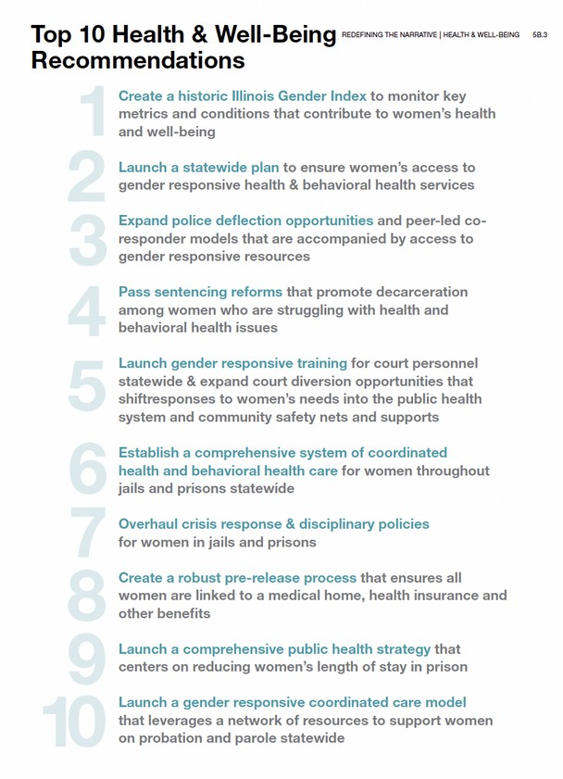
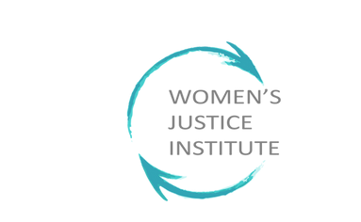

Slide 27
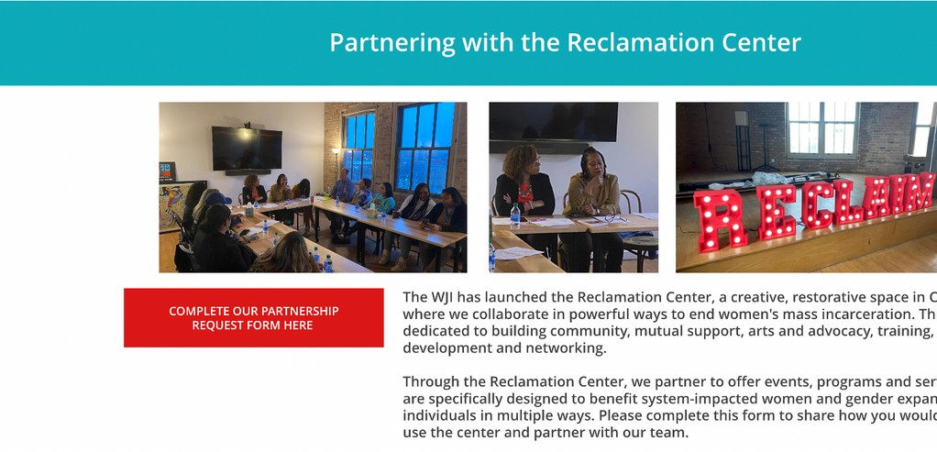
Partner with Us:
https://www.womensjusticeinstitute.org/reclamation-project Read Our Report: https://redefine.womensjusticeinstitute.org/
Contact Us:
Elizabeth Cruz : elizabeth@womensjusticeinstitute.org

Slide 28
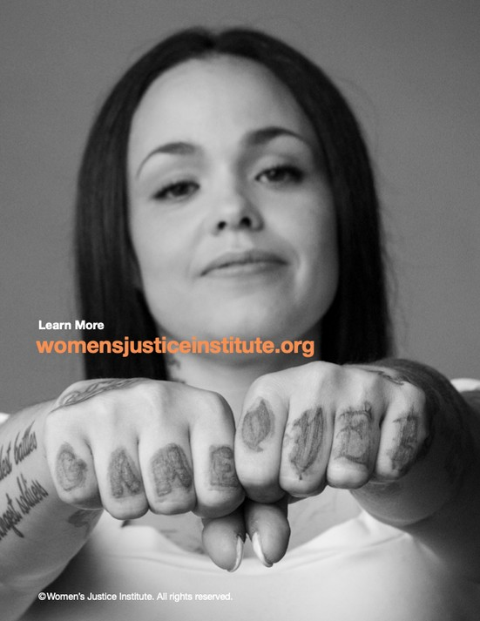

Slide 29
