Slide 1
WELCOME
Recovery Innovations

Slide 2
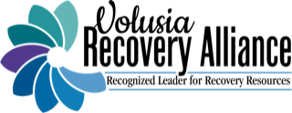
YOU TOO CAN INNOVATE TO MEET YOUR COMMUNITY NEEDS
June 5, 2023

Slide 3
The Volusia Recovery Alliance, Inc. (VRA) is a grassroots not-for-profit education and advocacy Recovery Community Organization (RCO) committed to furthering the message that recovery is possible for anyone who desires a life of wellness. Our purpose is to coordinate peer driven services that provide substance use recovery resources.
Our Mission
We exist to serve all those seeking recovery from the impact of addiction including families, friends and allies.
Our Vision
The Volusia Recovery Alliance works to mobilize resources, reduce barriers, increase awareness and support in an effort to eliminate stigma and enhance recovery through multiple pathways.

Slide 4
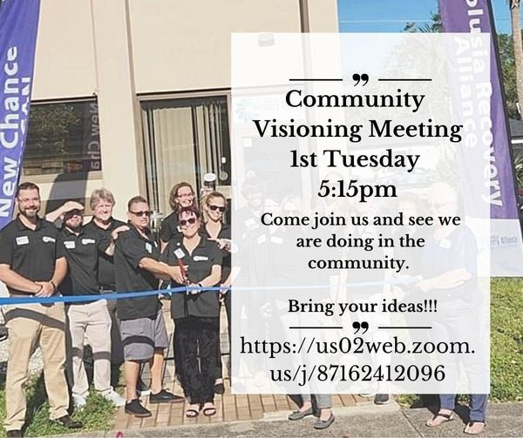
VRA Process
The Volusia Recovery Alliance was created through participatory process. Based on several community planning meetings, a Symposium was organized by the Florida Alcohol and Drug Abuse Association (FADAA) funded by the Aetna Foundation that took place January 26, 2019. Café conversations were held there about community strengths and gaps in recovery needs that resulted in the formation of our Vision, Mission and Purpose. Since then, VRA has held 51 community visioning meetings where we continue to receive feedback on recovery trends, concerns and needs which form the basis of innovative solutions.
Community Visioning meetings
Dialogue with Board of Director members
Staff brainstorming
Advisory Board input
DCF and funder requests
Community partner conversations and collaborations

Slide 5
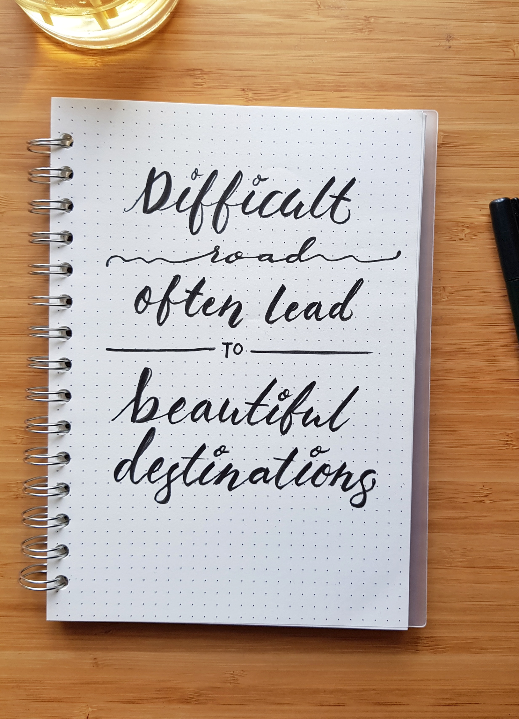
whY Innovate
Recovery Community Organization's are still relatively unknown.
Save more lives.
Shows we are responsive to community needs.
Gain recognition so we continue to spread the word that recovery is possible.
Traditional recovery methods don’t work for everyone.
Recovery community organizations are in place to embrace multiple pathways to be more inclusive. We need to get outside our comfort zone to be more successful.
Commitment to innovation can release creativity.

Slide 6
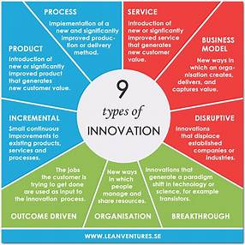
whY Innovate
Because one size does not fit all, we work to improve services to be more inclusive.
We can increase the value of our day-to-day services.
We can create meaningful products.
We can generate a paradigm shift when it comes to recovery.

Slide 7
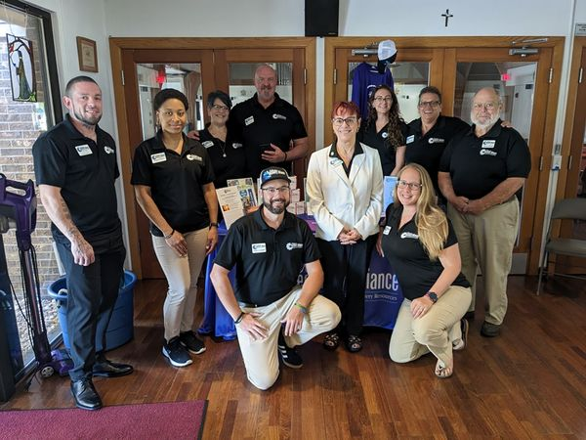
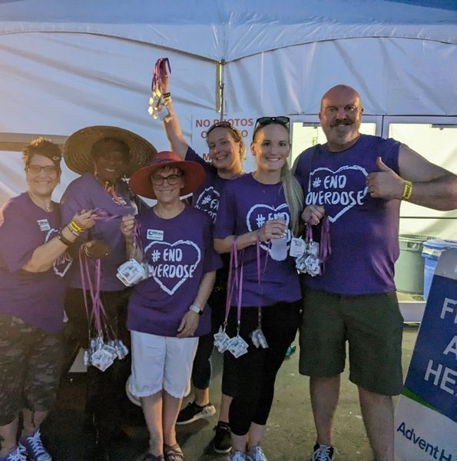
VRA SERVICES INCLUDE:
Hope Hub Resource and Engagement Center with a lending library
Trainings including Overdose Response & Reversal with free Narcan distribution
Peer Support
Linking to services/resources
Parent Café
Recovery Connections for Dads
Bridge4Hope
Invitation to Change Family Support Group
A Window Between Worlds
Y12sr
Career Connect
Freedom To Change
Advocacy

Slide 8
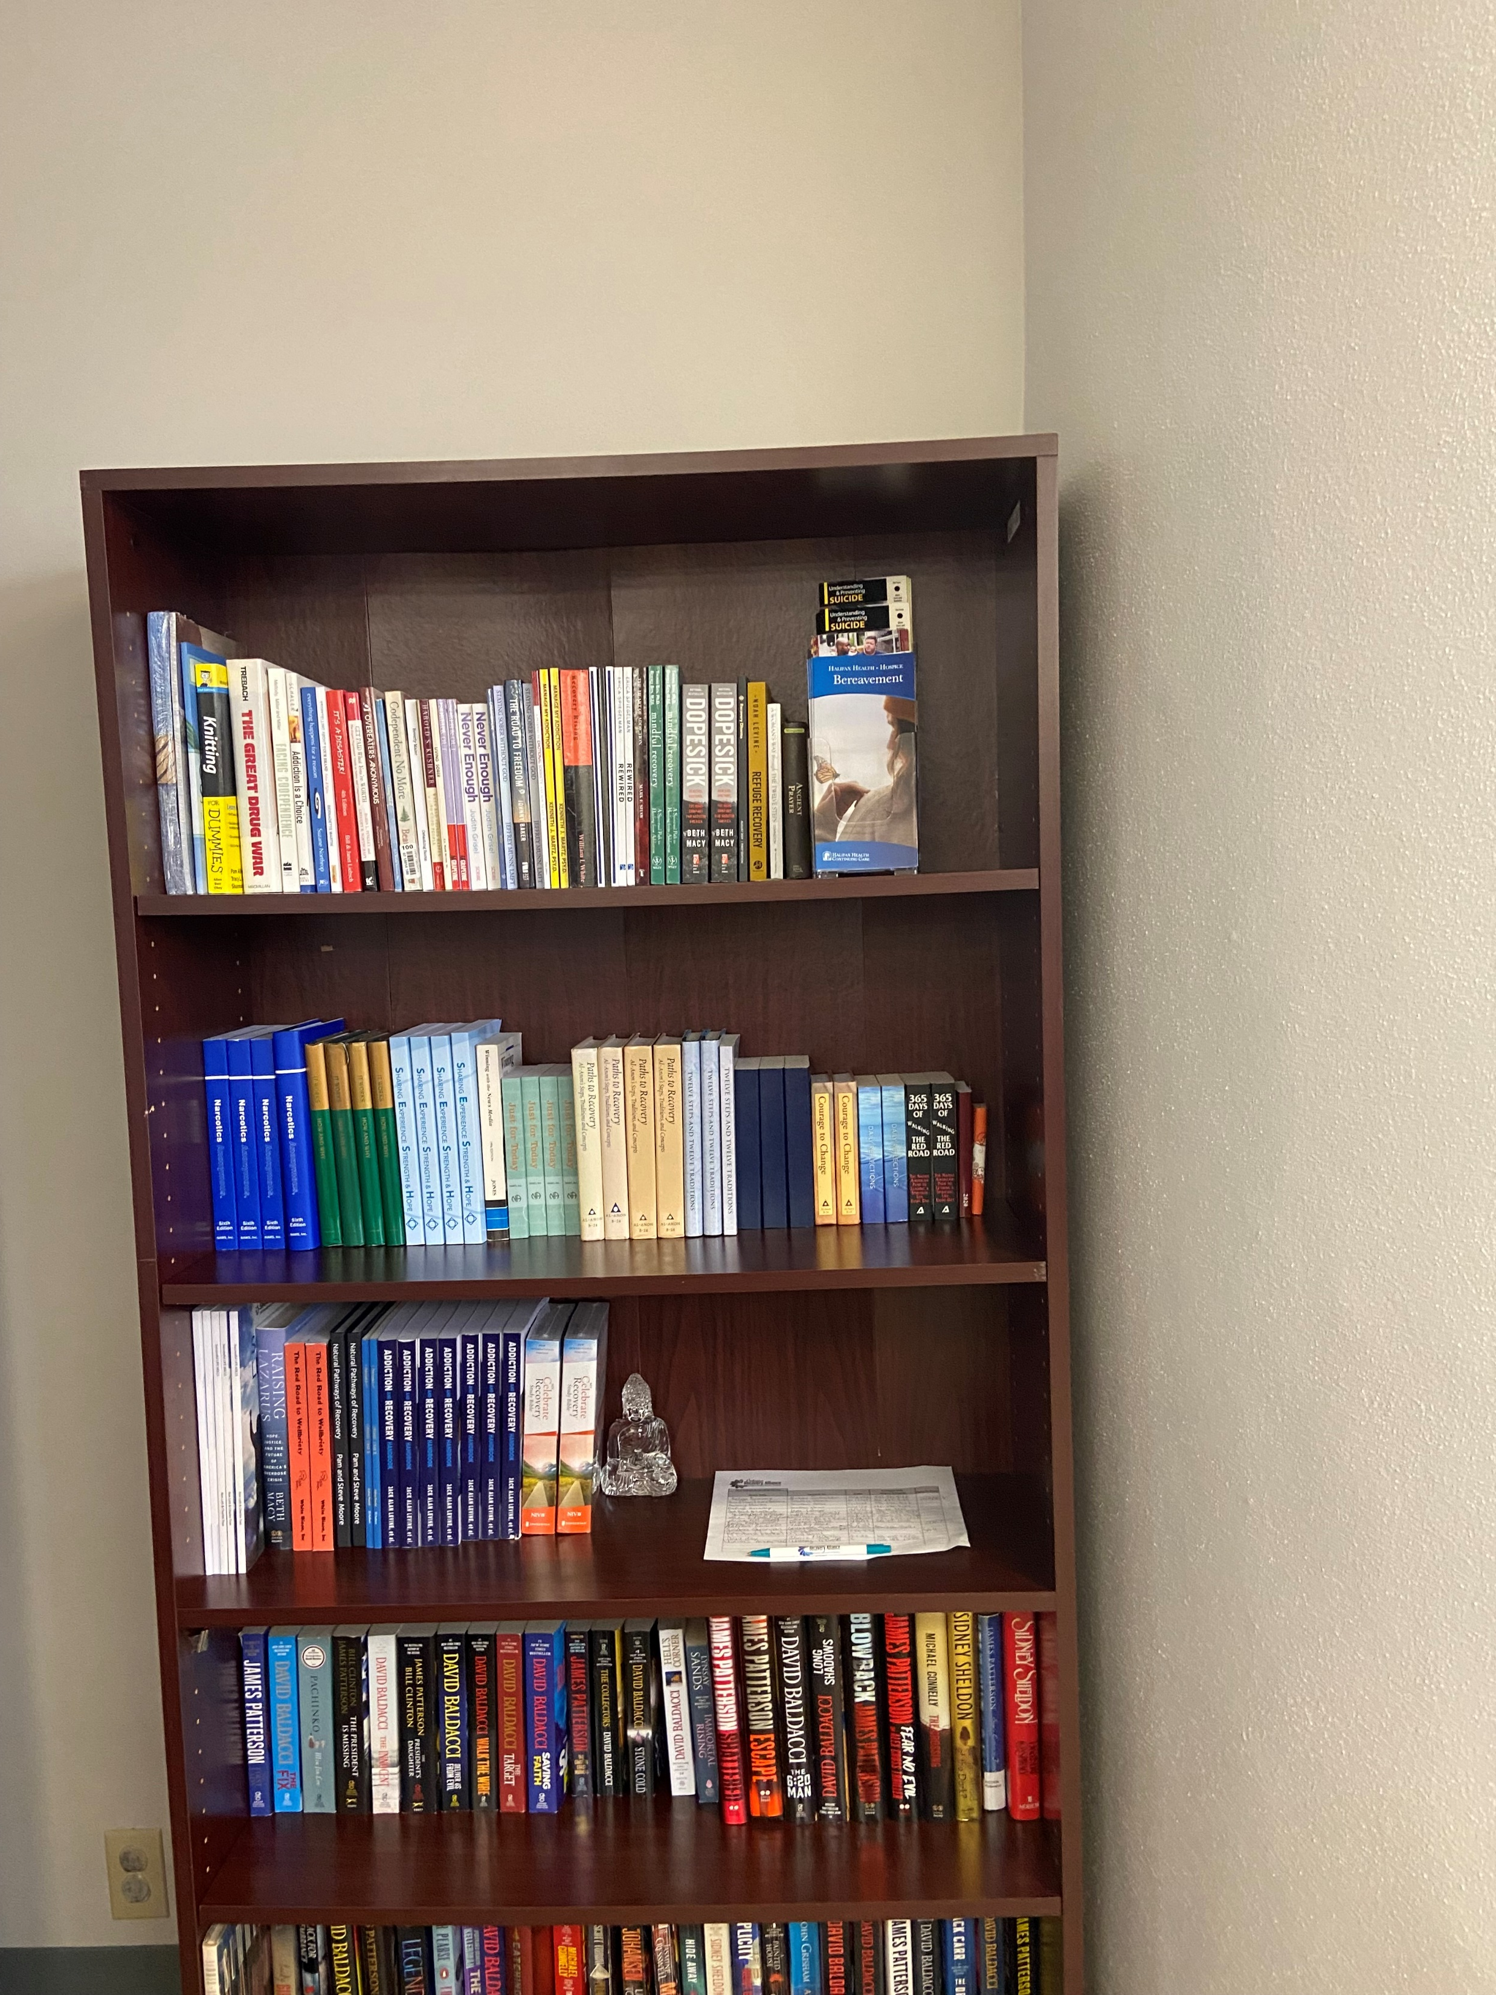
How to Promote Multiple Pathways
Search out recovery groups beyond your own comfort level
Lending library with books on multiple pathways
List resources on your website
Attend and/or host special events targeted to other types of mutual aid groups
Keep reaching out – one door opens another

Slide 9
SEE A NEED, FILL A NEED
Keeping Hope: Overdose Awareness and Remembrance Day
Campaign for Climate & Wellness
Fentanyl Awareness Video
Welcome Back Backpack

Slide 10
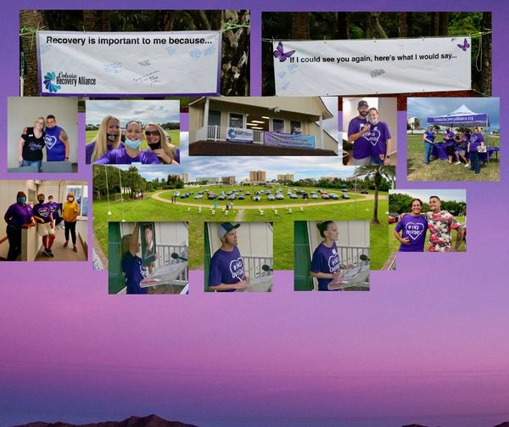
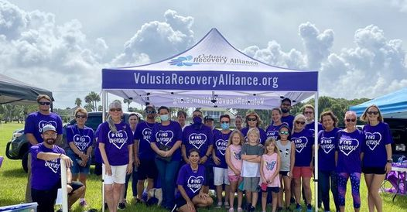

Slide 11
IOAD/End Stigma

Slide 12
Community Response - West Volusia
Pierson is the fern capital of the world.
Fern worker conditions are rough.
SUD impacts these families who are underserved.

Slide 13
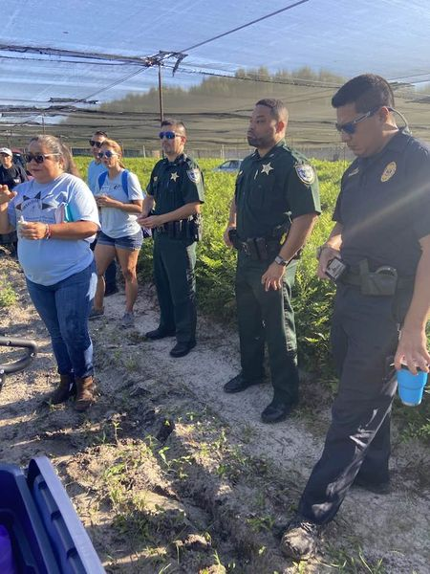
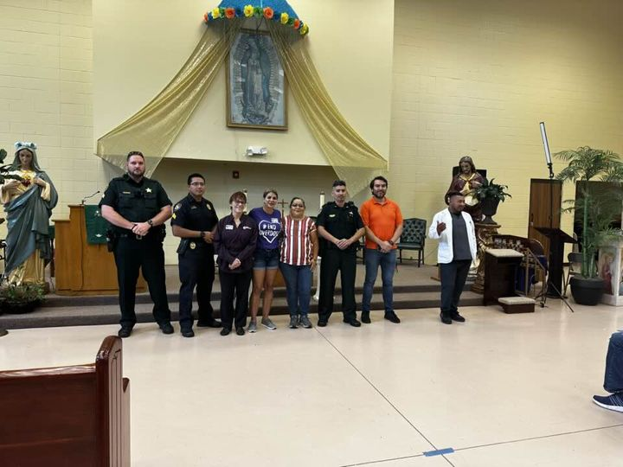
Community Response - West Volusia

Slide 14
Fentanyl awareness
This project came about from a dialogue with a funder about increasing awareness about the dangers of fentanyl.

Slide 15
Welcome back backpacks
Developed by the VRA BOD based on community needs, the Freedom To Change program meets twice a week in the Volusia County Women’s Jail and, also provides individual recovery coaching sessions to reduce recidivism and improve recovery outcomes. Welcome Back Backpacks resulted from a need identified while working with our first returning citizen. The backpacks contain Narcan, a 30-day bus pass, Subway gift card, a VRA t-shirt, clothing voucher, toiletries, and other personal essentials to ease the ladies' adjustment back to society.

Slide 16
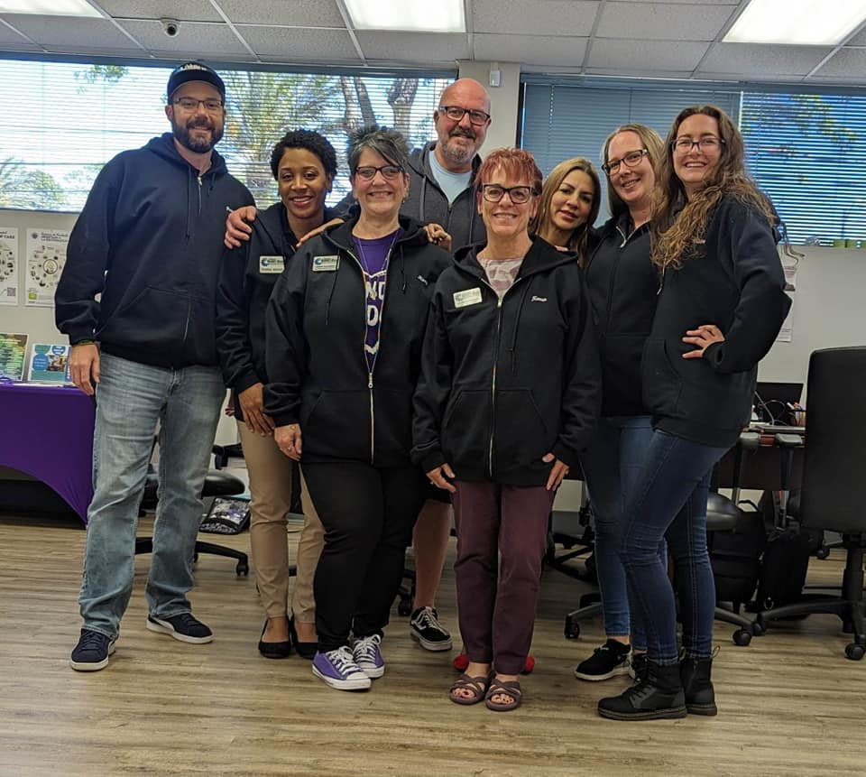
SEE A GAP, FILL A GAP
A Window Between Worlds
Invitation to Change
Recovery Connections for Dads
Bridge4Hope

Slide 17
A Window between worlds
Previous collaboration with the Volusia Sherriff's office and DCF led to DCF coming to VRA to develop an art program to help heal aging out foster kids and other people in recovery that suffer from trauma and substance use disorder.

Slide 18
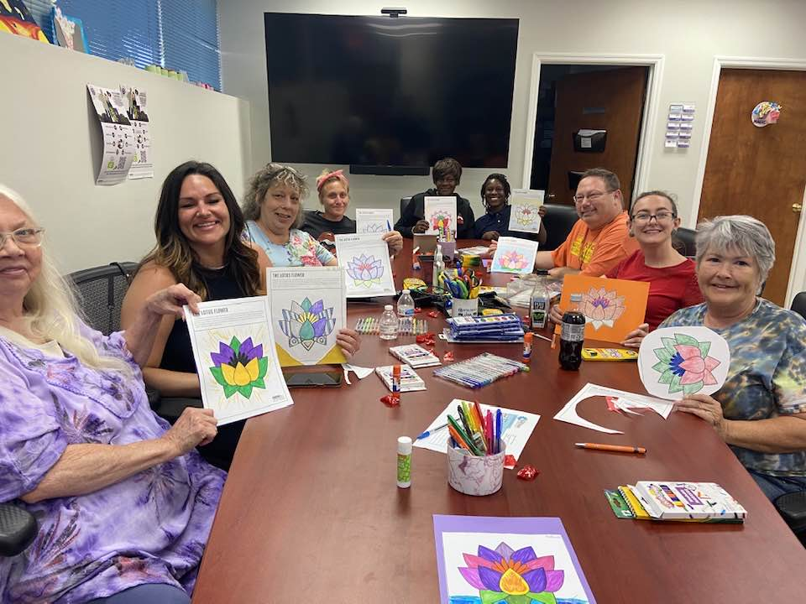
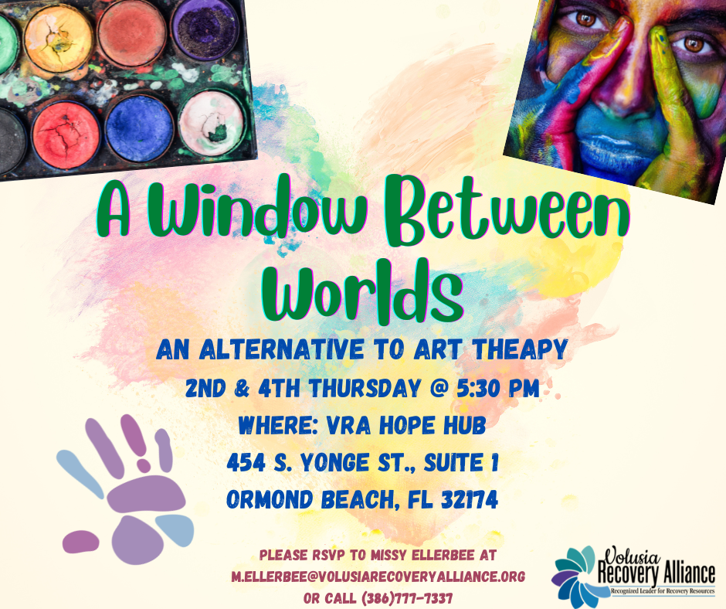
Tonight’s A Window Between Worlds is about the Lotus. The Lotus grows in murky water that can represent growth during difficult times. Use the finished flower to remind yourself of your resilience.

Slide 19
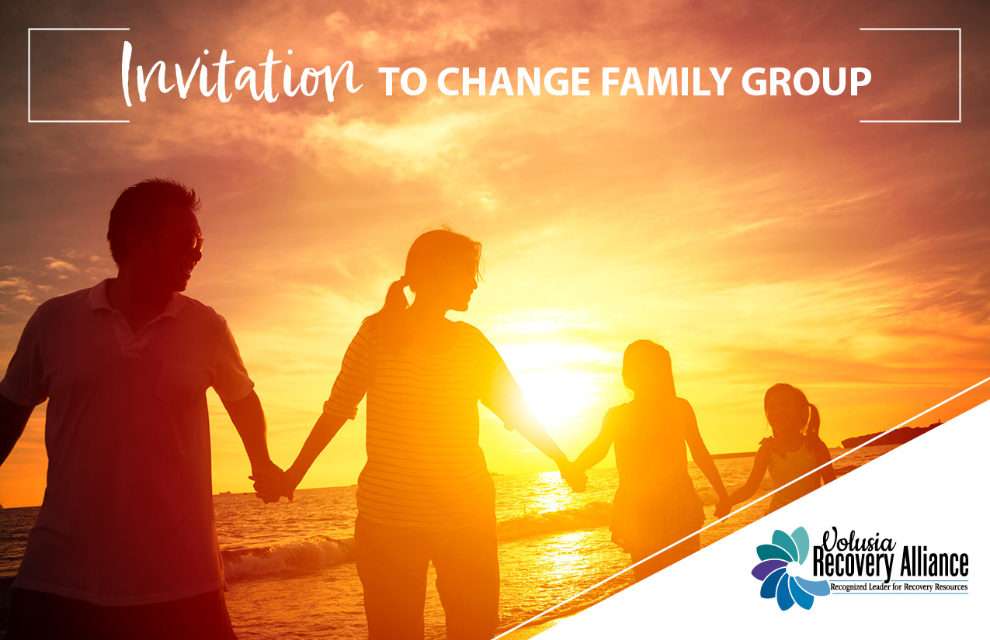
Invitation to Change Family Group
Meets the 1st and 3rd Wednesdays of the month 5:30pm-7pm Childcare available upon request

Slide 20
Invitation to Change Family Group
The Invitation to Change approach is built upon evidence-based practices that work. It is rooted in love and
compassion, which most people already have in abundance. It empowers individuals to be part of the change they would like to see! The group teaches practices and tools that empower and can be used to be part of creating conditions for change. “If you change the way you look at things, the things you look at change.” - Wayne Dyer
This is a Learning and Practice Group, as opposed to a support group – we share tools, concepts, and
practices from the ITC model each session and ask that participants to practice with them between sessions.
We welcome family members and friends of those struggling with substance/alcohol use issues. It is an opportunity to
learn how to encourage change, in a place of openness and support. This group uses the Invitation to Change Approach (ITC) as the basis for discussions. This approach is grounded in compassion, connection, and the belief that a person is not powerless – something can be done to help loved ones. ITC is based on the evidence-based practices of CRAFT (Community Reinforcement & Family Therapy), Motivational Interviewing, and ACT (Acceptance and Commitment Therapy). In this Learning Group, individuals connect with a supportive community and engage with tools and techniques to use in their daily life.

Slide 21
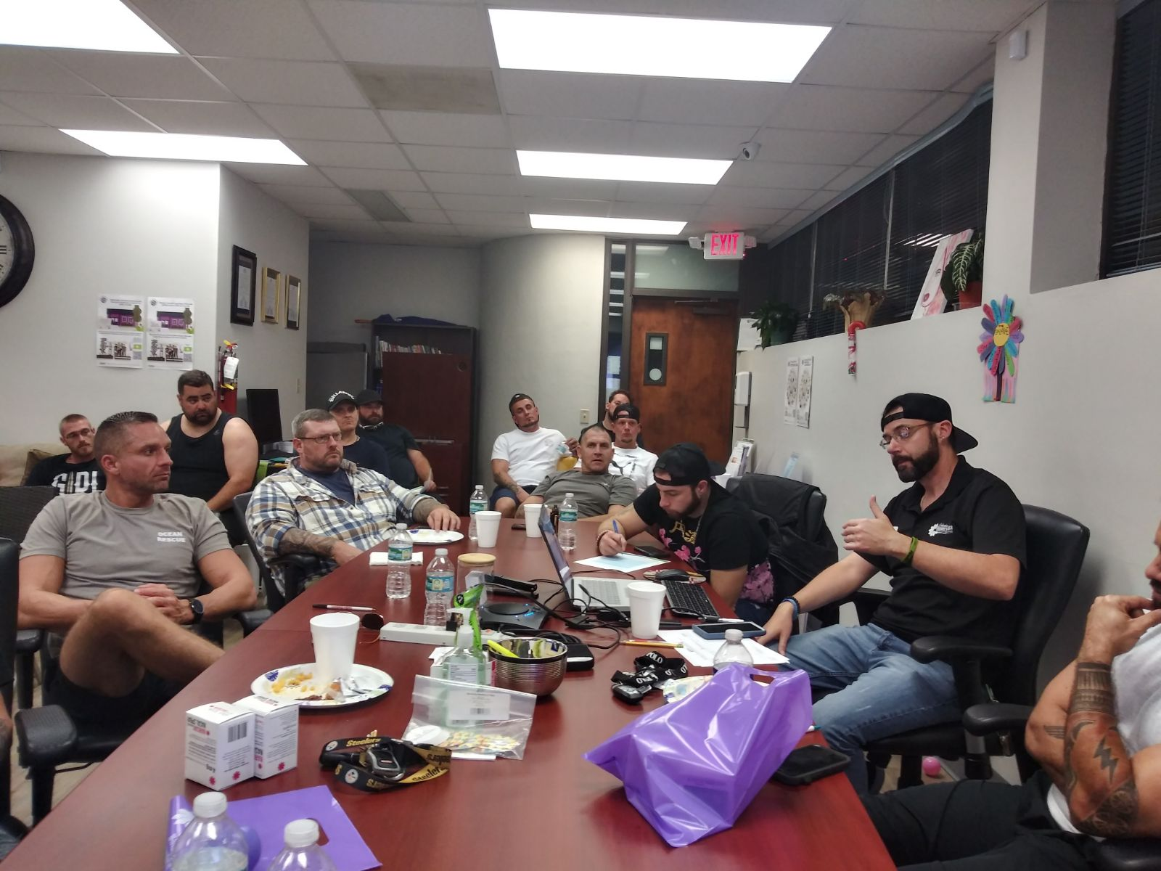
Recovery connections for dads
Based on ACES scores, Protective Factors and WRAP principles, this program was created based on the experience of staff while helping a participant navigate the aftermath of his baby being born substance exposed. Further investigation showed a real lack of local services for dads in recovery.

Slide 22
Bridge4Hope: Overdose Grief Support Group Led by a bereavement therapist, this group was created based on a car ride conversation that led to looking into this type of support. Shortly after Halifax Hospice received a grant to provide this sort of help and the group was launched.

Slide 23
Go forth and Replicate!
Reach out to VRA and other RCO’s to assist
Get staff trained as AWBW facilitators (www.awbw.org)
Get staff trained as ITC facilitators (www.cmcffc.org)
Hold brainstorming sessions with your stakeholders and invite them to participate
Generate excitement about new groups via social media and ads

Slide 24
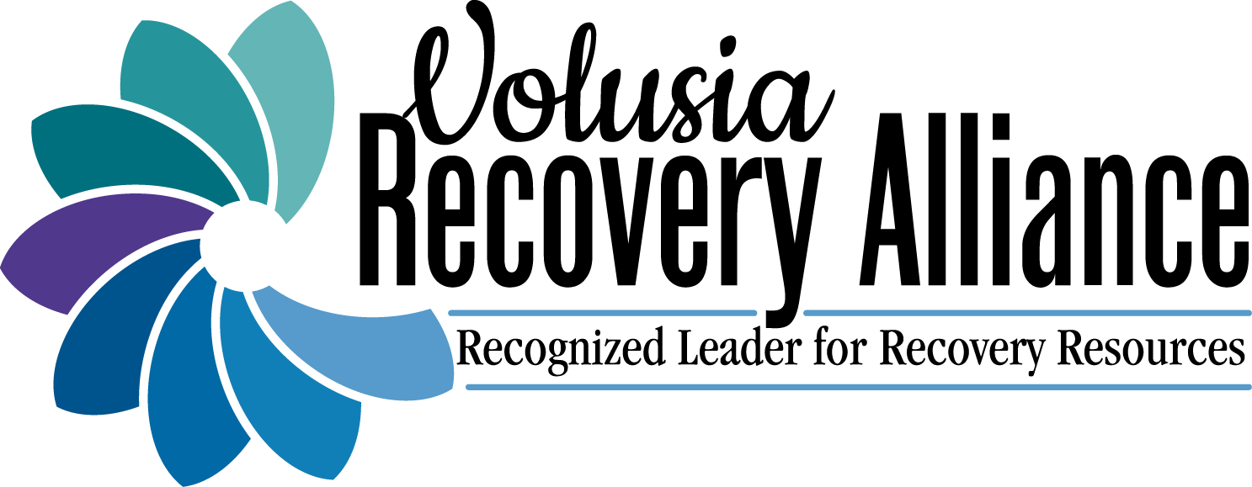
Thank You
Karen Chrapek, BSBM, RRT, CRPS-A
Registered Respiratory Therapist, Certified Recovery Peer Specialist for Adults AWBW & WRAP ® Facilitator
386-777-PEER (7337) or 386-846-6061
www.volusiarecoveryalliance.org

Slide 25
