Slide 1
WELCOME
Recovery Innovations

Slide 2
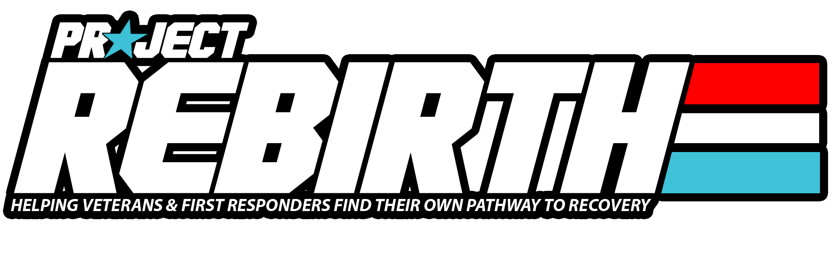
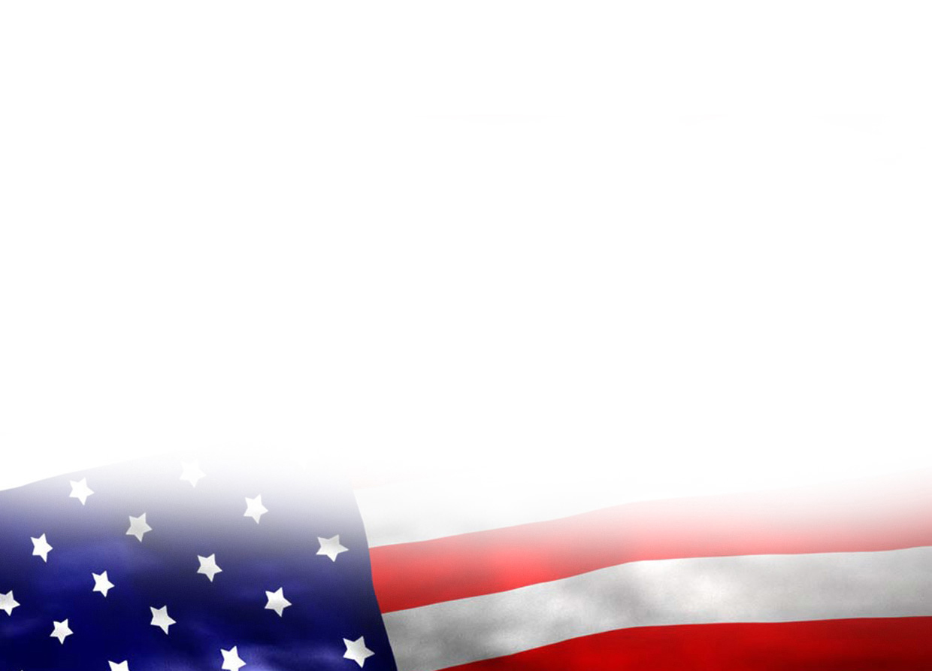

WALKING WITH WARRIORS
How to respond to Veteran & First Responder Peers in need
Brian W. Sims, CRPS-V, CEI, GISP – National Director, Project: REBIRTH
Programs Director, Miami Recovery Project

Slide 3

Walking With Warriors Training Objectives
Learn: Military and First Responder culture, and their barriers to recovery, trends and coming trends.
Learn: Systems of care for Veterans & First Responders - how to navigate and access them as a Peer Specialist.
Learn: Tools provided by Project: REBIRTH for Peer Specialists and RCOs.

Slide 4
Our Mission
The mission of Miami Recovery Project is to support recovery in all its forms and increase recovery capital in the recovery community. MRP provides recovery support services through peer support, advocacy, education and stigma reduction.
Our Vision
Miami Recovery Project envisions a community where everyone has an equal opportunity to recover from alcohol and substance use. One day recovery will be destigmatized and understood by all.

Slide 5
What is Project: REBIRTH?
Project: REBIRTH is the first National Peer-Support model for Veterans & First Responders developed exclusively for Recovery Community Organizations.
Project: REBIRTH improves outreach, partnerships, efficacy, and impact of programs and recovery outcomes for Veterans, First Responders, and their loved ones.
We are a peer-based model for support towards self-advocacy and community service, supporting all pathways to recovery.
`

Slide 6
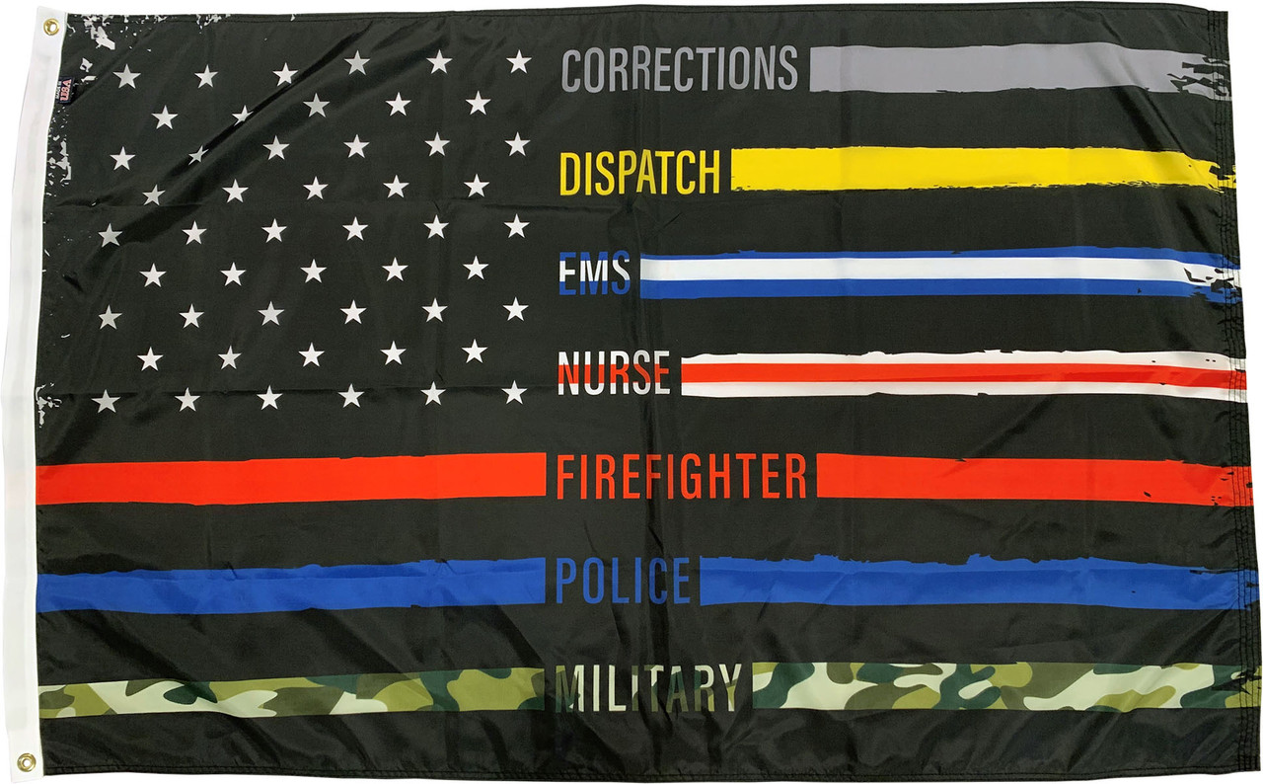
Military & Responder Culture –
A view from behind the "Thin Line"

Slide 7
Recovery is culturally-based and influenced
Culture and cultural background in all of its diverse representations—including values, traditions, and beliefs—are keys in determining a person’s journey and unique pathway to recovery. Services should be culturally grounded, attuned, sensitive, congruent, and competent, as well as personalized to meet each individual’s unique needs.
SAMHSA Definition of Recovery – PEP12-RECDEF

Slide 8
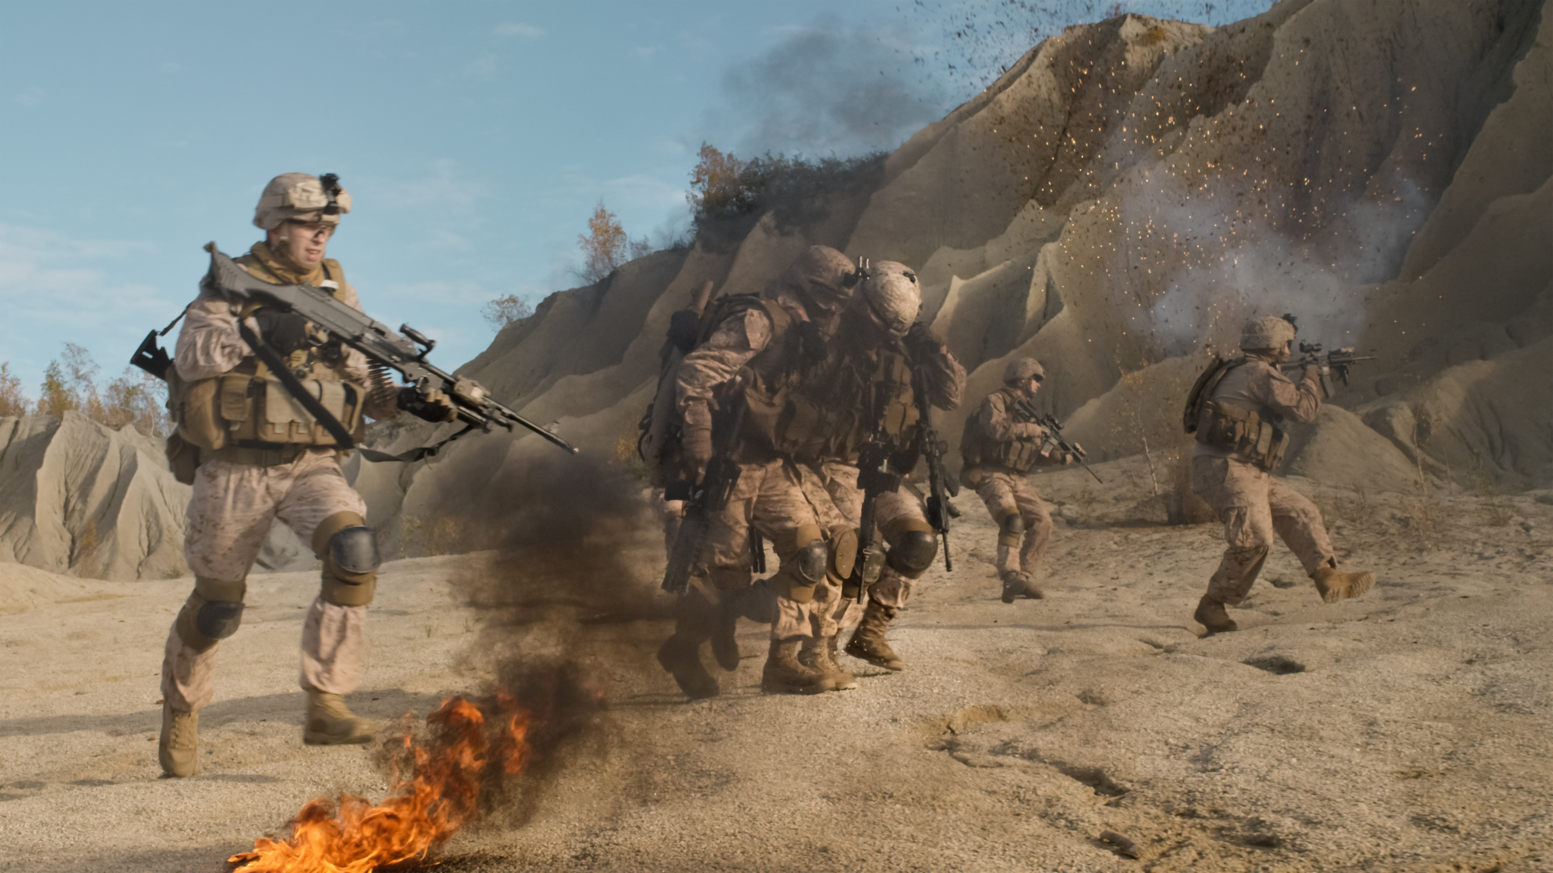
Let’s talk about WHY
Veterans need a dedicated program.

Slide 9
Current Veteran Population:
18,792,000
(approx 2021 per VA)

Slide 10
GLOBAL WAR ON TERRORISM POPULATION DATA:
Approximately 3 million post 9/11 military veterans
80 percent of those spent some time in an overseas combat zone.
Over 2 million served in Afghanistan and Iraq, spending 1 out of 3 years serving overseas.
60% are under the age of 34.
30% of vets have disabilities as a result of their service.

Slide 11
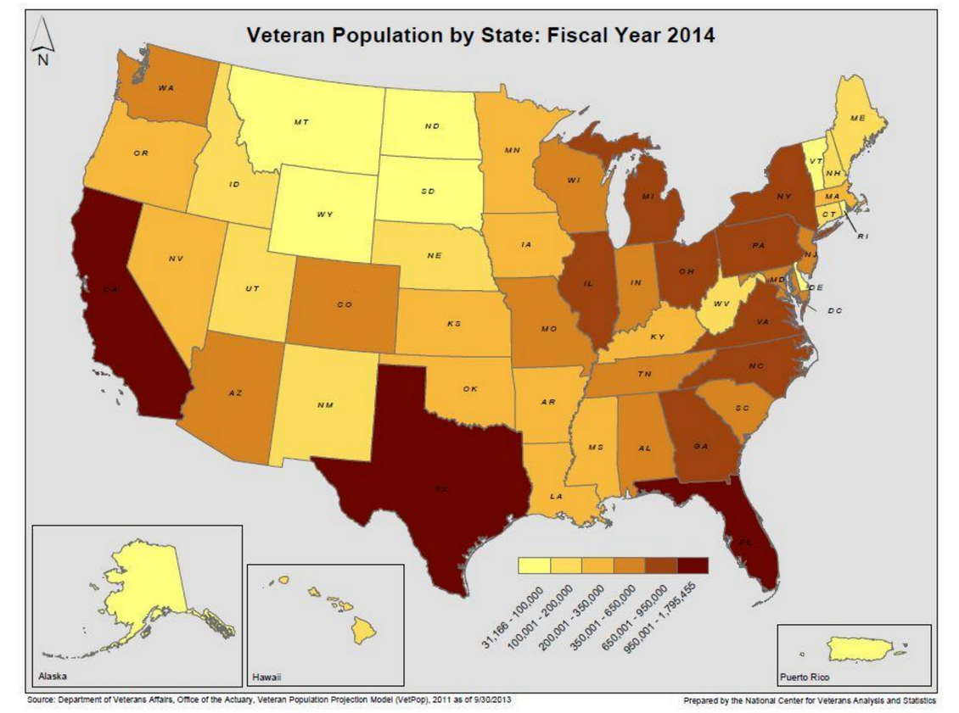
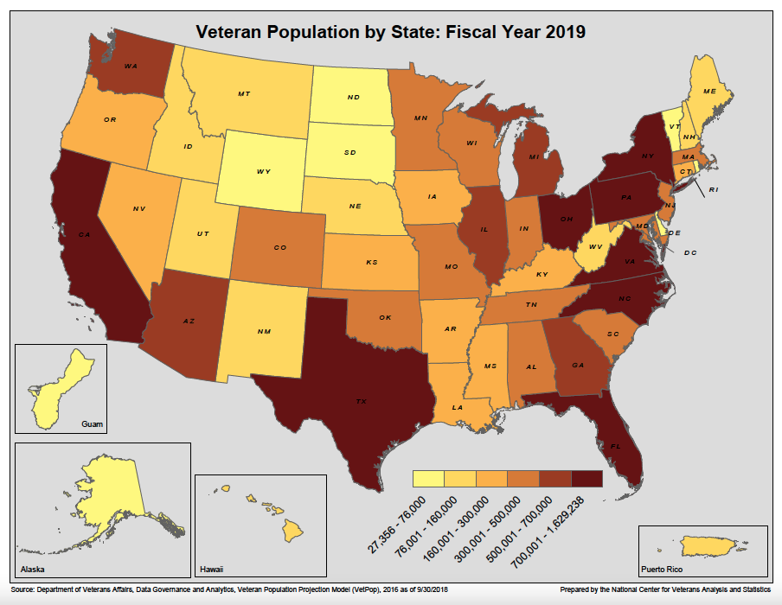
Veteran Population Change (by state) 2014-2019

Slide 12
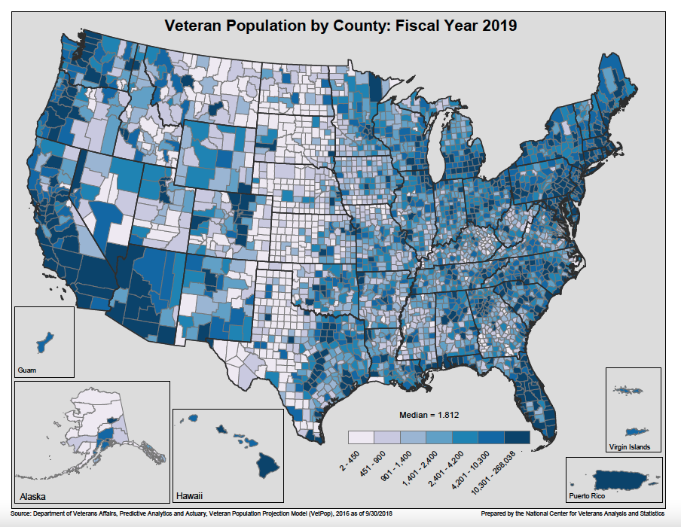

Slide 13
Current Data Points
According to the Department of Veterans Affairs, there are more than 2 million female veterans in the U.S., and women are the “fastest grouping group” of veterans, expected to make up 18% of the veteran community by 2040. Data from the VA also says that the number of veterans who are minorities is only going to increase over the next few decades.
For example, nearly 13% of veterans are Black and 8% are Hispanic.
By 2045, those percentages are expected to increase to 15% and 12%, respectively.

Slide 14
Not every veteran is a hardened combat vet —
and not every veteran has even seen combat.
A 2019 survey from the Pew Research Center found that roughly 40% of veterans were never deployed during their military service. That ratio changes for the Global War on Terror generation, of which 77% of veterans said they deployed at least once. Veterans in the post-9/11 generation are also more likely than their immediate predecessors to have seen combat: 49% of GWOT veterans had combat experience, compared to 24% of veterans who served before Sept. 11, according to the Pew Research Center report.
And ultimately, whether someone saw combat or not doesn’t determine their status as a veteran. They still served.

Slide 15
Key Challenges Veterans Face
(Wounded Warrior Project 2017 Survey)
• Finding employment (the challenge most often identified by veterans).
• Dealing with a loss of purpose and isolation after leaving the military.
• Accessing and having success with postsecondary education
• Dealing with housing and financial instability that could ultimately lead to homelessness for some.
• Accessing resources that uniquely address the needs and challenges of female Veterans
• Finding support for family members of Veterans—spouses, children, siblings—who may be dealing with caretaking and other reintegration issues, including relationship issues with the Veteran.

Slide 16
Key Challenges Veterans Face
(Wounded Warrior Project 2017 Survey)
• Navigating the complex and confusing network of benefits, services and support that is available to Veterans.
• Long wait times to receive benefits from the VA
• Coping with Post Traumatic Stress Disorder (PTSD), Traumatic Brain Injury (TBI) and/or major depression that are prevalent among Global War on Terrorism Veterans

Slide 17
Veteran drug overdose mortality, 2010-2019
Results: From 2010-2019, age-adjusted overdose mortality rates increased 53.2% among Veterans and 79.0% among non-Veterans.
Conclusions: In all years, overdose rates were higher among male Veterans with recent VHA use than those without recent use.
While overall rates of Veteran overdose deaths declined from 2017 to 2019, rates involving psychostimulants and synthetic opioids continued to rise.
Begley MR, Ravindran C, Peltzman T, Morley SW, Stephens BM, Ashrafioun L, McCarthy JF. Veteran drug overdose mortality, 2010-2019. Drug Alcohol Depend. 2022 Apr 1;233:109296. doi: 10.1016/j.drugalcdep.2022.109296. Epub 2022 Jan 12. PMID: 35219064.

Slide 18
Veteran drug overdose mortality, 2010-2019
From May 2014 to September 2019, the US Department of Veterans Affairs (VA) issued naloxone to more than 200,000 veterans.
“Veterans are twice as likely to die from accidental overdose compared to the general US population.” - VA Secretary Robert Wilkie
Bennett, Alex S., et al. “Military Veterans' Overdose Risk Behavior: Demographic and Biopsychosocial Influences.” Addictive Behaviors, Pergamon, 25 June 2019, https://www.sciencedirect.com/science/article/abs/pii/S030646031930156X?via%3Dihub.

Slide 19
Veteran Suicide Report, AWP, 2022
The rate of suicide among veterans may be more than double what federal officials report annually because of undercounting related to drug overdose deaths and service record errors, according to a new analysis released Saturday.
Officials from America’s Warrior Partnership, in a joint study with University of Alabama and Duke University, reviewed census death data from 2014 to 2018 for eight states and found thousands of cases of suspected or confirmed suicides not included in federal calculations.
III, Leo Shane. “Veterans Suicide Rate May Be Double Federal Estimates, Study Suggests.” Military Times, 17 Sept. 2022, www.militarytimes.com/veterans/2022/09/17/ veterans-suicide-rate-may-be-double-federal-estimates-study-suggests/?utm_source=sailthru&utm_medium=email&utm_campaign=mil-ebb. Accessed 19 Sept. 2022.

Slide 20
Veteran Suicide Report, AWP, 2022
“If those figures were to be repeated across the other states, it would push the veterans suicide rate from about 17 individuals a day (the official estimate released by the Department of Veterans Affairs last year) to 44 veterans a day.”
III, Leo Shane. “Veterans Suicide Rate May Be Double Federal Estimates, Study Suggests.” Military Times, 17 Sept. 2022, www.militarytimes.com/veterans/ \2022/09/17/veterans-suicide-rate-may-be-double-federal-estimates-study-suggests/?utm_source=sailthru&utm _medium=email&utm_campaign=mil-ebb. Accessed 19 Sept. 2022.

Slide 21
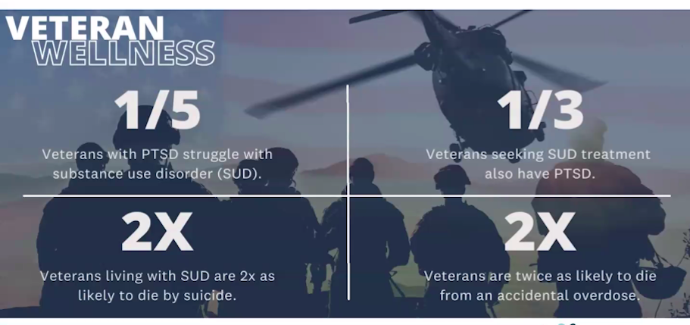
Credit: SAFE Project, 2022

Slide 22
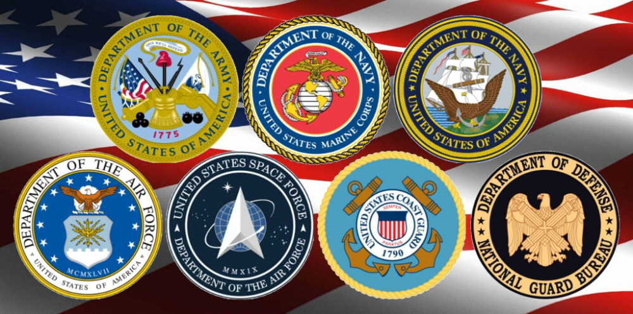

Slide 23
Official & Unofficial Nomenclature
of the DoD Branches
Army (Soldiers)
Air Force (Airmen)
Space Force (Guardians)
Navy (Sailors, or the Army favorite: Seamen)
Marines (MARINE)
Coast Guard (Coast Guardsman)

Slide 24
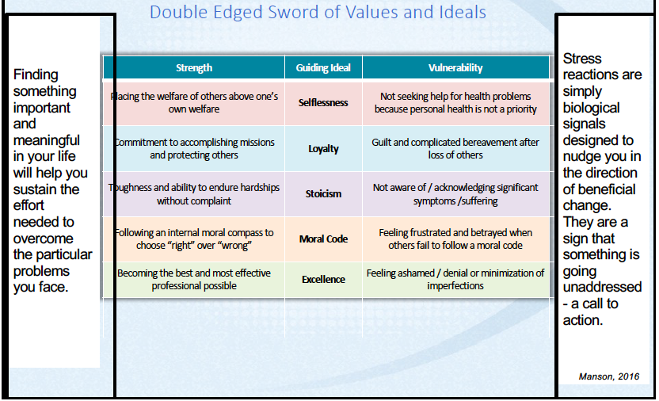

Slide 25
The Department of Veterans Affairs
Two sections:
The VBA (Veteran’s Benefits Administration). This is where disability ratings, pensions, home loan certificates, etc are handled.
The VHA (Veteran’s Healthcare Administration) This is who runs all healthcare, hospitals, community care programs, community-based outpatient clinics (CBOCs), VetCenters, etc.
AND
- The National Cemetery Administration
While both work together, THEY ARE SEPARATE ENTITIES.

Slide 26
What is the VetCenter?
Vet Centers are community-based counseling centers that provide a wide range of social and psychological services, including professional readjustment counseling to eligible Veterans, active duty service members, including National Guard and Reserve components, and their families. Readjustment counseling is offered to make a successful transition from military to civilian life or after a traumatic event experienced in the military.
Individual, group, marriage and family counseling is offered in addition to referral and connection to other VA or community benefits and services. Vet Center counselors and outreach staff, many of whom are Veterans themselves, are experienced and prepared to discuss the tragedies of war, loss, grief and transition after trauma.

Slide 27
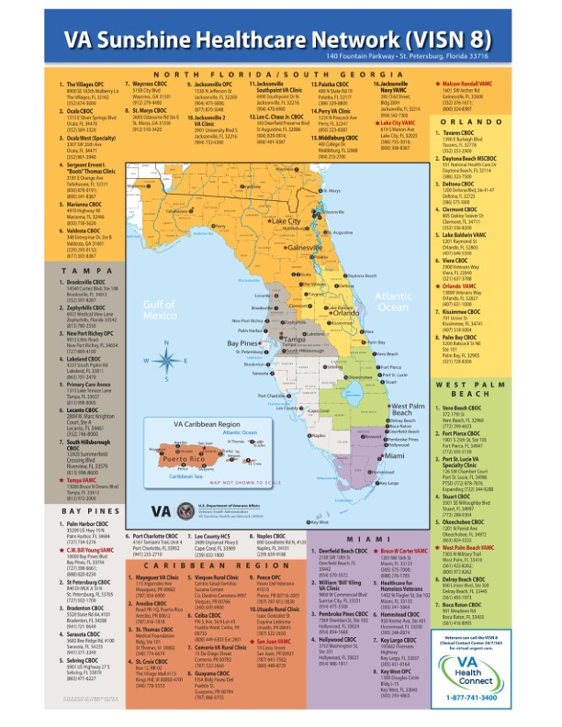
VA Healthcare Systems in Florida
Miami VA Healthcare System
West Palm VA Healthcare System
Orlando VA Healthcare System
Bay Pines VA Healthcare System
North Florida/South Georgia Healthcare System
Two main types of healthcare for Veterans: VA Healthcare and/or TriCare

Slide 28
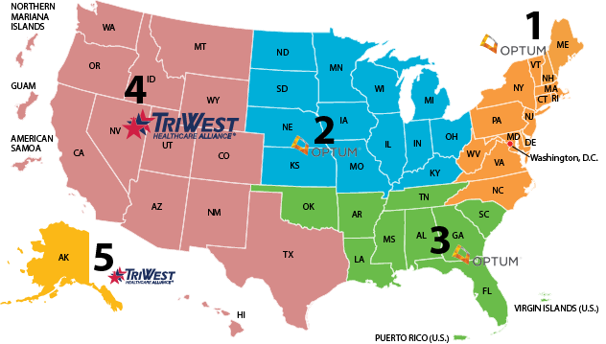

Slide 29
VA Community Care
Per VA Community Care website (http://va.gov/communitycare):
VA provides health care for Veterans from providers in your local community outside of VA. Veterans may be eligible to receive care from a community provider when VA cannot provide the care needed. This care is provided on behalf of and paid for by VA.
Community care is available to Veterans based on certain conditions and eligibility requirements, and in consideration of a Veteran’s specific needs and circumstances. Community care must be first authorized by VA before a Veteran can receive care from a community provider.
In most cases, Veterans must receive approval from VA before receiving care from a community provider to avoid being billed for the care. VA staff members generally make all eligibility determinations for community care.

Slide 30
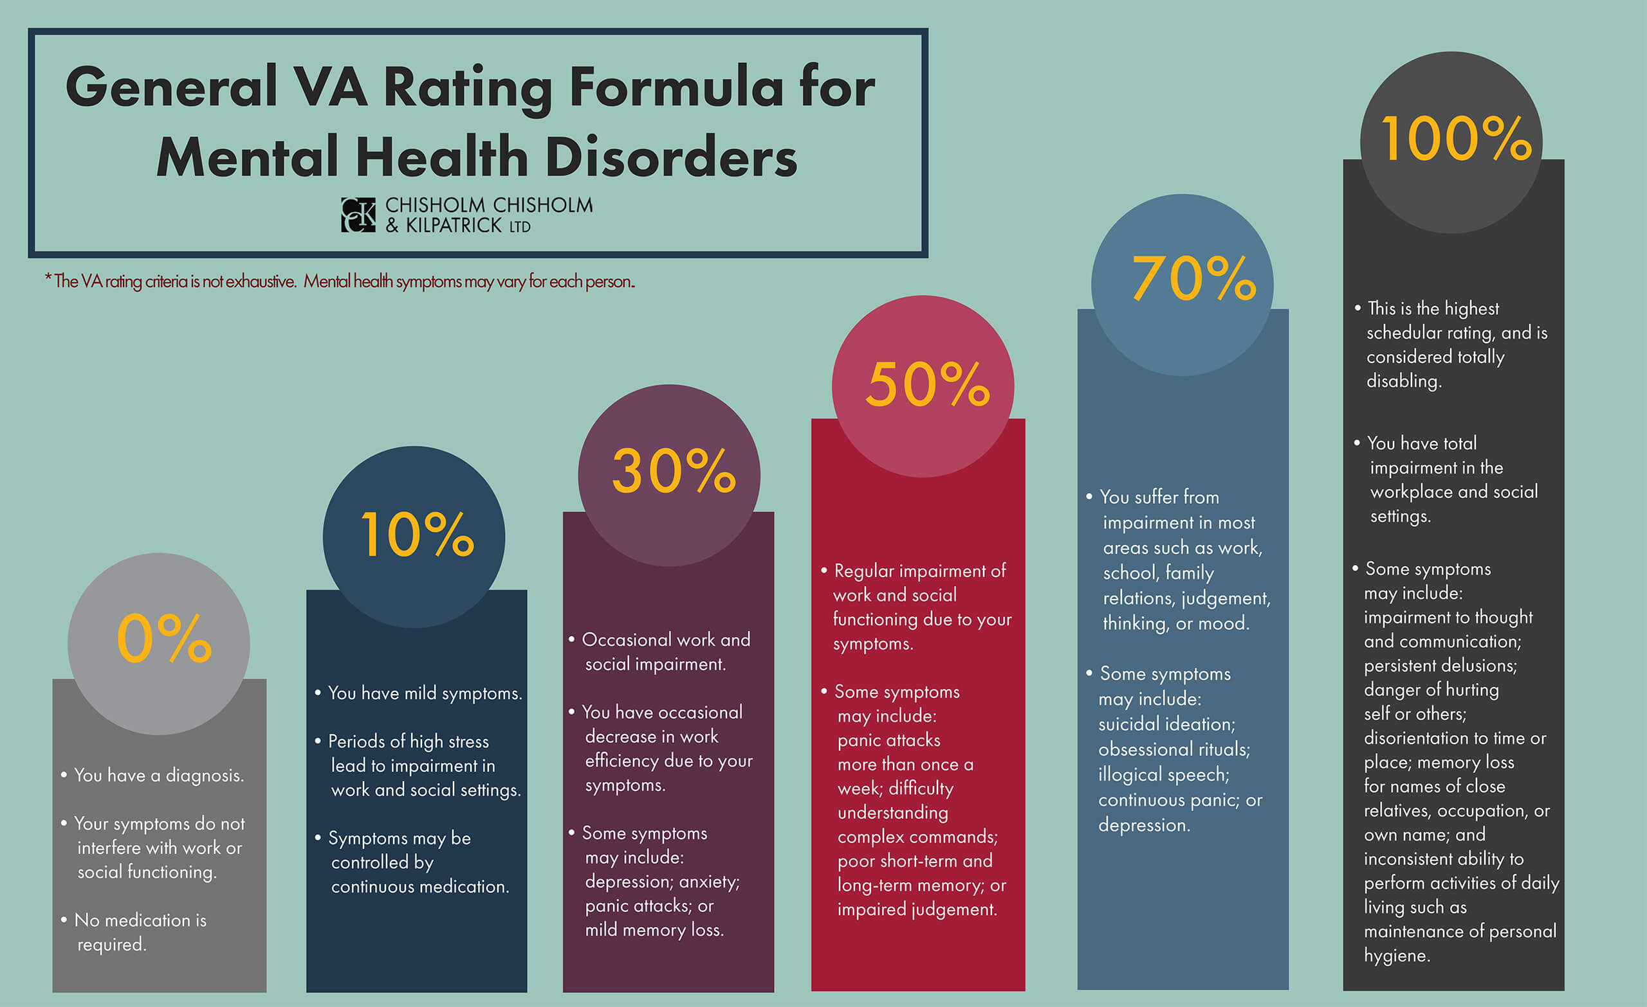
HMIS access

Slide 31
Generally, the VA will ONLY treat Veterans who have a RATED, SERVICE CONNECTED CONDITION (disability) and ONLY things related specifically to that condition, or, if they have OVER 70% TOTAL Disability Rating with the VA (qualifies for full VA medical coverage, always).

Slide 32
This is NOT the case for Veterans in Crisis. Veterans in Mental Health crises (INCLUDING SUBSTANCE USE) have been granted access to VA Hospitals for acute care up to 90 days BY CONGRESSIONAL MANDATE.
VA MEDICAL TREATMENT:
https://news.va.gov/60349/other-than-honorable-discharge/#:~:text=You%20can%20call%20or%20visit,1)%2C%20or%20text%20838255.

Slide 33
Starting Jan. 17, Veterans in suicidal crisis can go to any VA or non-VA health care facility for free emergency health care
“Veterans in suicidal crisis can now receive the free, world-class emergency health care they deserve – no matter where they need it, when they need it, or whether they’re enrolled in VA care,” said VA Secretary for Veterans Affairs Denis McDonough. “This expansion of care will save Veterans’ lives, and there’s nothing more important than that.”
Starting Jan. 17, Veterans in acute suicidal crisis will be able to go to any VA or non-VA health care facility for emergency health care at no cost – including inpatient or crisis residential care for up to 30 days and outpatient care for up to 90 days. Veterans do not need to be enrolled in the VA system to use this benefit.
This expansion of care will help prevent Veteran suicide by guaranteeing no cost, world-class care to Veterans in times of crisis. It will also increase access to acute suicide care for up to 9 million Veterans who are not currently enrolled in VA.
https://www.va.gov/opa/pressrel/pressrelease.cfm?id=5852]

Slide 34
VA Homeless Systems of Care & Programs
SSVF (Supportive Services for Veteran Families)
G&P (Grant and Per Diem)
HUD-VASH (Housing and Urban Development – Veteran’s Affairs Supportive Housing) aka SECTION 8 VOUCHER

Slide 35
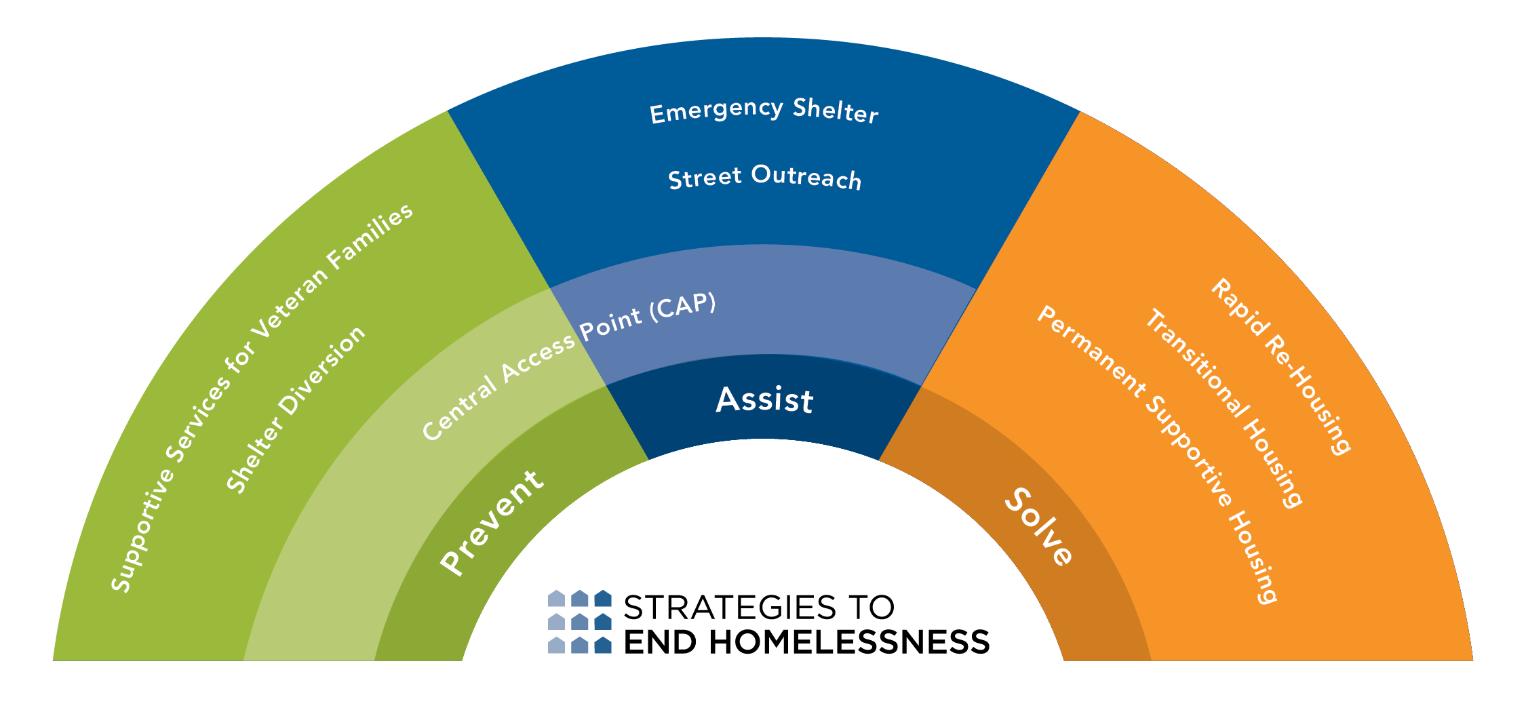

Slide 36
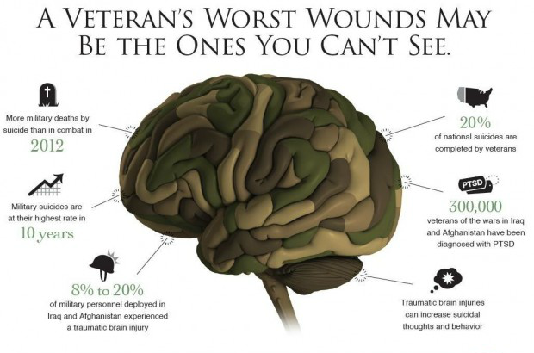

Slide 37
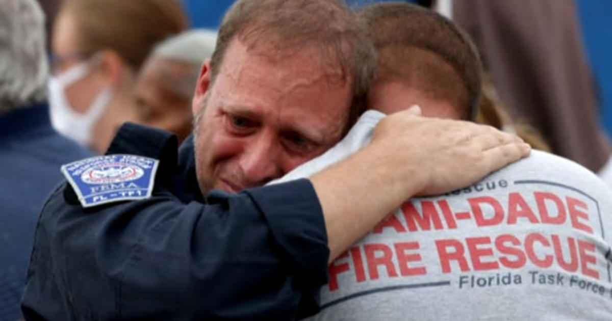
Let’s talk about WHY
First Responders need a dedicated program.
Image credit: CBS News, SURFSIDE, FL CONDO COLLAPSE RESPONSE

Slide 38
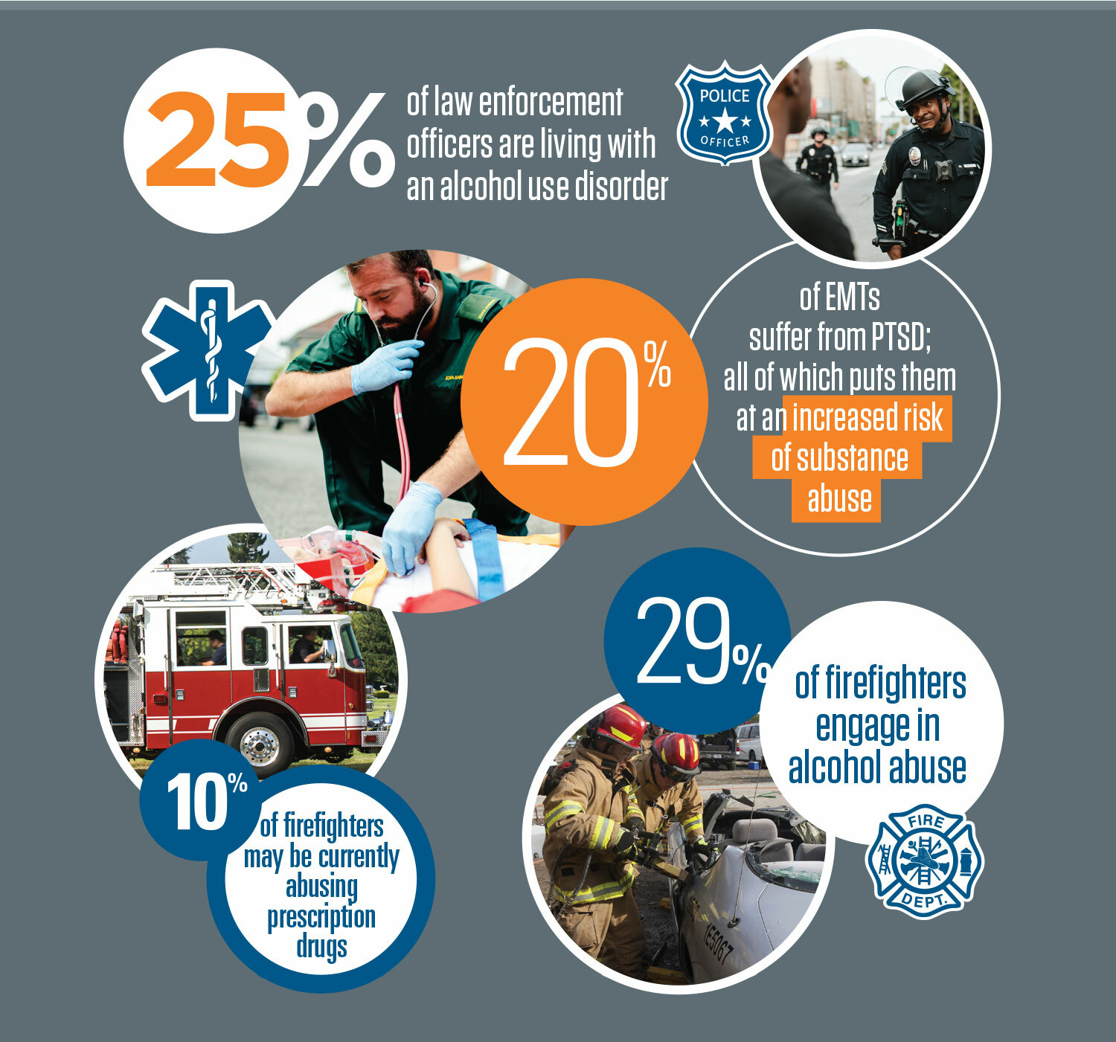

Slide 39
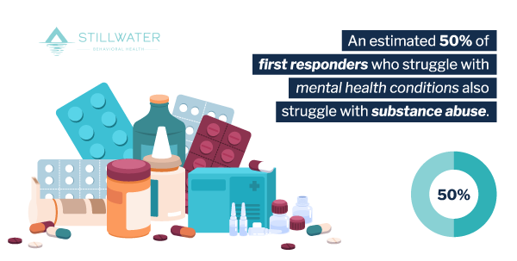
Suicide for 1rs slide

Slide 40
“Like Military culture, “asking for help” is commonly seen as a sign of weakness amongst peers. Fear of being removed from a position or post, loss of rank/pay, and the fear of the sociological impact within the agency against the individual asking for help are identified as the largest barriers to entering the recovery process.”
- (FL DCF First Responder Suicide Deterrence Task Force)

Slide 41
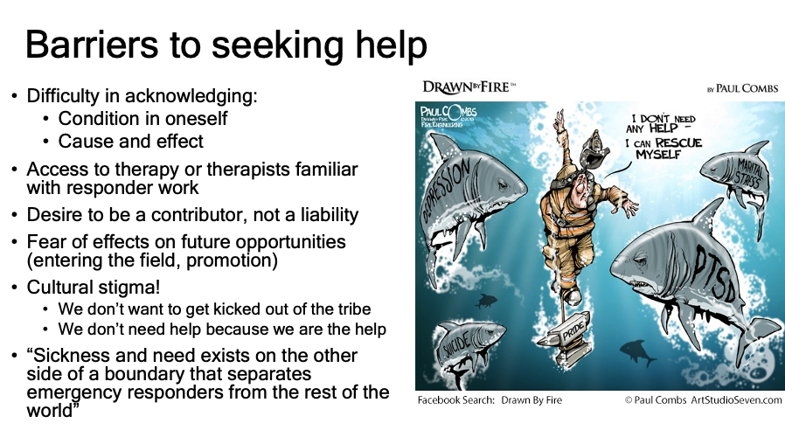

Slide 42
Recovery is supported by addressing trauma
The experience of trauma (such as physical or sexual abuse, domestic violence, war, disaster, and others) is often a precursor to or associated with alcohol and drug use, mental health problems, and related issues. Services and supports should be trauma-informed to foster safety (physical and emotional) and trust, as well as promote choice, empowerment, and collaboration.
SAMHSA Definition of Recovery – PEP12-RECDEF

Slide 43
Not Every Veteran has PTSD
One of the biggest myths of military service is that everyone leaves their respective branch with post-traumatic stress disorder, or PTSD. According to the VA, between 11 and 20% of Iraq and Afghanistan veterans have PTSD “in a given year” — meaning the vast majority do not.
Nevertheless, a 2021 study found that of roughly 2,000 U.S. adults surveyed, 67% said they believe most veterans have PTSD; 26% of respondents also said they think the majority of people with PTSD are dangerous. That couldn’t be further from the truth. Experiencing PTSD doesn’t make someone broken, or mean they can’t function in a public place or civilian work environment.
And PTSD doesn’t just come from combat. For example, a 2019 Defense Department Inspector General report found that service members who experience military sexual trauma are more likely to develop PTSD than service members who see combat. PTSD is also not specific to veterans — civilians experience traumatic events in their lives, too.

Slide 44
Military Moral Injury is NOT the Same as PTSD
Unfortunately, there is still no official separation between PTSD and Moral Injury. To put it in civilian terms, there is no difference between the men in combat afraid to die (those with PTSD) from those who suffer from Moral Injury and no longer feel life is worth living. Moral Injury can occur when a personal moral code – one’s understanding of “what’s right” – is violated. Most of us develop this code in childhood based on instructions from parents, teachers, and religious leaders. The difference between PTSD and Moral Injury is important. Post-Traumatic Stress Disorder is fear-based. Moral Injury is not. Therefore, the treatment is very different. Treating a patient with Moral Injury the same as a patient with PTSD will increase the injury. While medications can relieve the fear factor, they do not work with the shame or guilt of Moral Injury. In addition, reliving the incident with Moral Injury can cause greater shame and guilt.
Recalling those experiences brings back the guilt and shame which he/she faced when they first occurred. The shame and guilt can continue to build, and the memories get stronger over time. This leads to depression, anxiety, emotional numbing, anger, and a questioning of the meaning of life. Veterans often try to control the emotions by self-medicating with alcohol or drugs. They become unstable and isolate themselves. They have difficulty trusting others and there is often sleep disturbances. This is why suicide becomes common as they see no other options open for them.

Slide 45
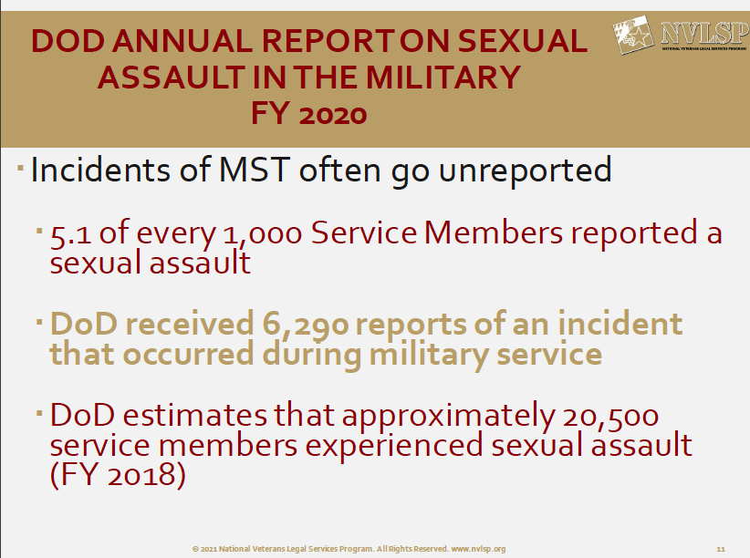

Slide 46
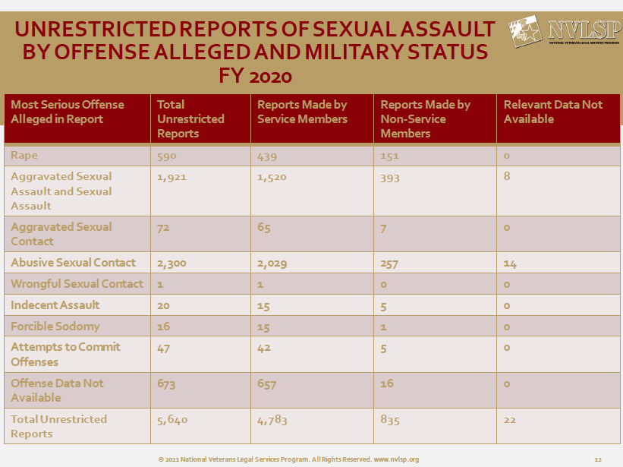

Slide 47
VA Traumatic Brain Injury (TBI)
Veterans Health Registry
At the direction of Congress, the Department of Veterans Affairs (VA) maintains the VA Traumatic Brain Injury (TBI) Veterans Health Registry that includes information about Veterans who served in Operation Enduring Freedom (OEF), Operation Iraqi Freedom (OIF), or Operation New Dawn (OND), who exhibit symptoms associated with TBI and seek care or benefits from the VA.
Veterans in the registry meet any one or a combination of these conditions:
- Screened positive on the VA TBI Screen
- Had a TBI related diagnostic code in their VA electronic medical record
- Applied for benefits for TBI as shown in the VA disability benefit file
From September 2001 through September 2021, a total of 441,639 Veterans have entered the VA TBI Veterans Health Registry.

Slide 48
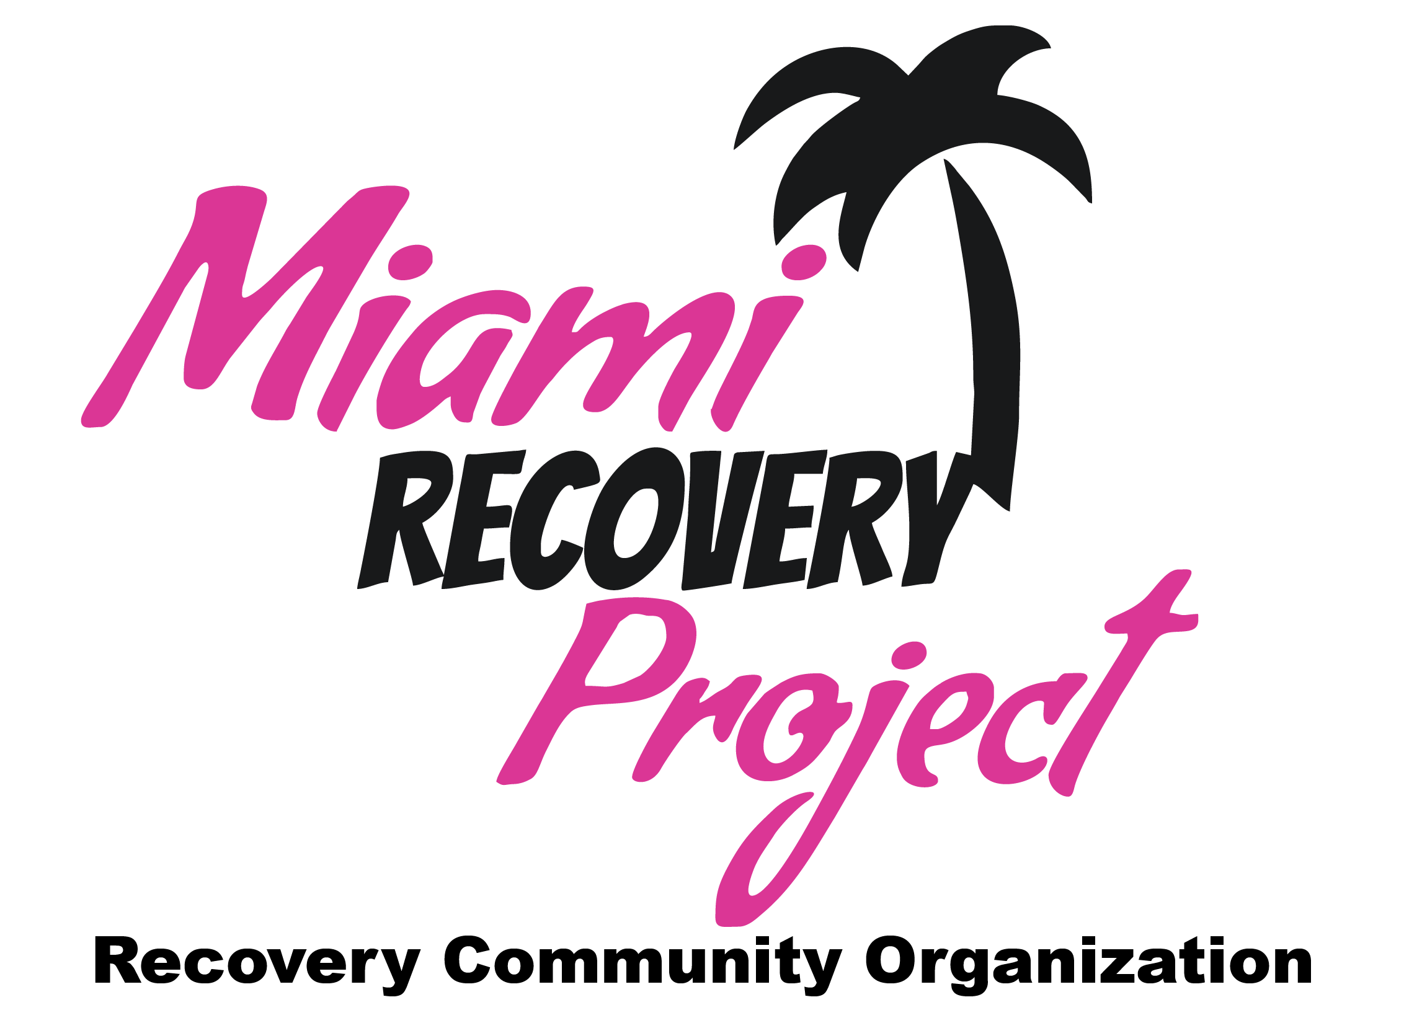




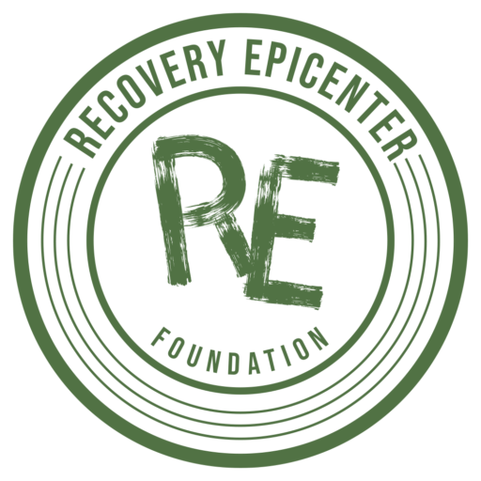
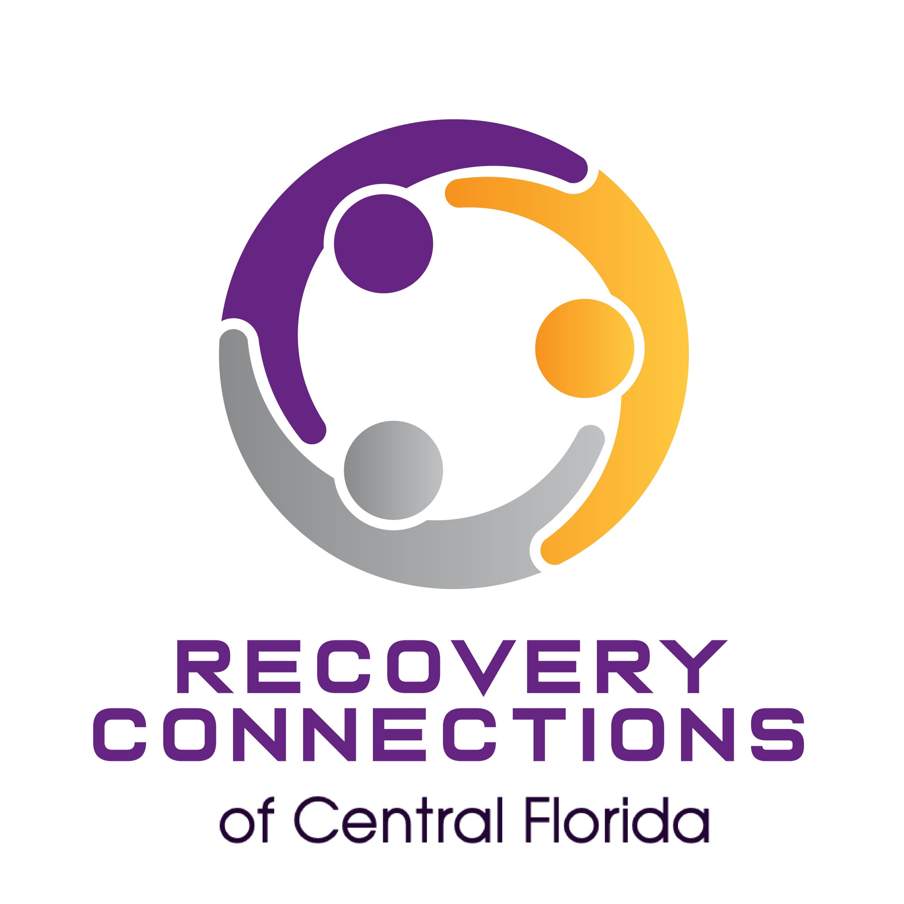

Our Network

Slide 49
PROJECT: REBIRTH HQ SUPPORT INCLUDES:
1. Trains an RCO and its Peer Specialists to navigate the recovery related resources for Veterans and First Responders.
2. Facilitates training for its core curriculums, SAFE Veterans: A Journey from Coping to Thriving by The SAFE Project and ResponderStrong by All Clear Foundation for Emergency Responders.
3. Fosters new and deeper relationships with other for-profit and non-profit organizations, especially key stakeholders and political allies, because of the US trend to assist Veterans and First Responders.
4. Expands the ability for the RCO to qualify and apply for Grants and Awards the RCO would not have been able to previously, supported by a robust, data driven program.
5. Provides money and training for full time Veteran designated Peer Specialist hires, who can work other cases as well, increasing the impact of the RCO exponentially.
6. Allows free access to verified resource lists, volunteer management and recruiting cloud software systems, standard reporting methods, custom branding and marketing materials.
7. MOST IMPORTANTLY, access to the network of all Project: REBIRTH Peer Specialists and to HQ to immediately get assistance for navigating cases and resources.

Slide 50
Common Grants
BCOR – “Behavioral Health for Military Service Members and Veterans,
SAMHSA encourages all recipients to address the behavioral health needs of active-duty military service members, returning veterans, and military families in designing and developing their programs and to consider prioritizing this population for services, where appropriate.” – Section 7, Page 14, BCOR 2022 NOFO
Volunteer Florida Fund Grant, 1R Resiliency (DCF), Bob Woodruff Foundation
Overwatch Alliance, Wounded Warrior Project
VA Grants Portal link:
https://www.grants.gov/learn-grants/grant-making-agencies/department-of-veterans-affairs.html

Slide 51
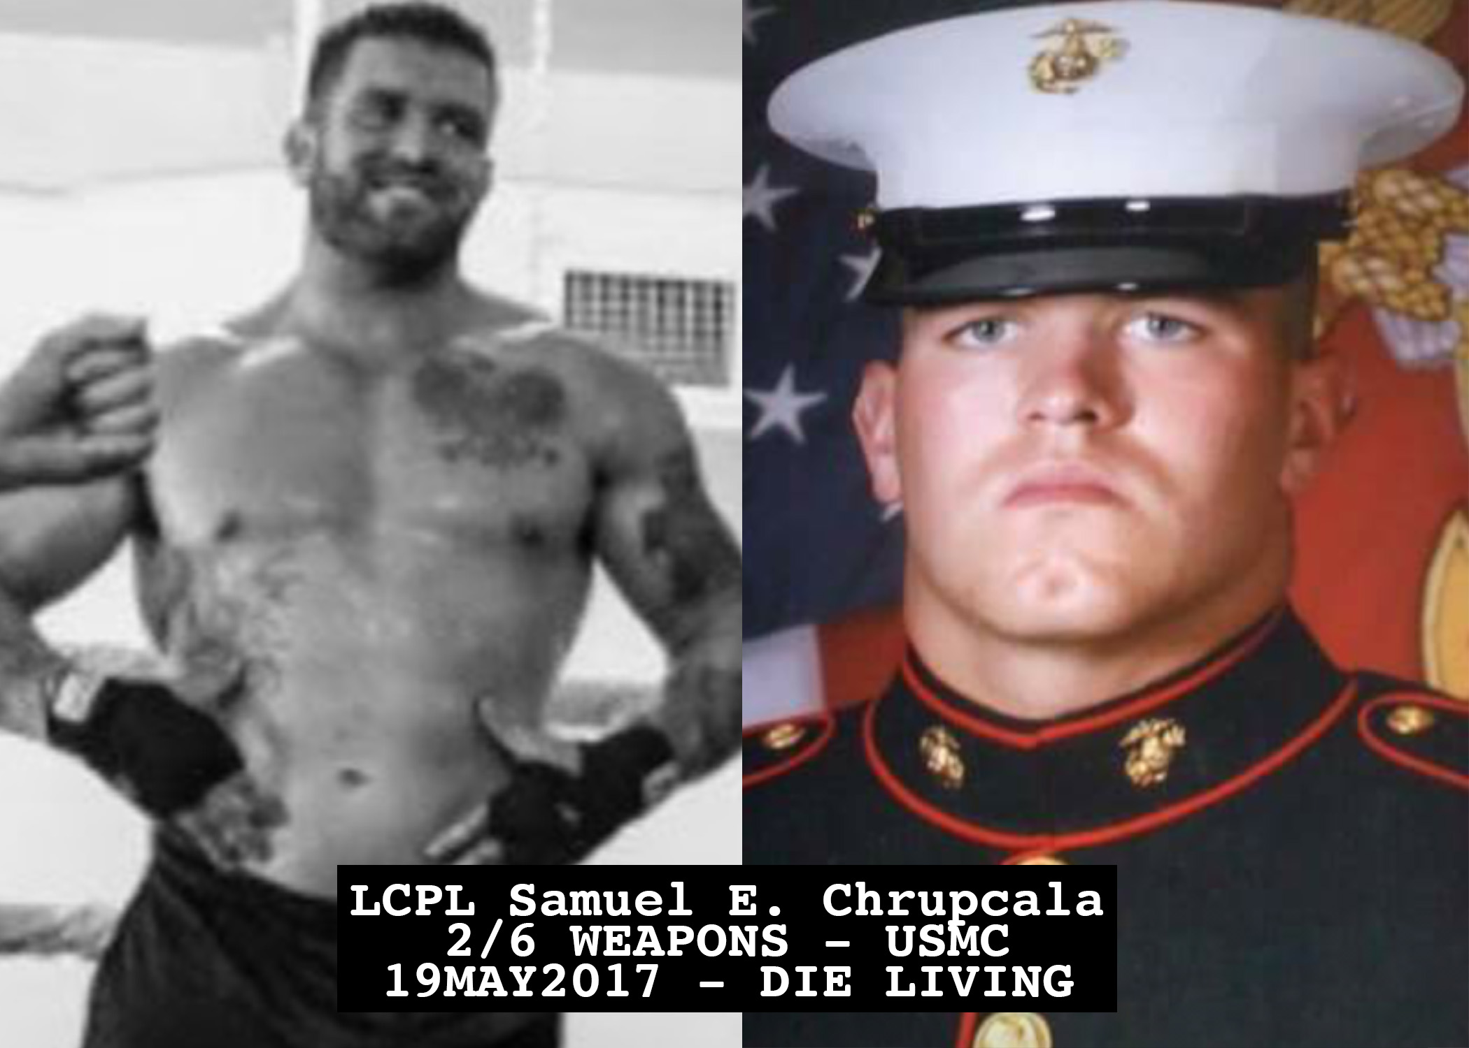
The Lance Corporal Sam Chrupcala
Peer Specialist Scholarship
The “Sam Scholarship”
Will cover the fees for training and applications for Veterans & First Responders who have a current duty position that qualifies for supervised hours, or a “sponsoring organization” such as an RCO.
Not limited to people in recovery from Substance Misuse, and MH Recovery qualifies.
Individual must meet the minimum requirements for Certification in their state.

Slide 52
Partnerships and Allies

Slide 53

Core Curriculum – The SAFE Project’s
“Veteran Wellness: Journey from Coping to Thriving”
SAFE Project’s “Veteran Wellness: Journey from Coping to Thriving” is a program created to help active-duty members separating from the service or for veterans that have already left the service.
The program was made by and for veterans and provides each attendee with individualized tools to navigate the loss of connection and mental health challenges associated with separating from military service. Furthermore, this program helps transitioning members and veterans understand the importance of resilience, help-seeking approaches, and how to get the best use of the benefits they have earned.

Slide 54
Florida National Guard
Partnership with Florida National Guard is vital for the advancement of mental health directives for their Soldiers. FLNG was named the NGB Red Ribbon Week winner of the year for 2022 by the Department of the Army, particularly due to its community collaboration and the inclusion of a stigma reduction campaign crafted to reduce the shame associated with substance use disorders and mental illness.
Army Substance Abuse Program (ASAP) and Prevention & Outreach Coordinators are main POCs
Nov 16th to 18th Project: REBIRTH trained 70 Unit Prevention Leaders (NOCs and Officers) on Narcan administration, providing over 160 doses to the individual unit leaders.
Project: REBIRTH trained 70 UPLs on what a CRPS is, does, and how to become certified
Project: REBIRTH trained 70 UPLs on what RCOs are, where to find us, and how to utilize RCOs for their soldiers and their families who are seeking recovery.
RCOs bridge a major gap in services for a majority of FLNG Soldiers

Slide 55
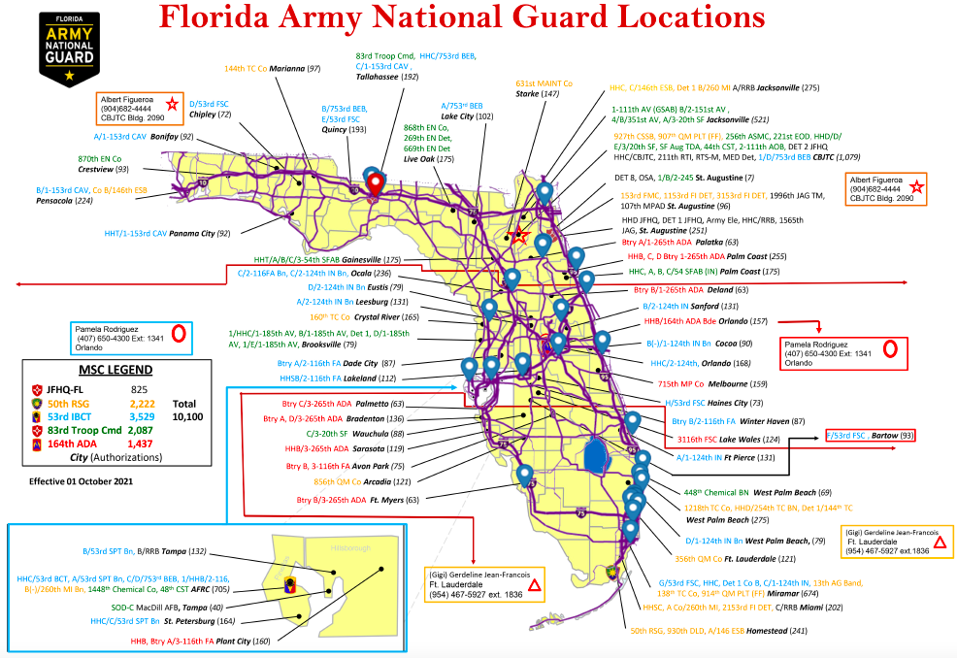

Slide 56
Recovery is supported through relationship and social networks
An important factor in the recovery process is the presence and involvement of people who believe in the person’s ability to recover; who offer hope, support, and encouragement; and who also suggest strategies and resources for change.
Family members, peers, providers, faith groups, community members, and other allies form vital support networks. Through these relationships, people leave unhealthy and/or unfulfilling life roles behind and engage in new roles (e.g., partner, caregiver, friend, student, employee) that lead to a greater sense of belonging, personhood, empowerment, autonomy, social inclusion, and community participation.
SAMHSA Definition of Recovery – PEP12-RECDEF

Slide 57
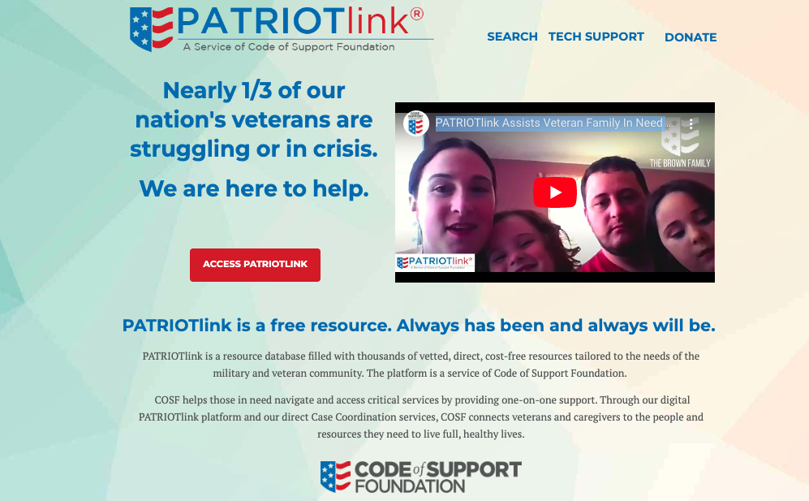

Slide 58
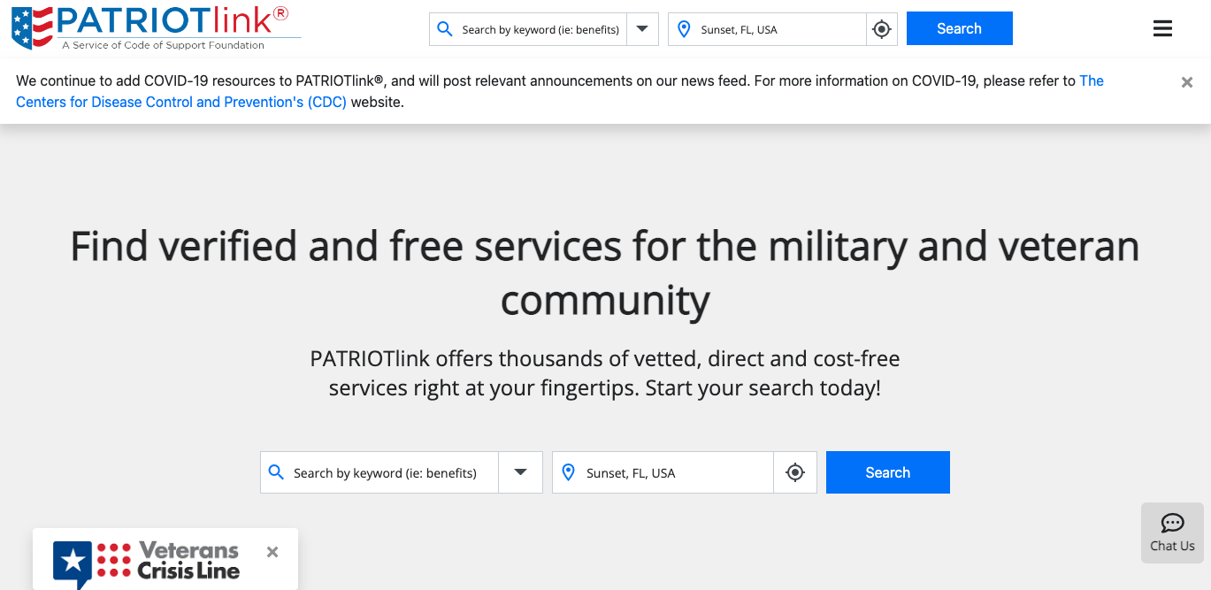

Slide 59
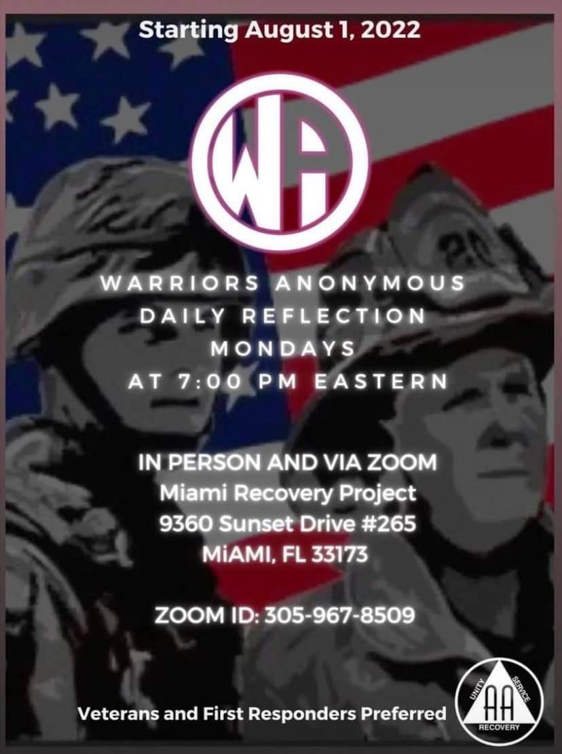
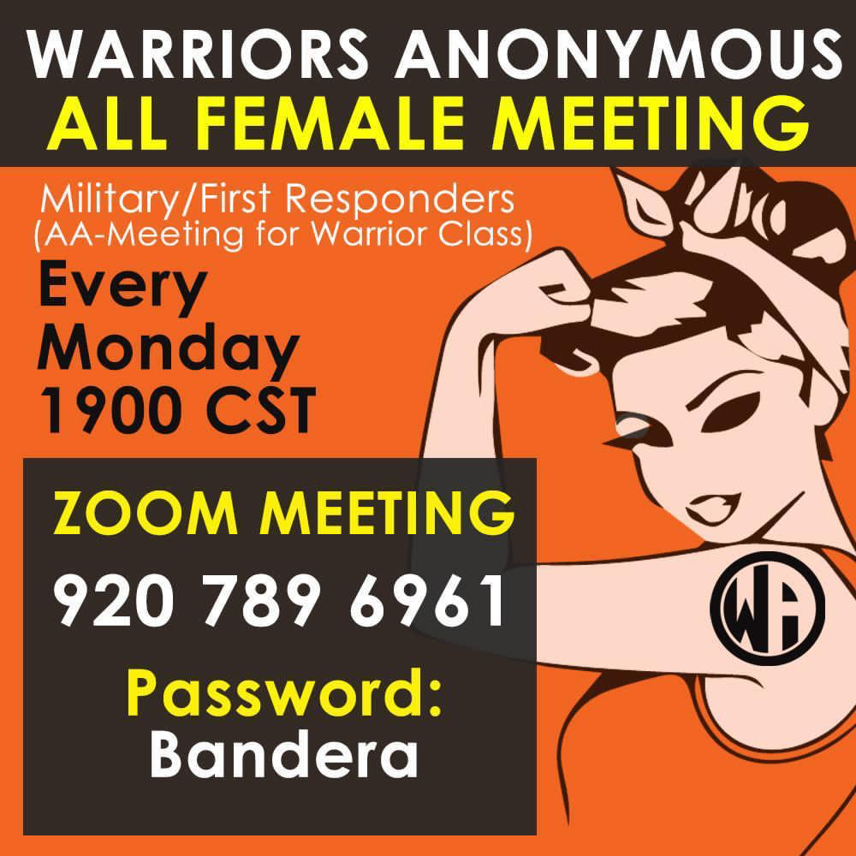
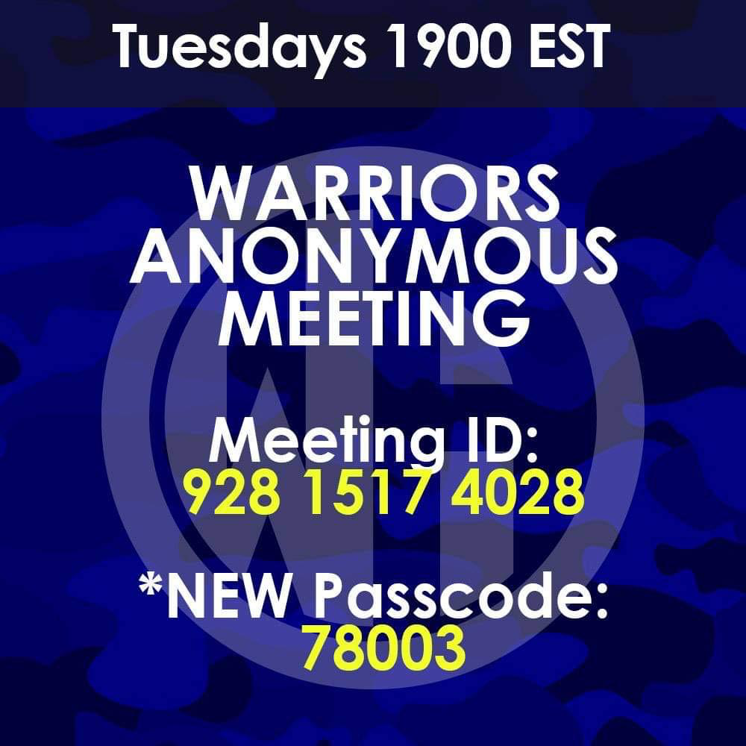
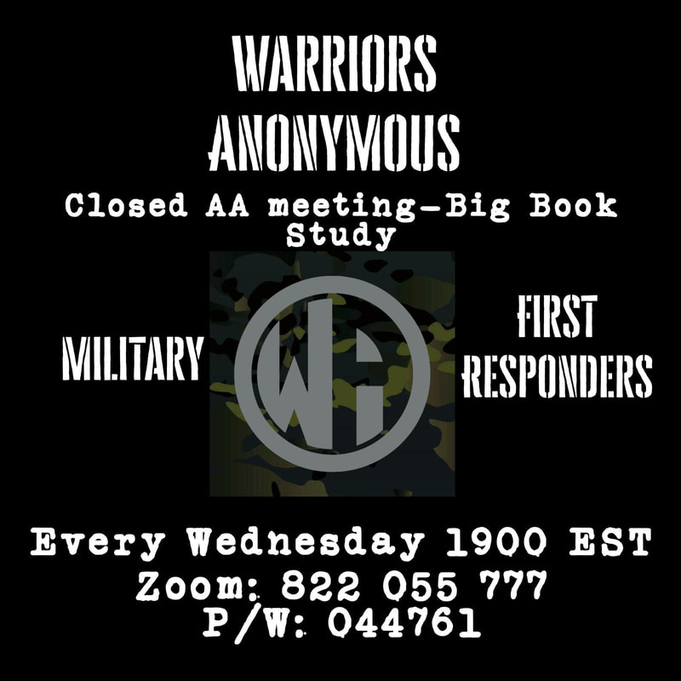
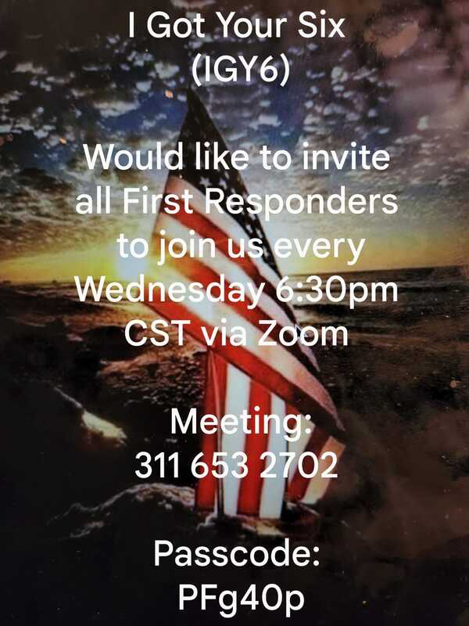
Warriors Anonymous
​Warriors Anonymous is recognized by AA World Services as a specialty group for Warriors (active military, Veterans, and First Responders) who are in recovery from a drinking/drug problem. Warrior Recovery is here to help grow the Warriors Anonymous community through connecting Warriors in recovery.
WarriorRecovery.Net
Continuously updated site with list of in person and virtual Mutual-Aid group meetings

Slide 60
SMART For Veterans & First Responders
The word SMARToon was coined by a participant in the specialized veterans and first responders (VFR) meetings created a little more than a year ago. It combines SMART and platoon to indicate a large group of individuals working together toward a common goal. And that is exactly what VFR is (with the name including military overtones): a group of individuals using SMART’s practical tools and mutual support to address their addictions–together.
https://www.smartrecovery.org/veterans/
https://community.smartrecovery.org/community/
(One Pager for SMART VFR is in the drive)

Slide 61
Key Partners
The SAFE Project
Wounded Veterans Relief Fund (WVRF)
Wounded Warrior Project
Team Red, White and Blue (Team RWB)
The Mission Continues
Team Rubicon
Iraq & Afghanistan Veterans of America (IAVA)
Disabled American Veterans (DAV)
American Legion
Florida Department of Veterans Affairs
Local Student Veterans Alliances (SVA)
All Clear Foundation
Behind The Badge
Local Unions for 1Rs
Under the Shield
Warriors Heart
Warriors Anonymous
Warrior Wellness
Hero’s Mile
Certified Event Interventionist Network @ ATC
Veterans Courts/Treatment Courts

Slide 62
Family/Ally Support
RCO
CRISIS PATHWAY
911/988/ER/VA ER
Project: REBIRTH
Vet/1R Treatment Centers
VA/NATL CRISIS HOTLINE
HOUSING FIRST MODEL
IAVA QRF/ WWP EFA TEAM
SAFE PROJECT - Veteran Wellness: Journey from Coping to Thriving
ResponderStrong: All Clear Foundation 1st Responder Core Curriculum
Veteran Peer Support Services
Dept of
Veterans
Affairs
(State & Federal)
Program Partners/
Key Stakeholders
LEO
And Fire
Unions/
Local Agencies & Depts
First Responder Peer Support Services
Education
Vocational
Mental Health
Physical/Medical
Nutrition
Spiritual/Recovery
Socialization
Community Service
College Campuses/SVA
Veteran Treatment Courts
United Way/Mission United
Local Military Installations
Community Health Partners
Targeted Service NonProfs
Non-Traditional Therapies
Education
Vocational
Mental Health
Physical/Medical
Nutrition
Spiritual/Recovery
Socialization
Community Service

Slide 63
When In Doubt…
REACH OUT!

Slide 64
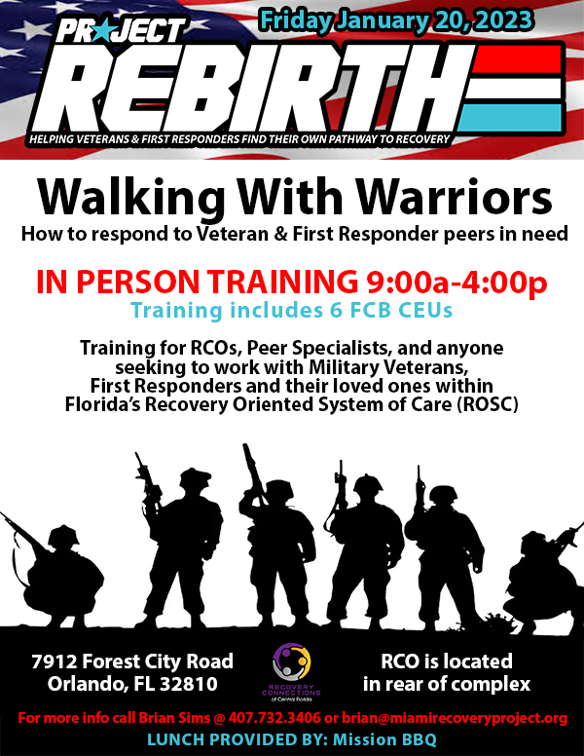

Slide 65
2022 Accomplishments
April 2022, Project: REBIRTH Founded
May to Oct 2022, Recovery Epicenter Foundation, South Florida Wellness Network, Volusia Recovery Alliance, Recovery Connections of Central Florida sign MOUs to join affiliate network
August 2022, SAFE Project and All Clear Foundation partnerships agreed upon by all parties
Sept 11, 2022, Director Brian Sims speaks at MDC 9/11 Memorial Event about Rebirth
September 2022, Partnership with Florida National Guard Initiated
November 2022, SoldierRush Parkland partnership executed, with outreach to over 800 participants on-site
November 2022, Faces & Voices/ARCO All Member Call Presentation
November 2022, First TX Affiliate Onboarded - OUTSIDERS ANONYMOUS (Founded by Army Veteran)
November 2022, 70 FLNG Unit Prevention Leaders trained in Narcan use (with 280 doses distributed for deployment) as well as who RCOs are, where they are, and what our partnership does to bridge their services gap
Dec 7 2022, Project: REBIRTH has facilitated detox and/or treatment for 8 Veterans; increased the Recovery Capital for 19 Veterans & First Responders, alongside facilitating benefits navigation for 6 Veterans who do not identify as having a Substance Misuse issue but do identify as having trauma and/or other related service-connected issues.

Slide 66
2023 Vision
National Guard Partnership Expansion for ALL RCOs in Florida
Grants & Awards to Sub-Grant to PR Affiliates (via WWP, Gary Sinise, Bob Woodruff, VA, DCF)
Facilitate Bi-annual SAFE Veterans training (starting in FEB 2023 @ SFWN) and ReponderStrong Training
Onboard affiliates in 4 other states & 5 more Florida RCOs (including WWW Training)
Assist via “Sam Scholarship” the addition of 3 more CRPS-Vs to the FL RCO workforce

Slide 67
2023 Vision
Addition of W3 Trained CRPS-Vs to 3 Veteran Treatment Courts in FL
Increase the Recovery Capital for 100 Veterans, First Responders, and/or their loved ones via PR Affiliates
Addition of “-1R” Endorsement by FCB for First Responder Certified Recovery Peer Specialists
NAADAC Accreditation of W3, potentially expansion into a certification: “C2W3”
Acquire $300,000 for Project: REBIRTH to subgrant to affiliates for program support

Slide 68
2024 Vision
Project: REBIRTH will transition into the
FIRST NATIONAL RCO
with a concentration on support for
Warriors & Warrior Families
while providing support to its affiliate programs across the USA and its territories.

Slide 69
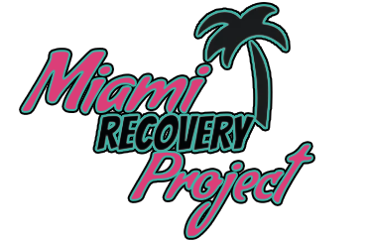
Brian W. Sims, CRPS-V, CEI, GISP
Interim Executive Director, Miami Recovery Project
Director, Project: REBIRTH
US Army Veteran (11B)
Brian@MRPRCO.org
Office: 305.967.8509 Cell: 407.732.3406
www.ProjectRebirth.us
RCO Address: 9360 Sunset Drive #265, Miami, FL 33176

Slide 70
