Slide 1
WELCOME
Peer Recovery Support Services

Slide 2
AFRO-CENTRIC PEER SUPPORT IN THE URBAN AREA

Slide 3
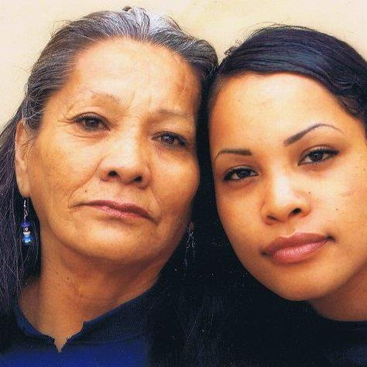
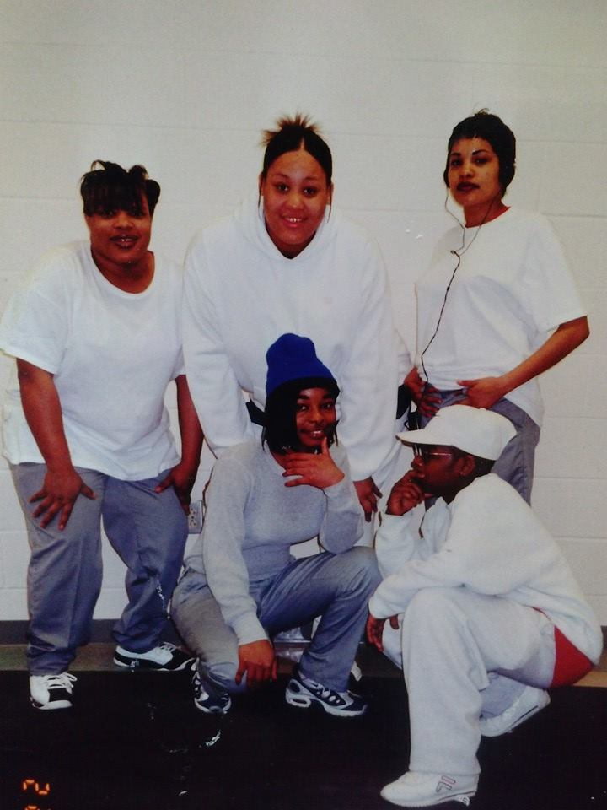
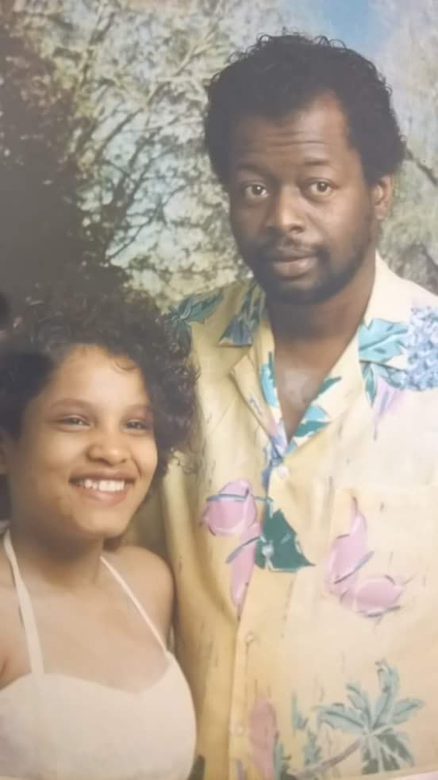
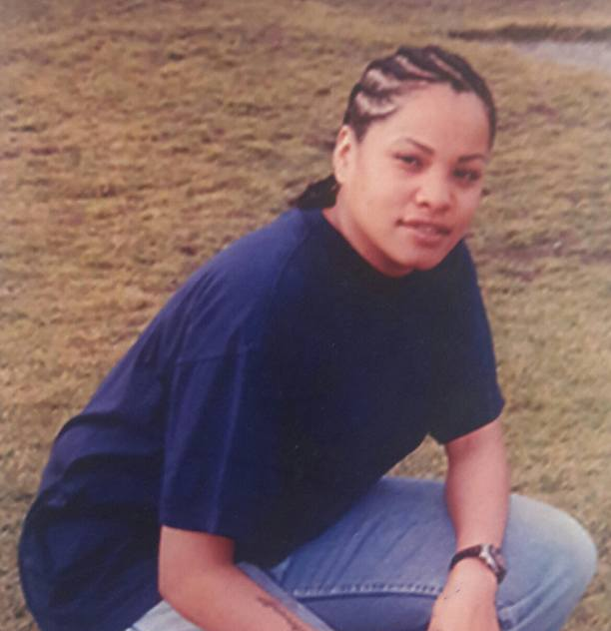
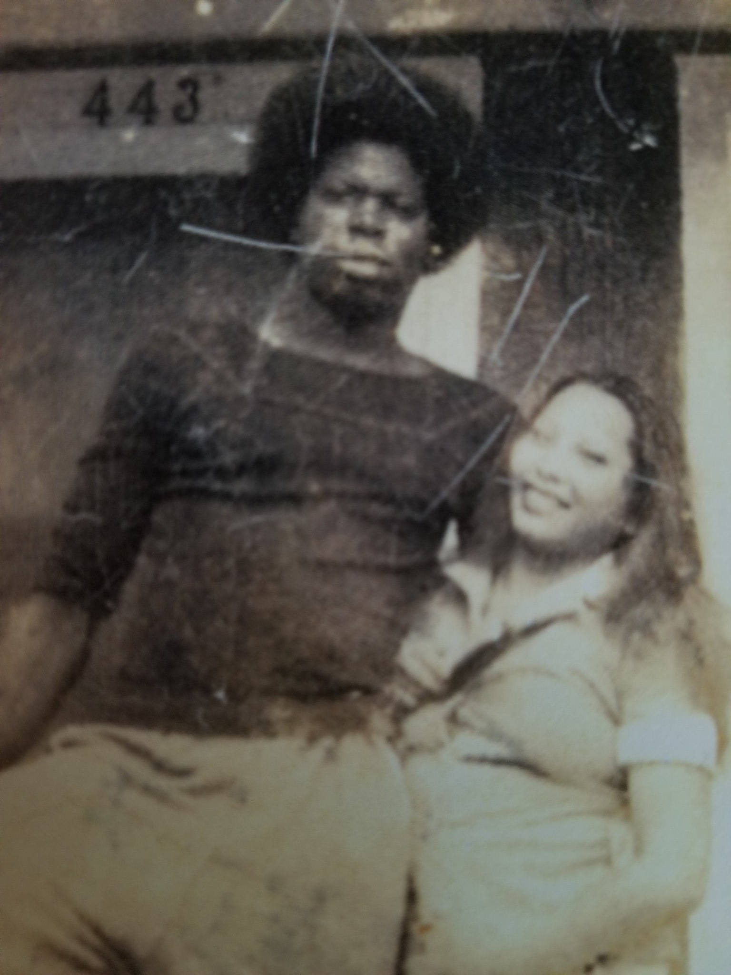
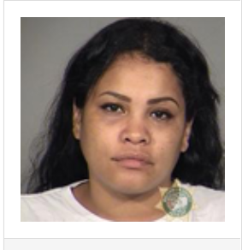
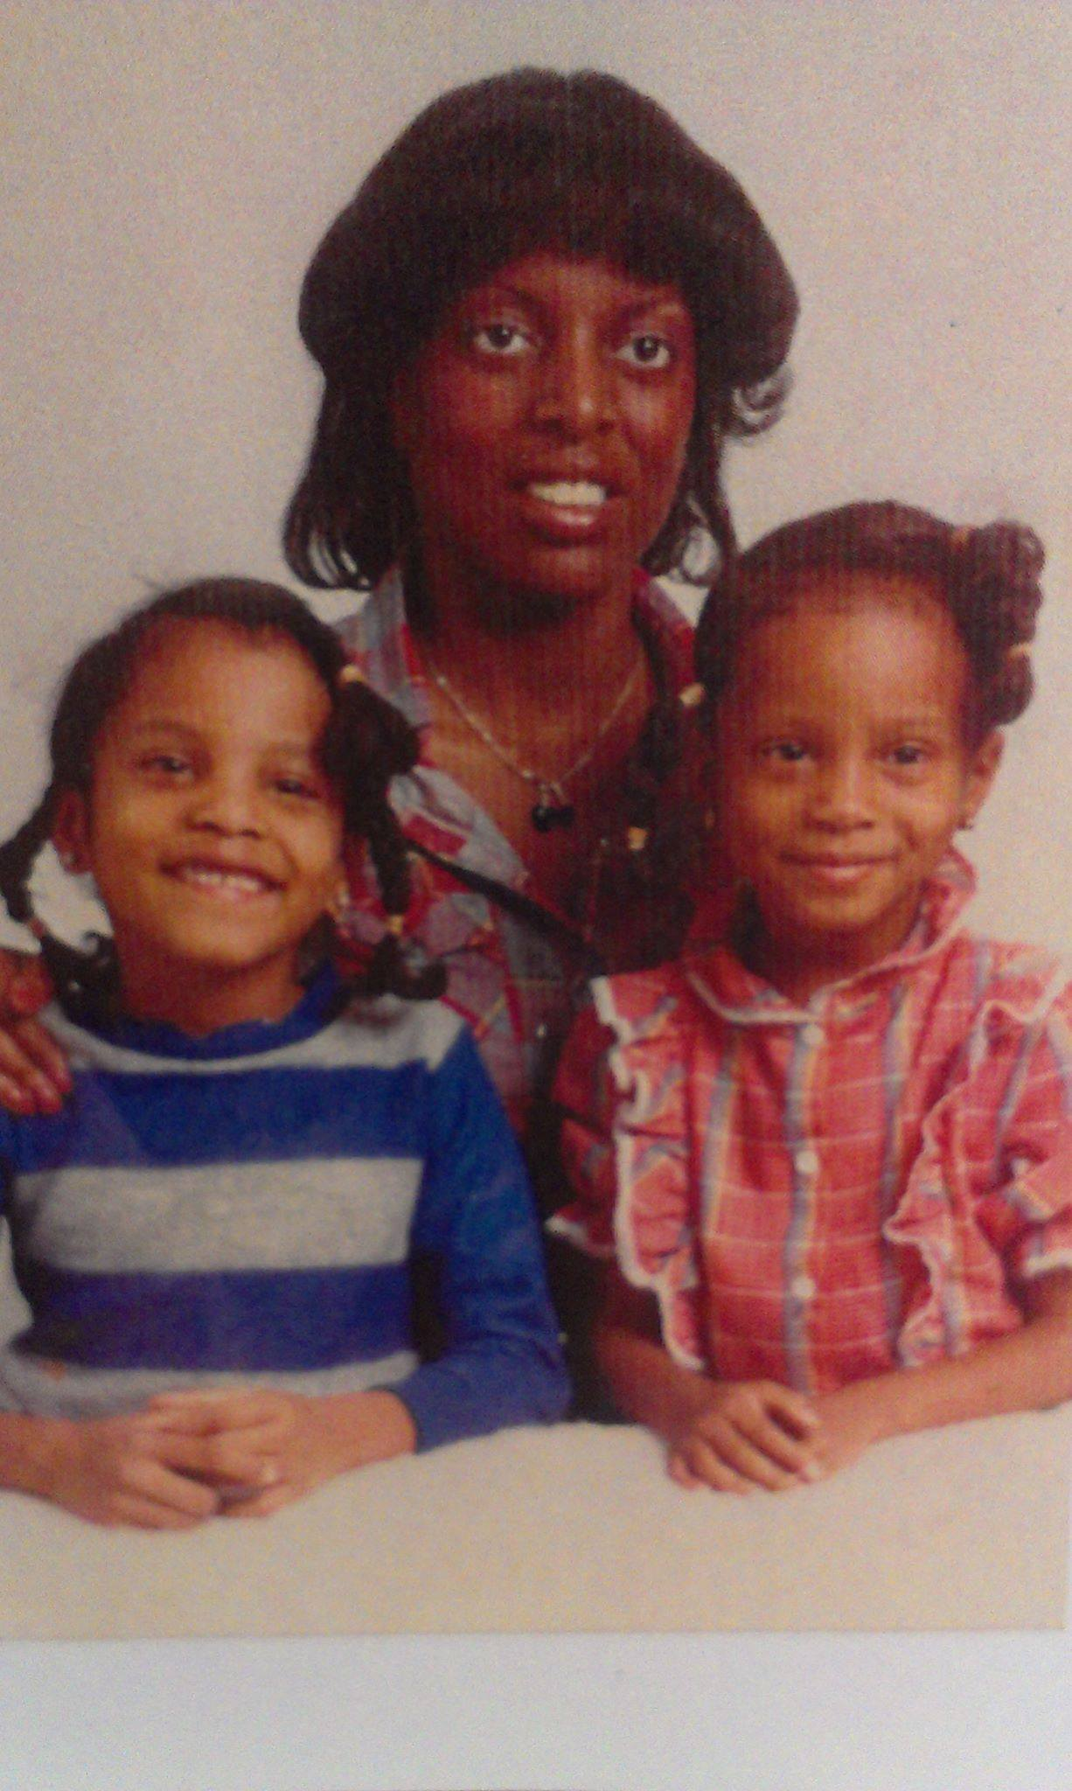
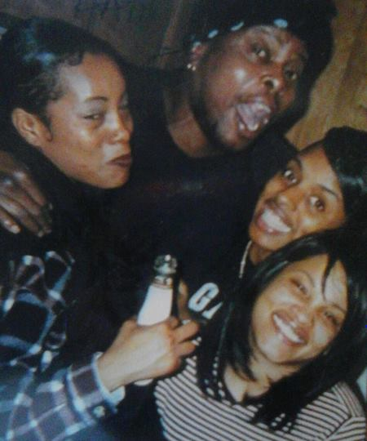
ONesha Cochran- My Story
Notes:
Here we can add our photos and introduce ourselves.

Slide 4
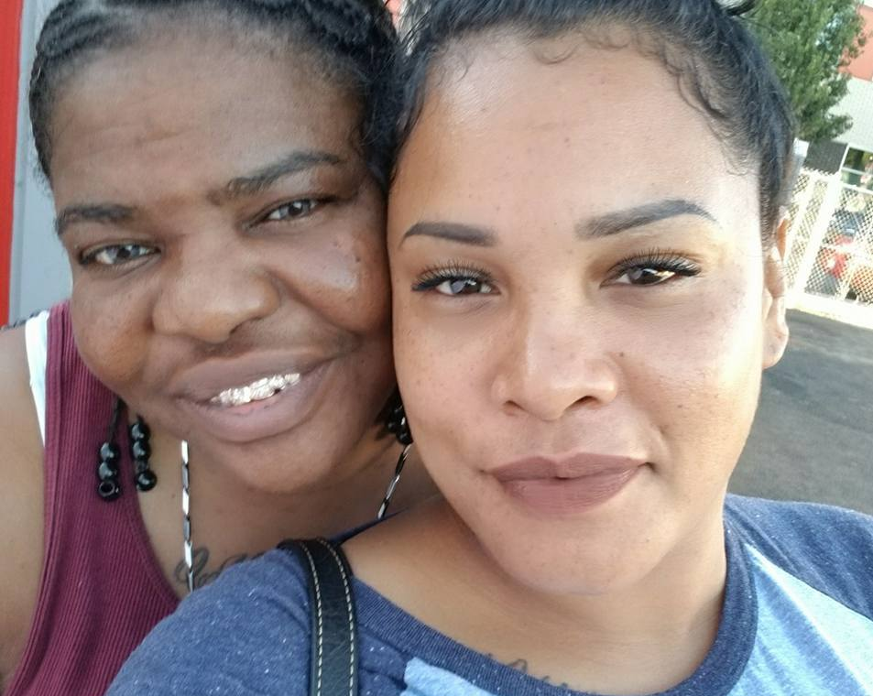
Know your why

Slide 5
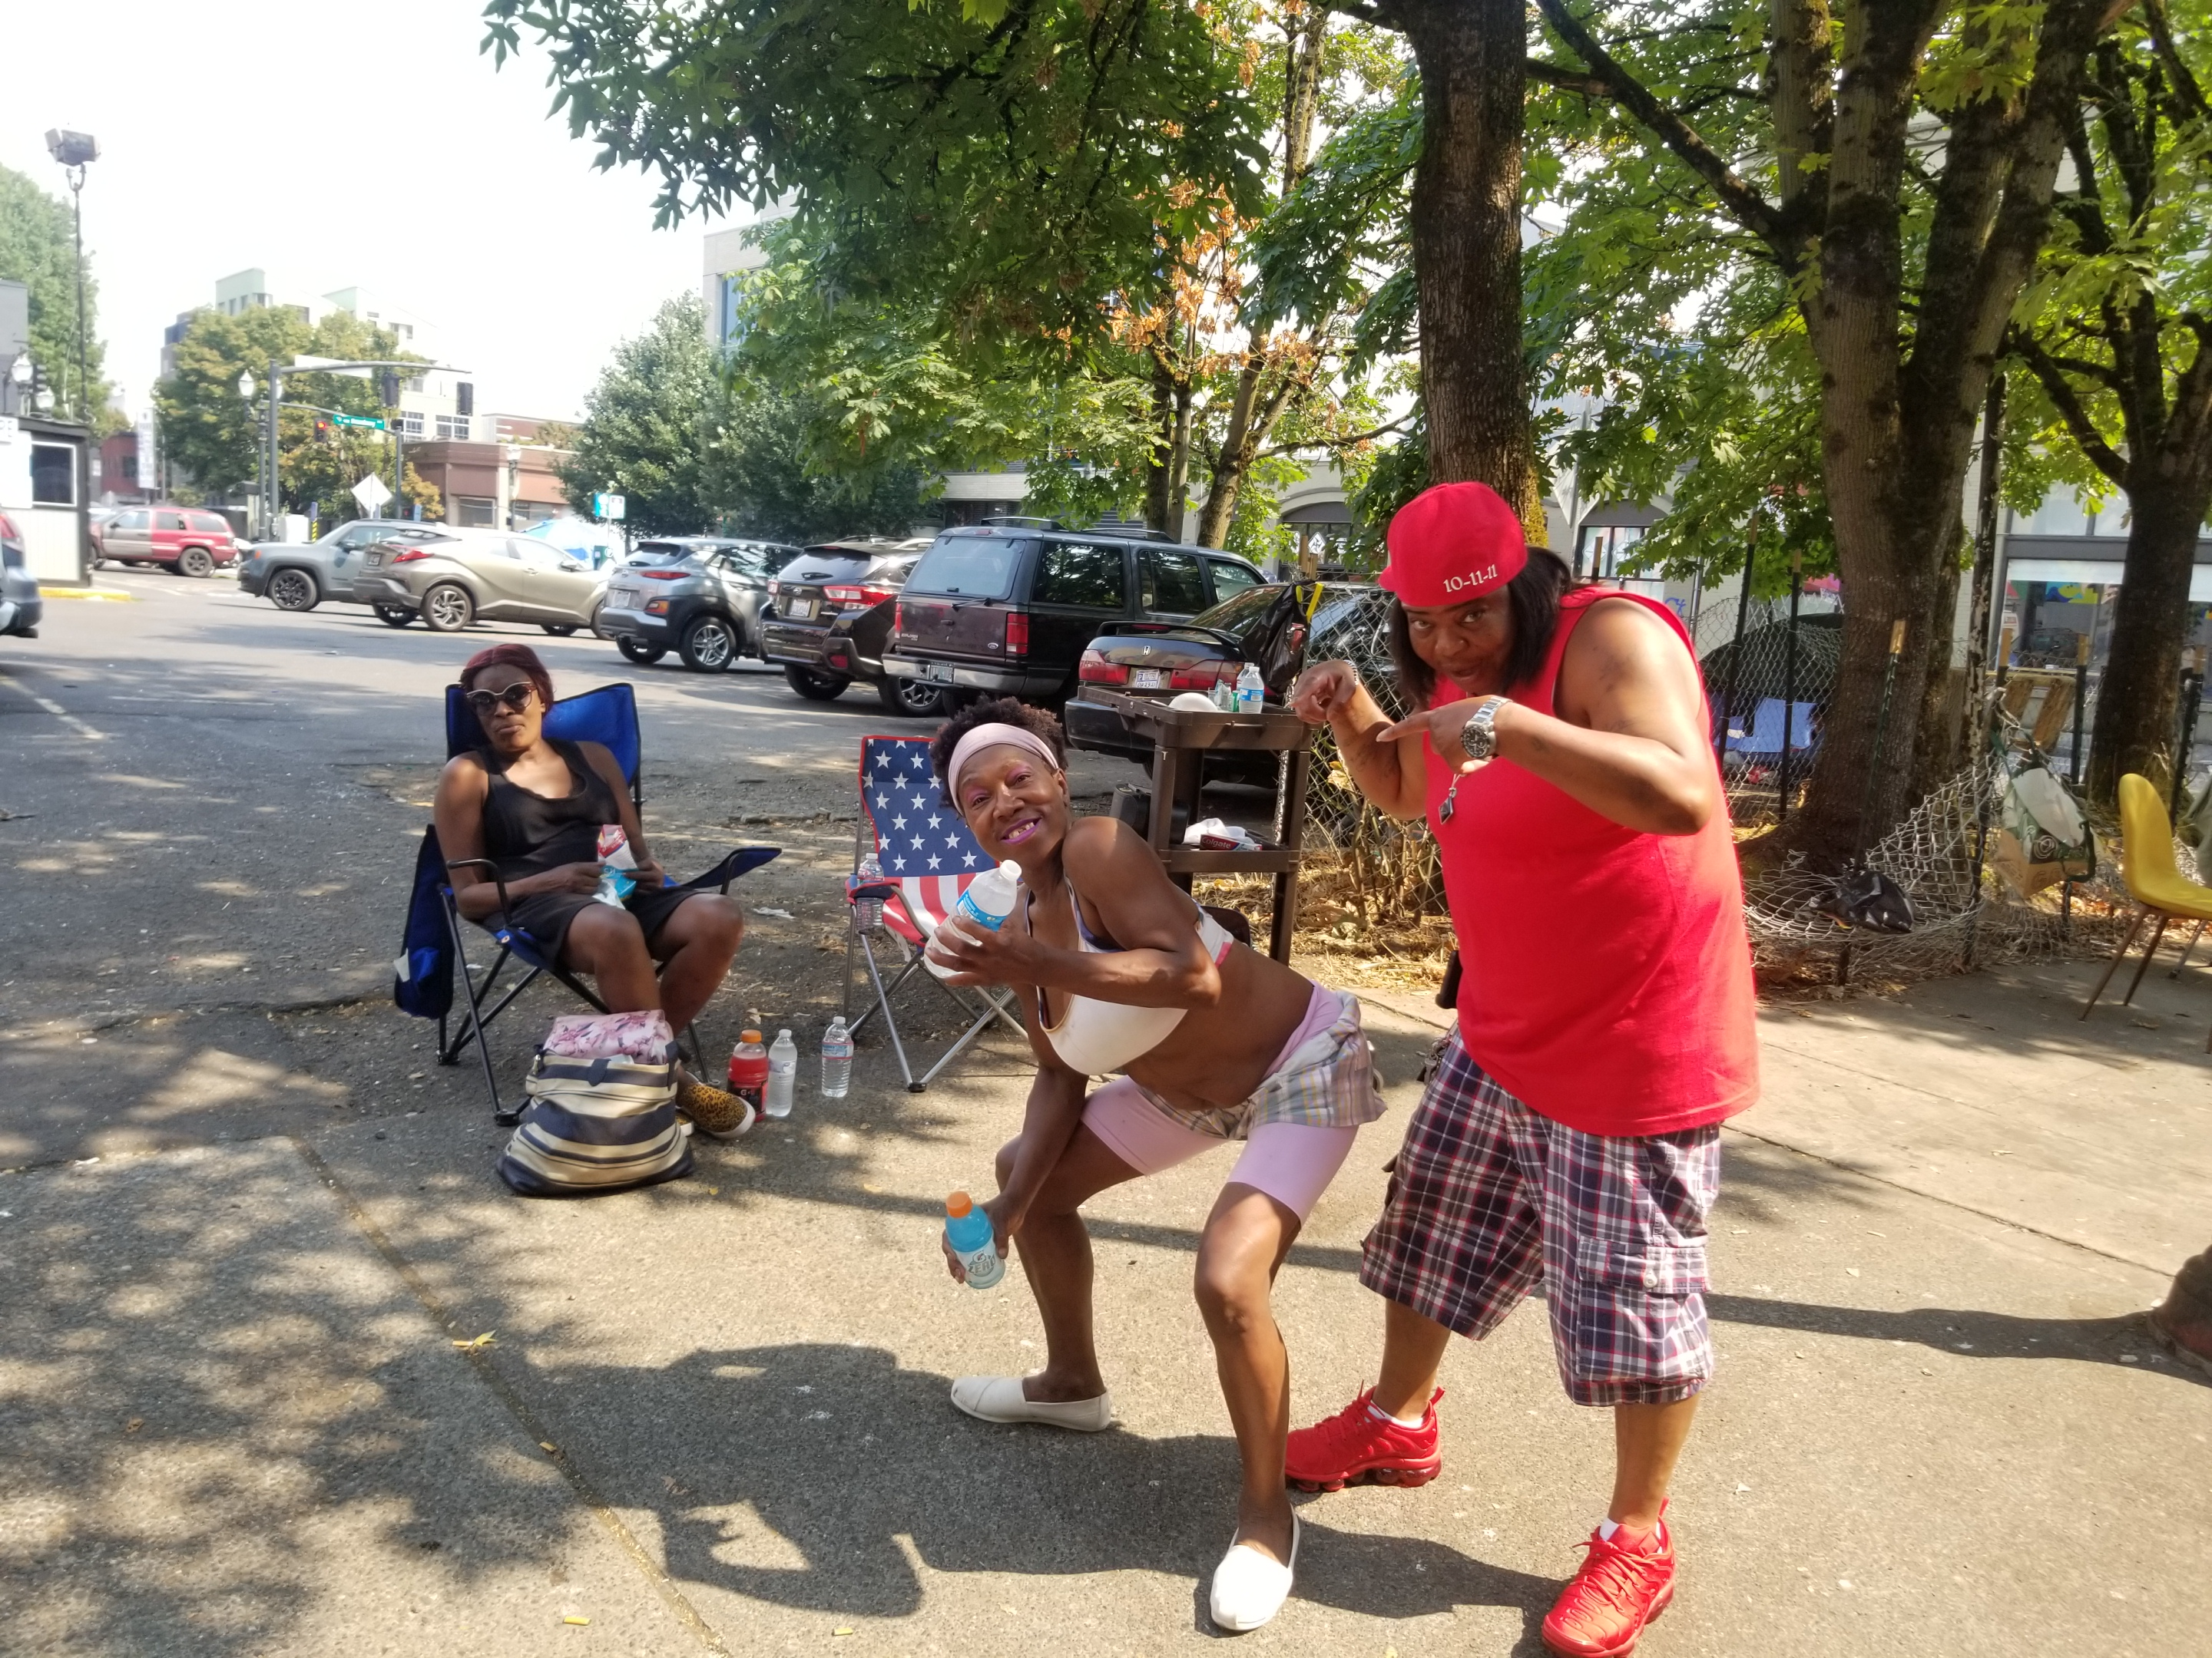
What role does a peer play in reducing harm?
Notes:
Reducing harm promotes healing Meeting people where they are, radically accepting they may not want to be abstinent. Accepting the cultural challenges and stigma people are facing in their lives and sitting with the fact that it may never be our idea standard however it can always be safer and improved

Slide 6
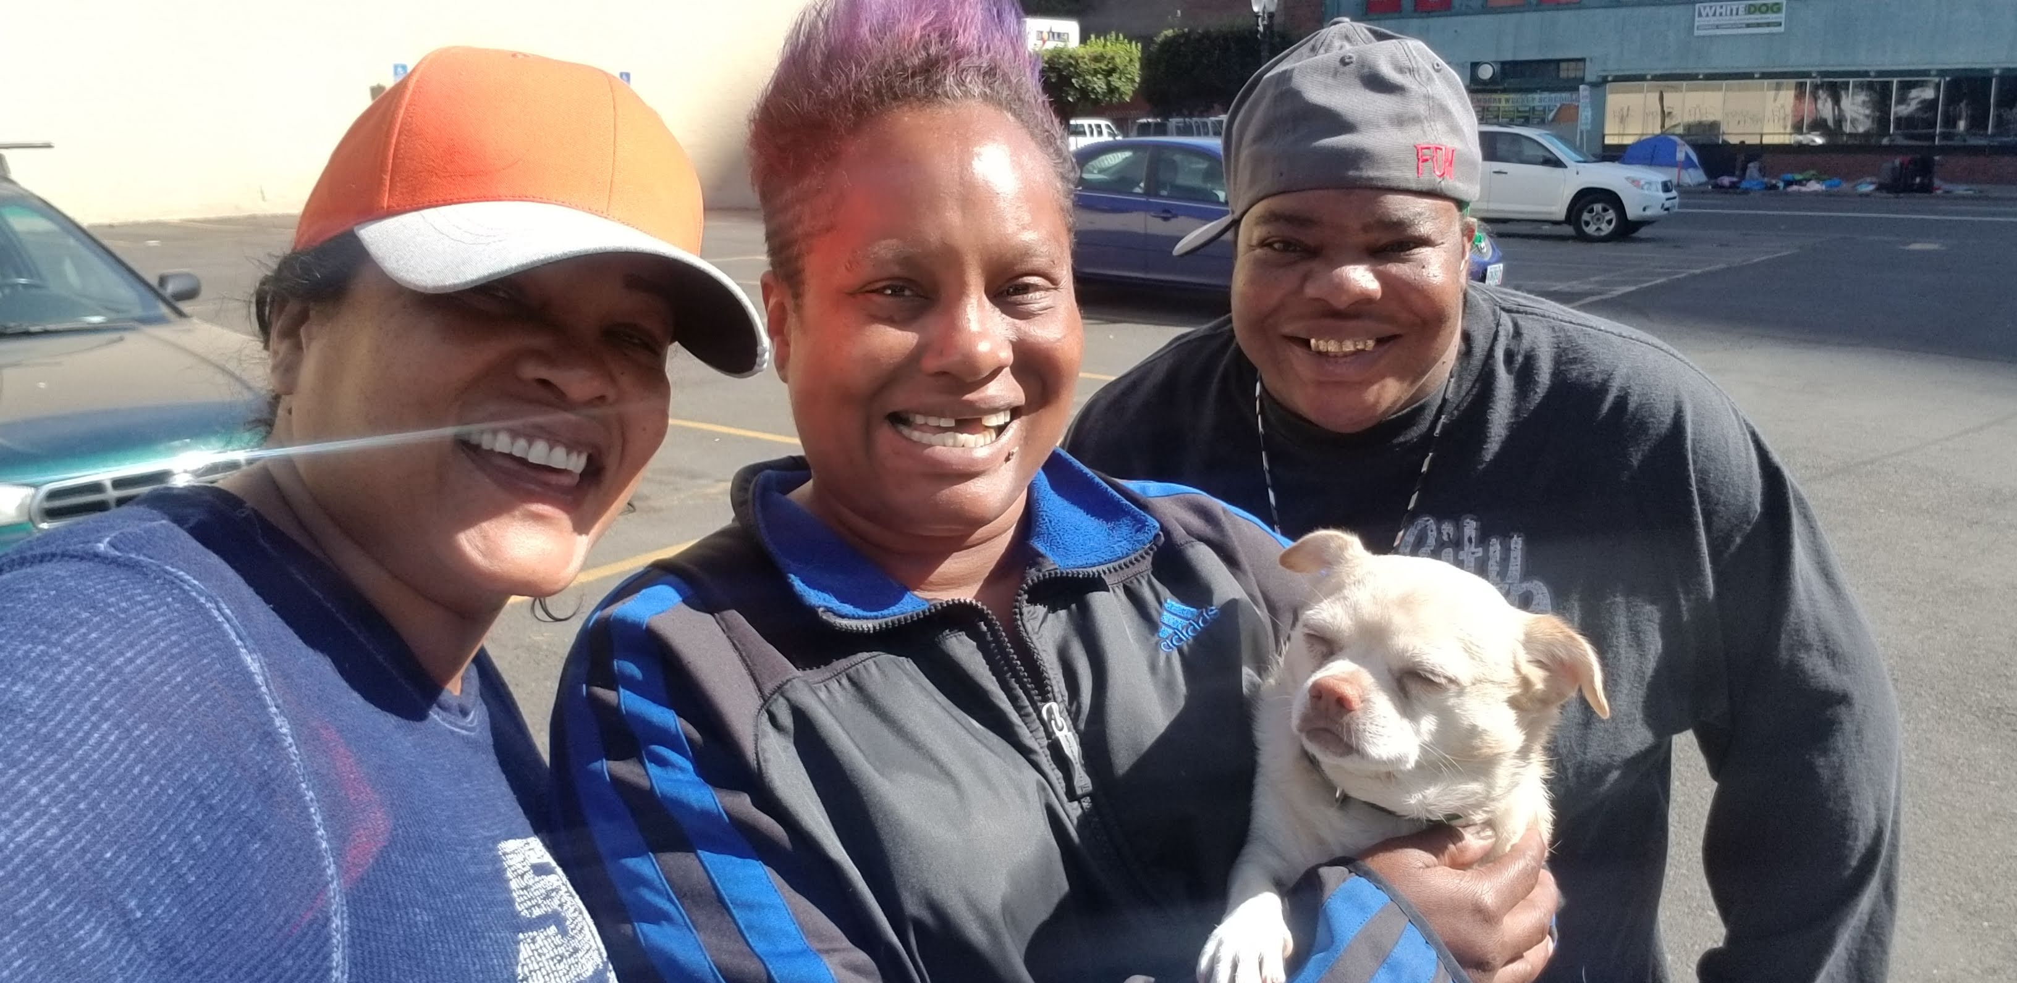
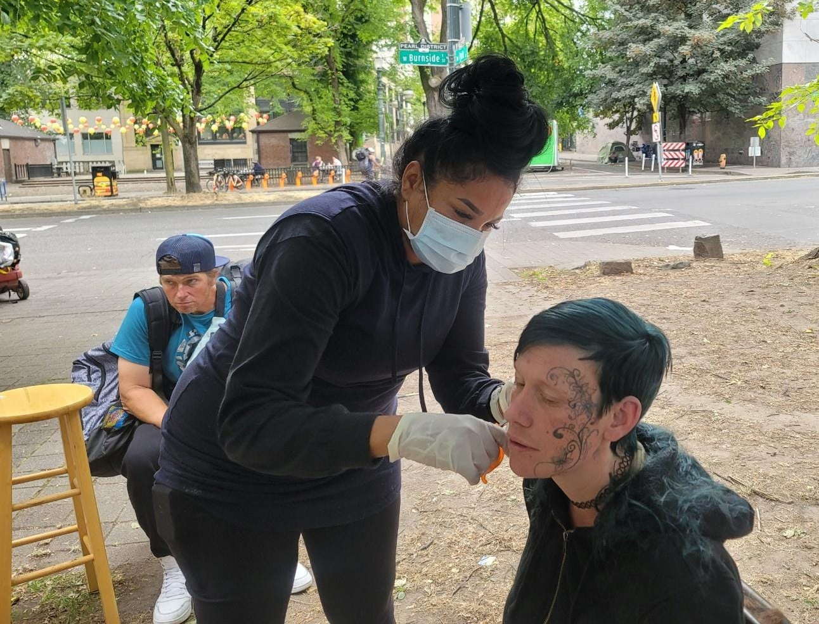
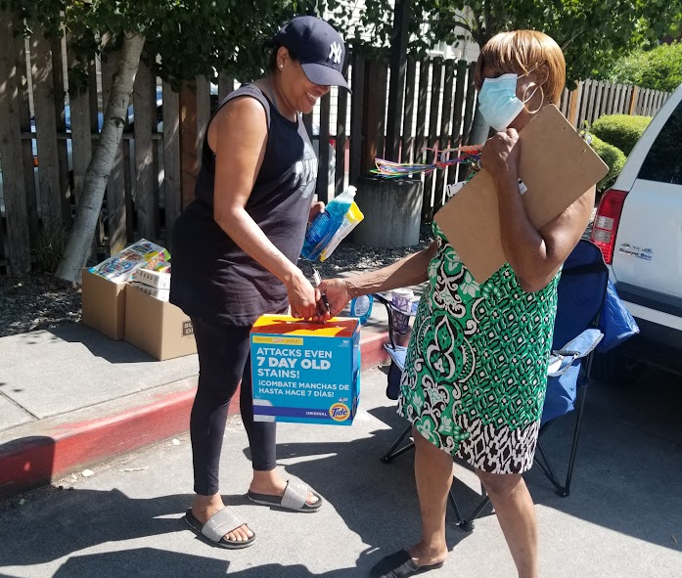
Outreach the Heart of a peer's role
Notes:
Services and Supplies

Slide 7
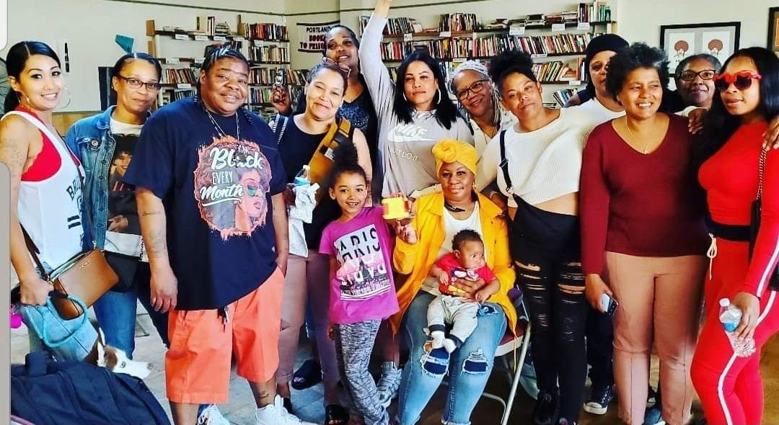
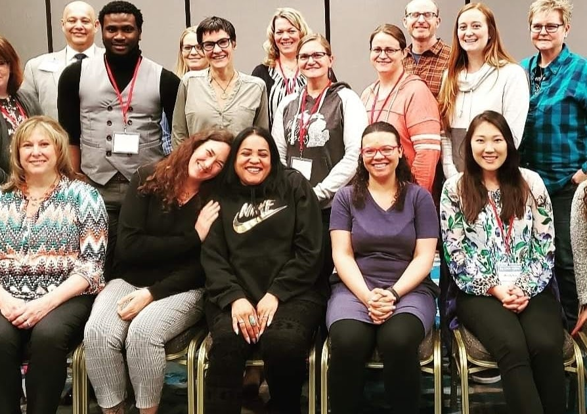
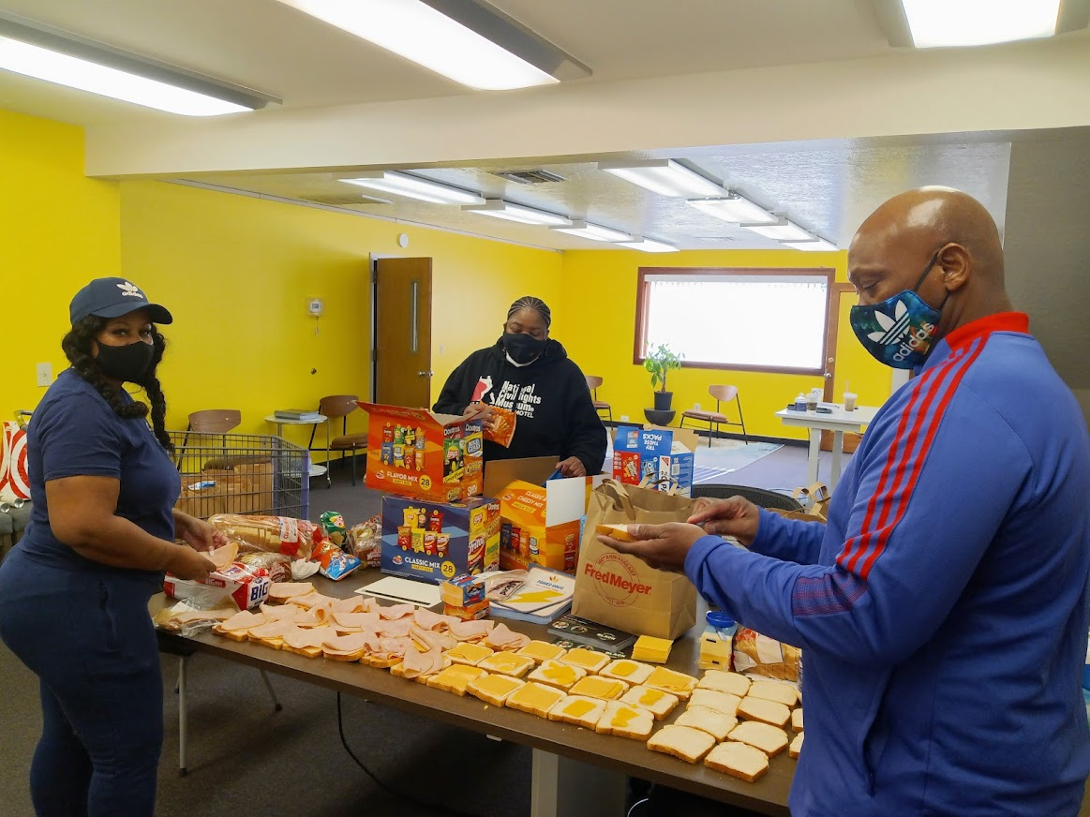
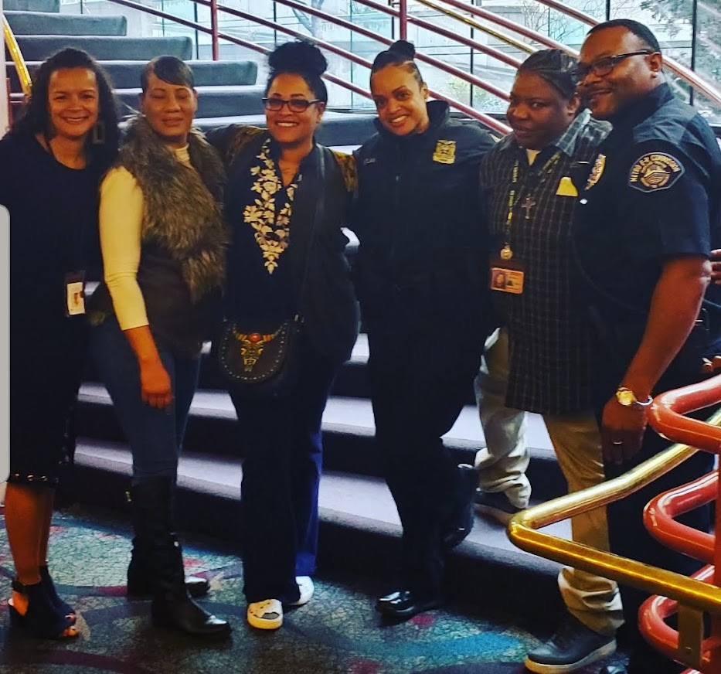
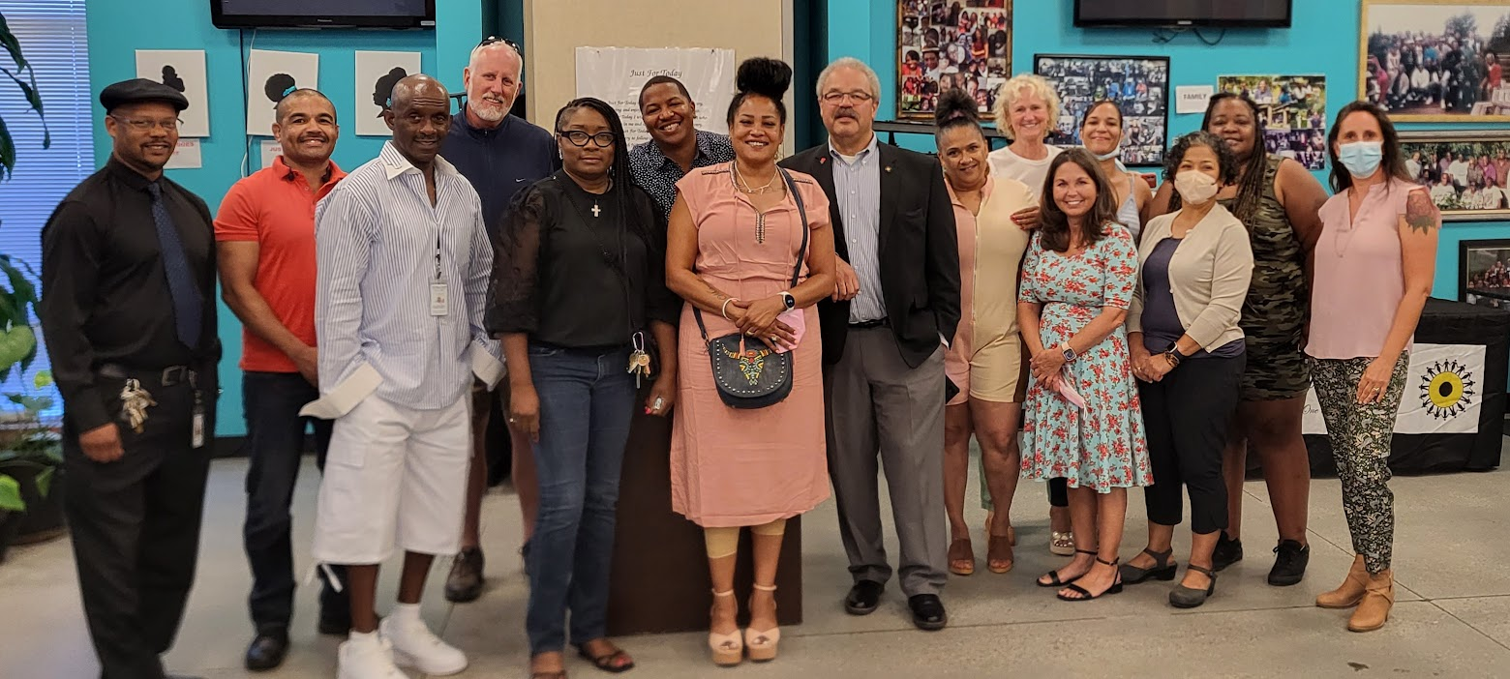
build community everywhere you go

Slide 8
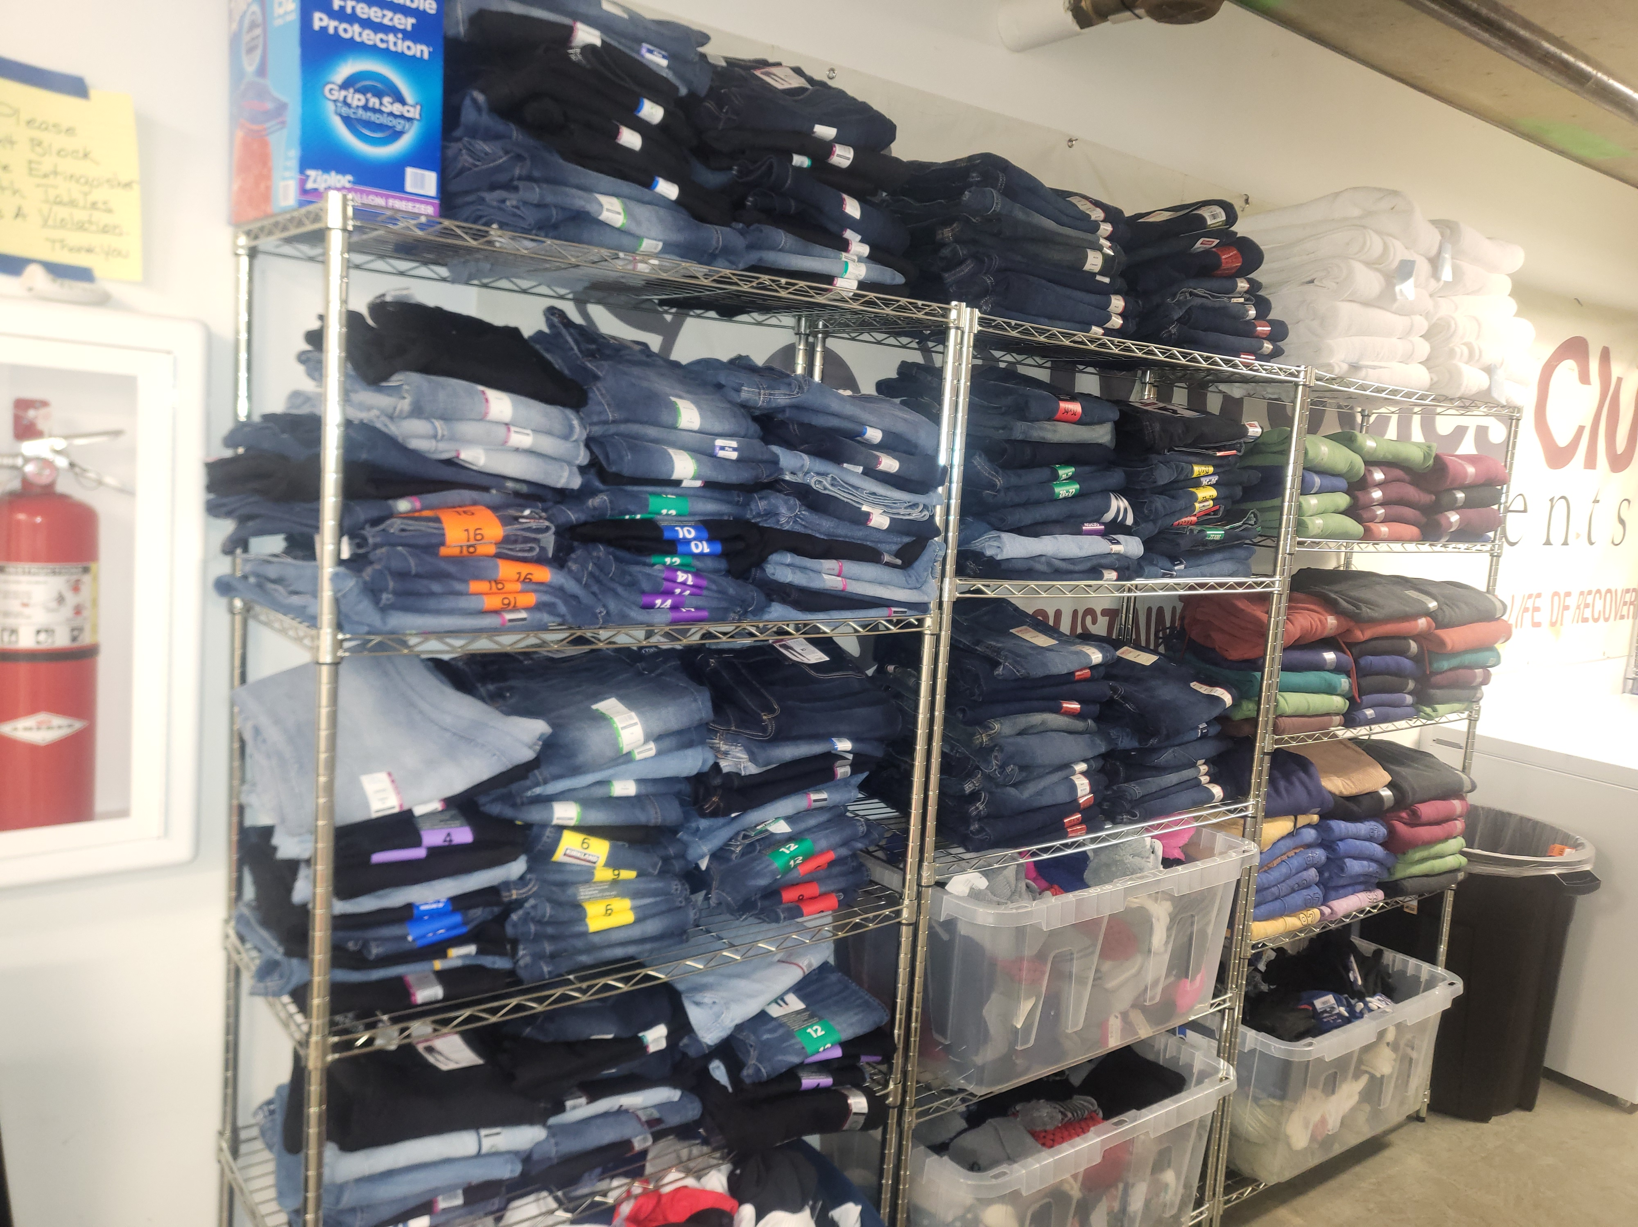
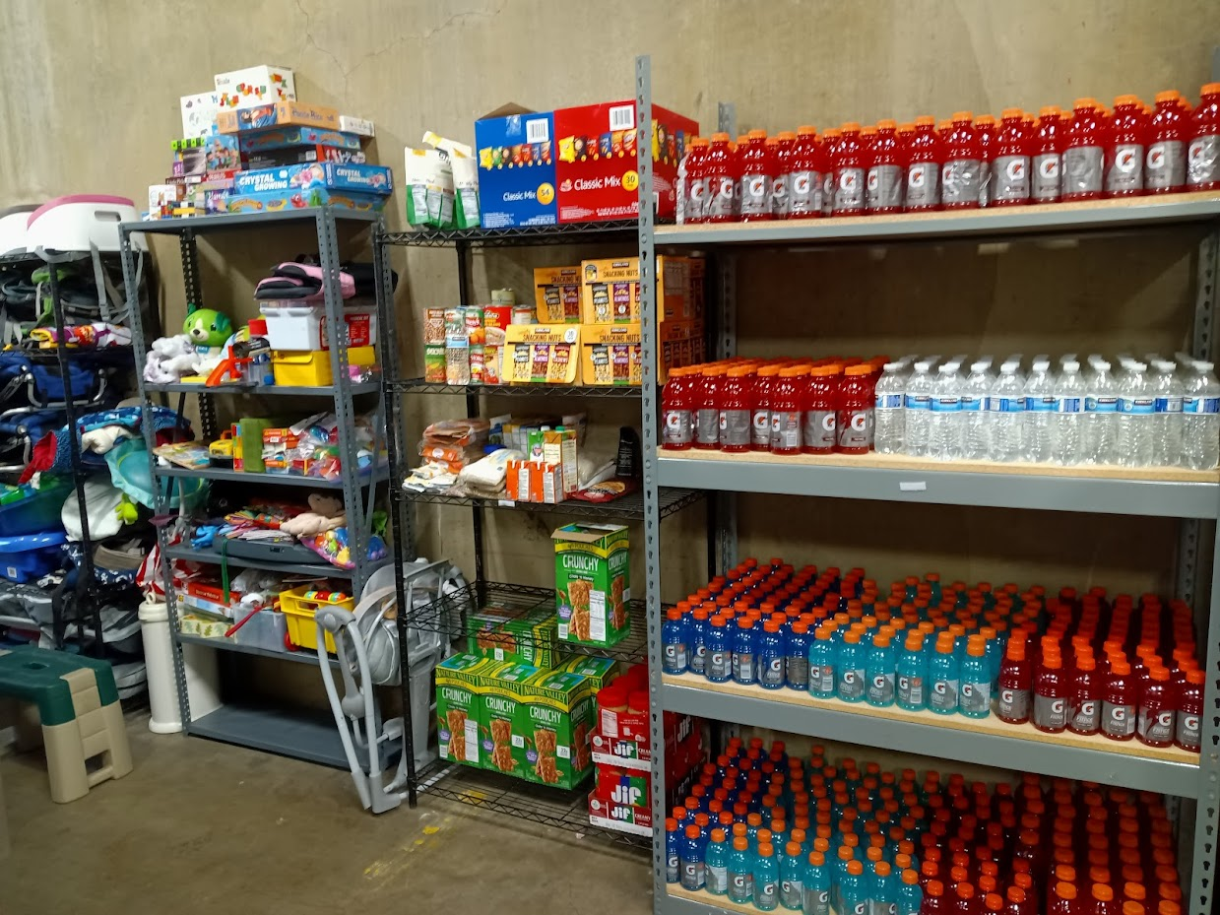
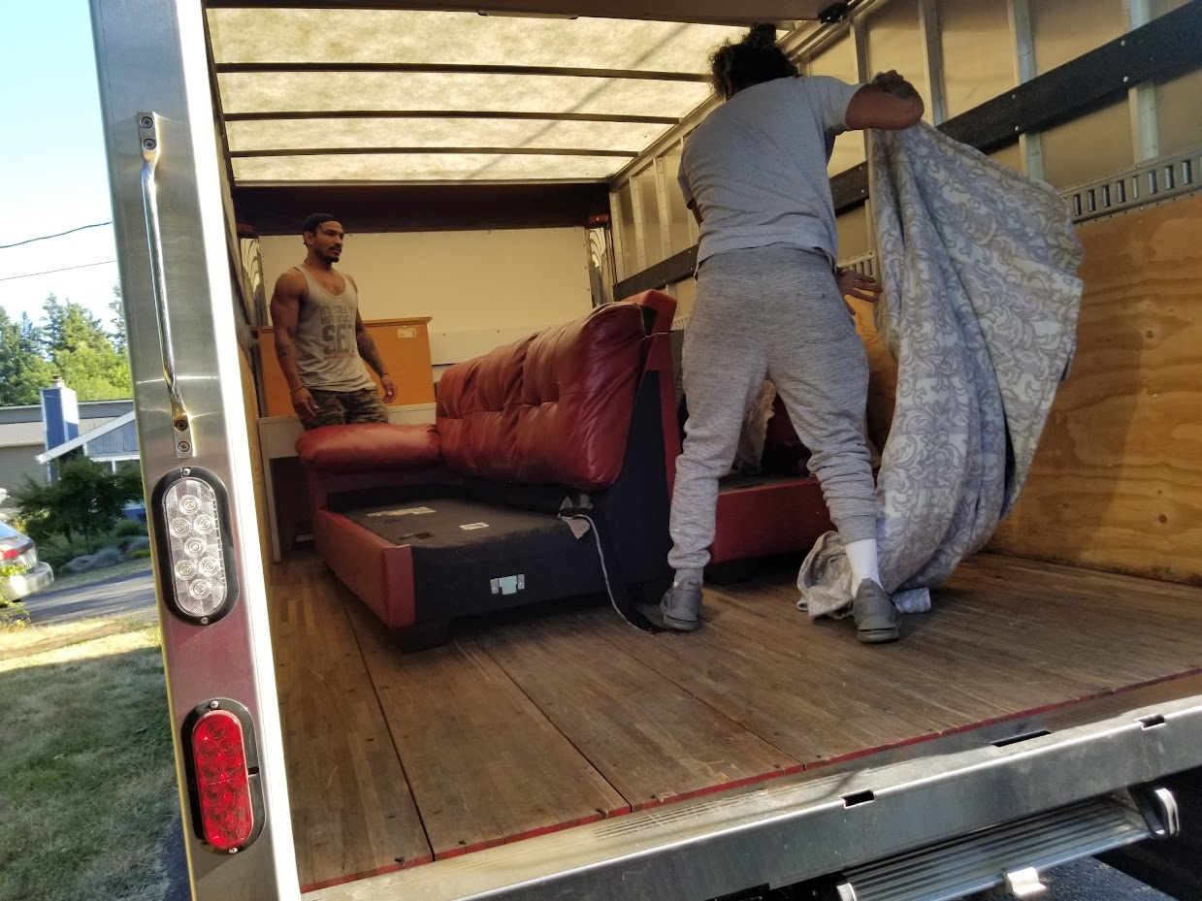
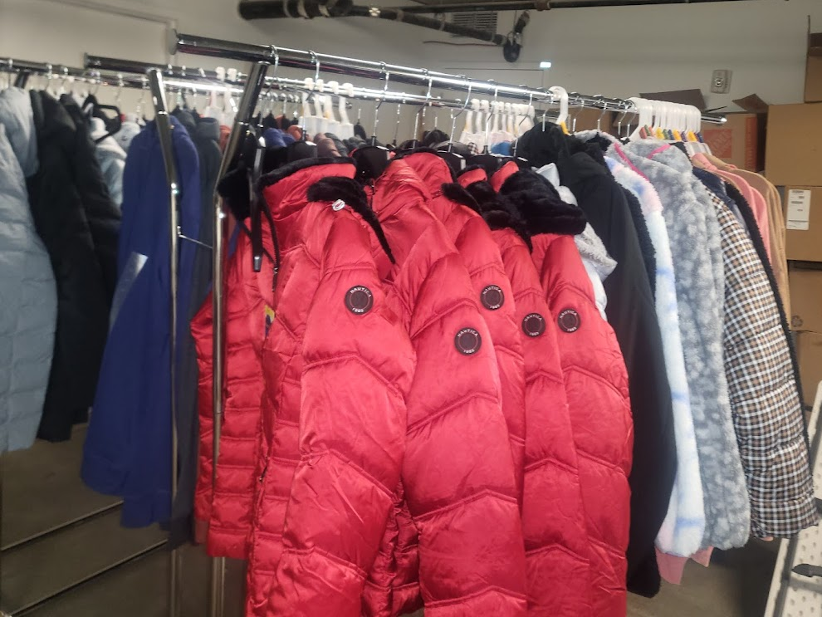
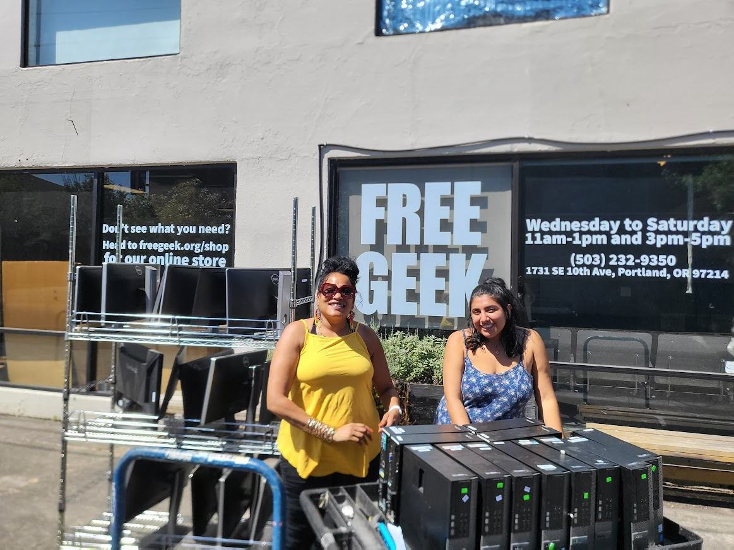
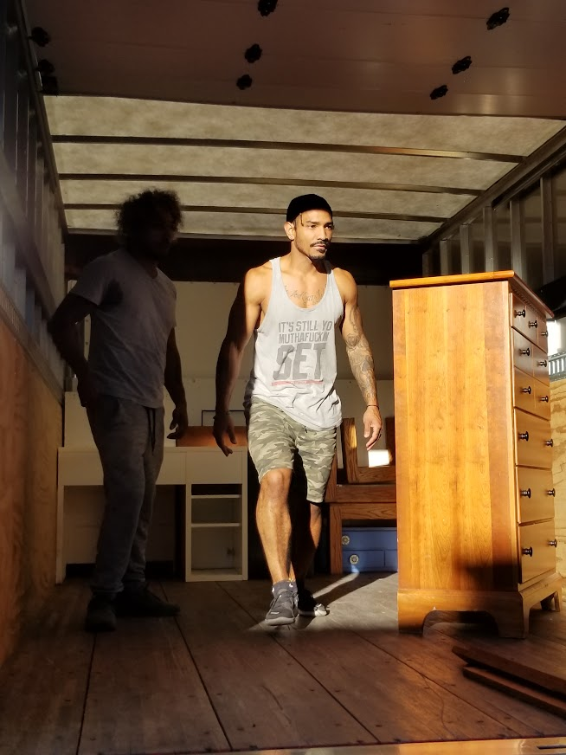
Hustle Hard So you don’t have to show up empty handed

Slide 9
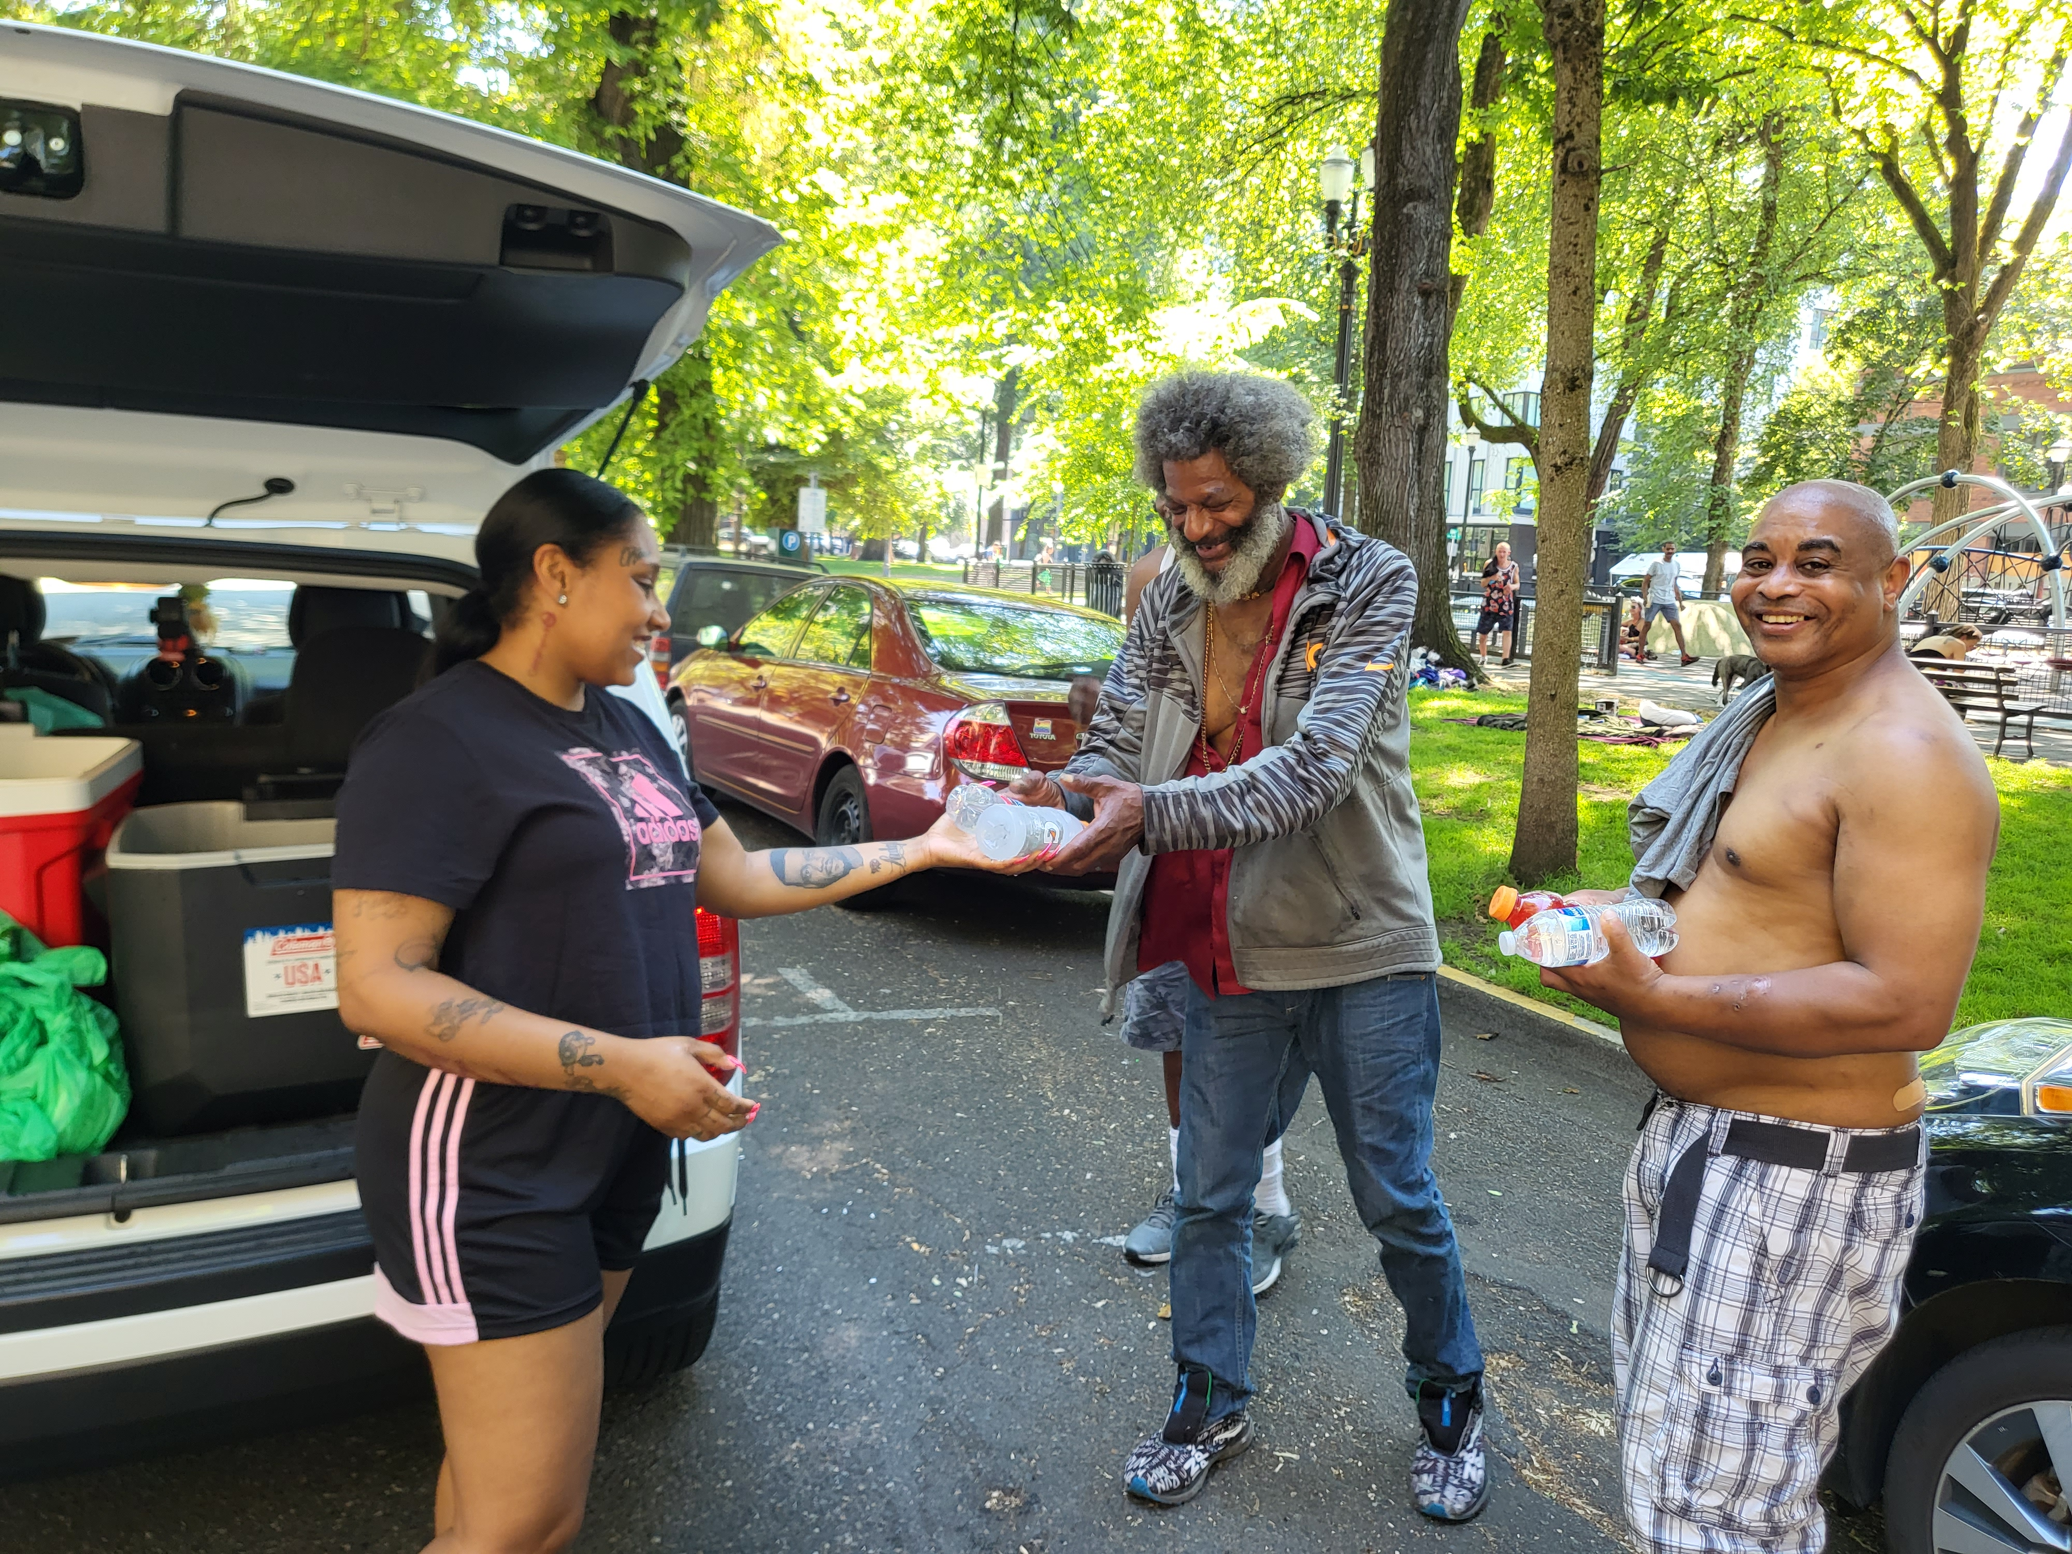
Facing stigma With Needle Exchange
Notes:
Am I willing to love people where they are, Am I willing to see the beauty in their existence

Slide 10
What I put in the bag
FOOD/Cell ph
DOG/CAT FOOD
NARCAN
NEEDLES
GIFT CARDS
WARM CLOTHES/COATS
TENTS
WATER/REUSABLE BOTTLES
BALNKETS
PIPES
BAR B Q GRILLS
LOTS OF SOCKS
BACK PACKS
Notes:
Cell phones are lifelines

Slide 11
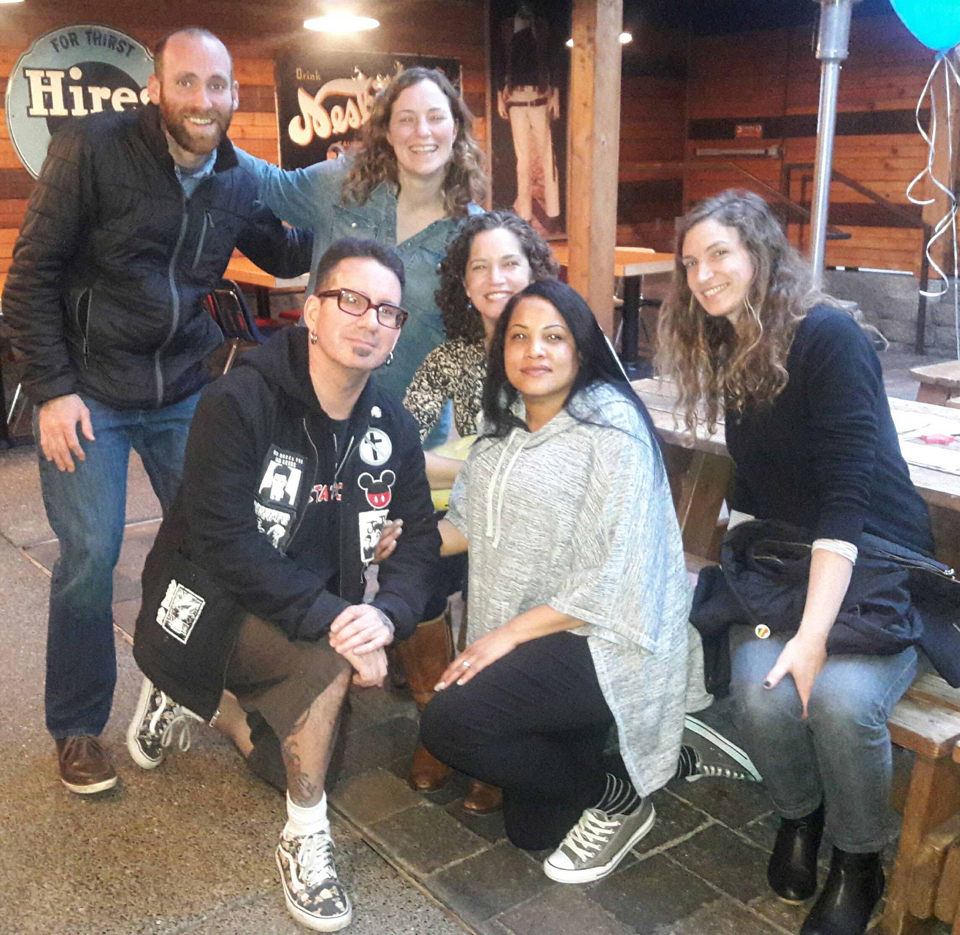
Peer Mentors in Nontraditional Settings
Notes:
these services are constantly changing a peer will know this and may even have direct contacts for each of these resources.
Peers can navigate through systems like DHS, Probation, and Parole and homeless services. From a personal lens and walk Patients through the entire process
clinicians are busy. allowing peers to take the lead on relationship building can be freeing.
peer mentor teach the patient how to receive care respectfully. How to ask for what they need and be kind when they do it.

Slide 12
The IMPACT TEAM

Slide 13
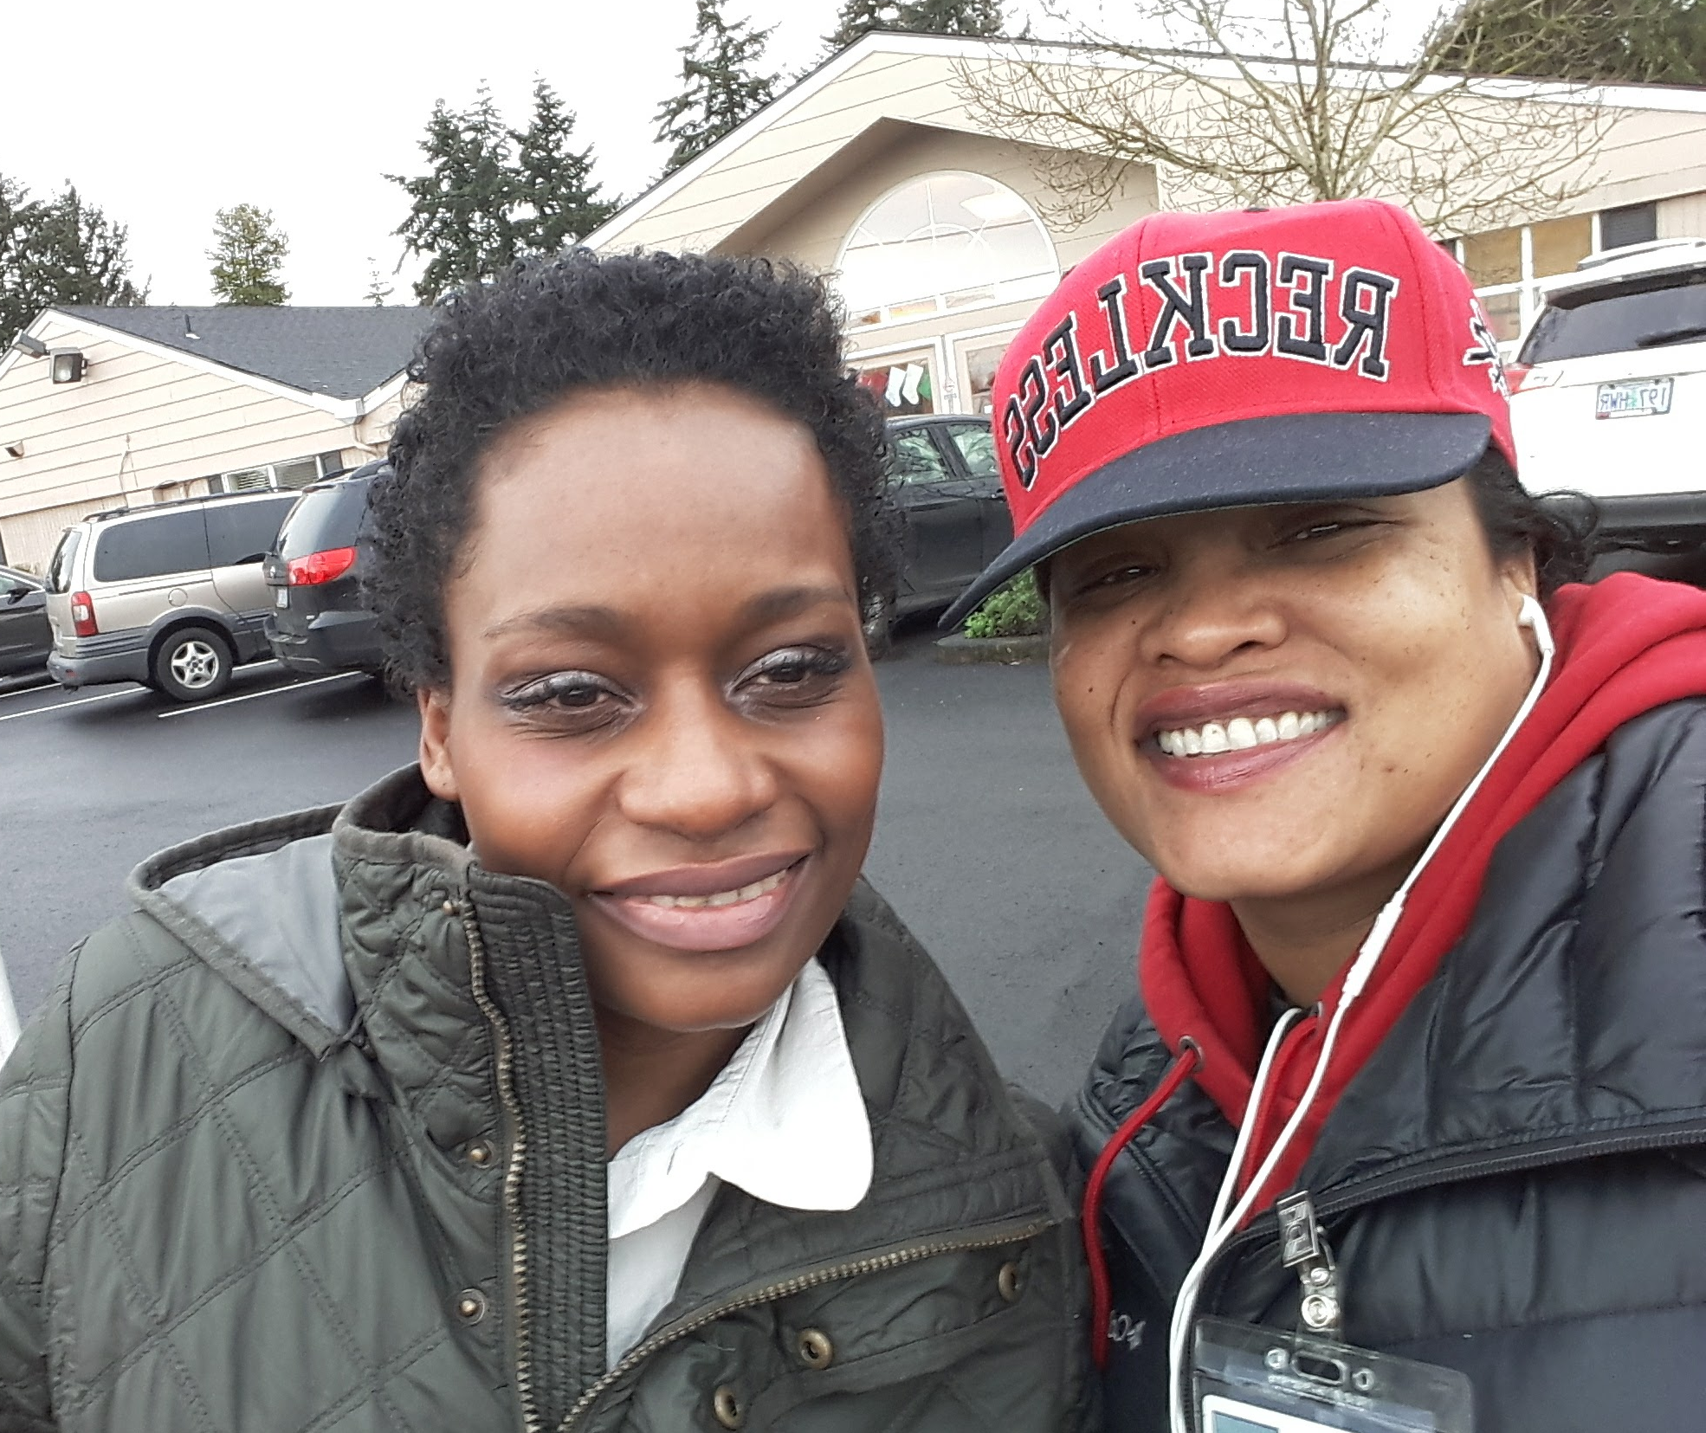
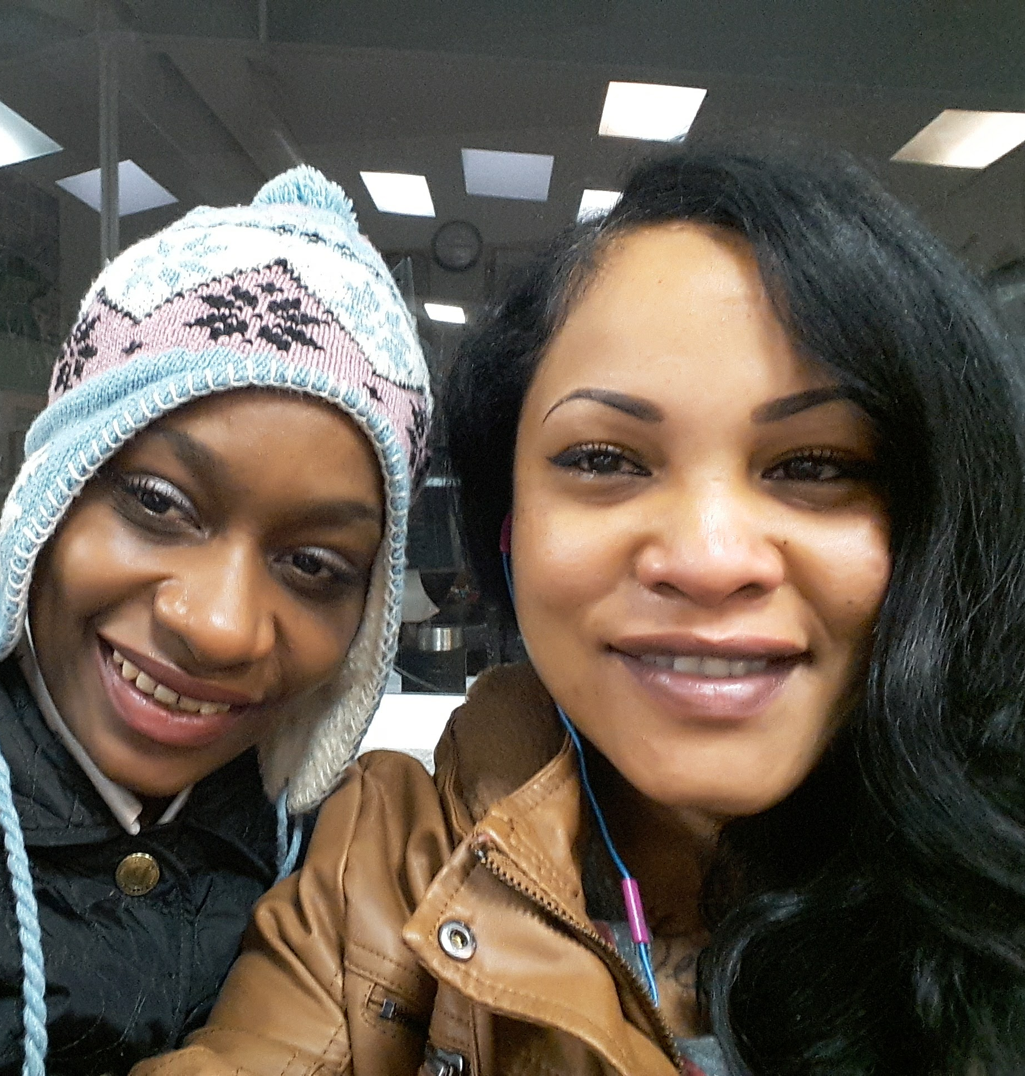
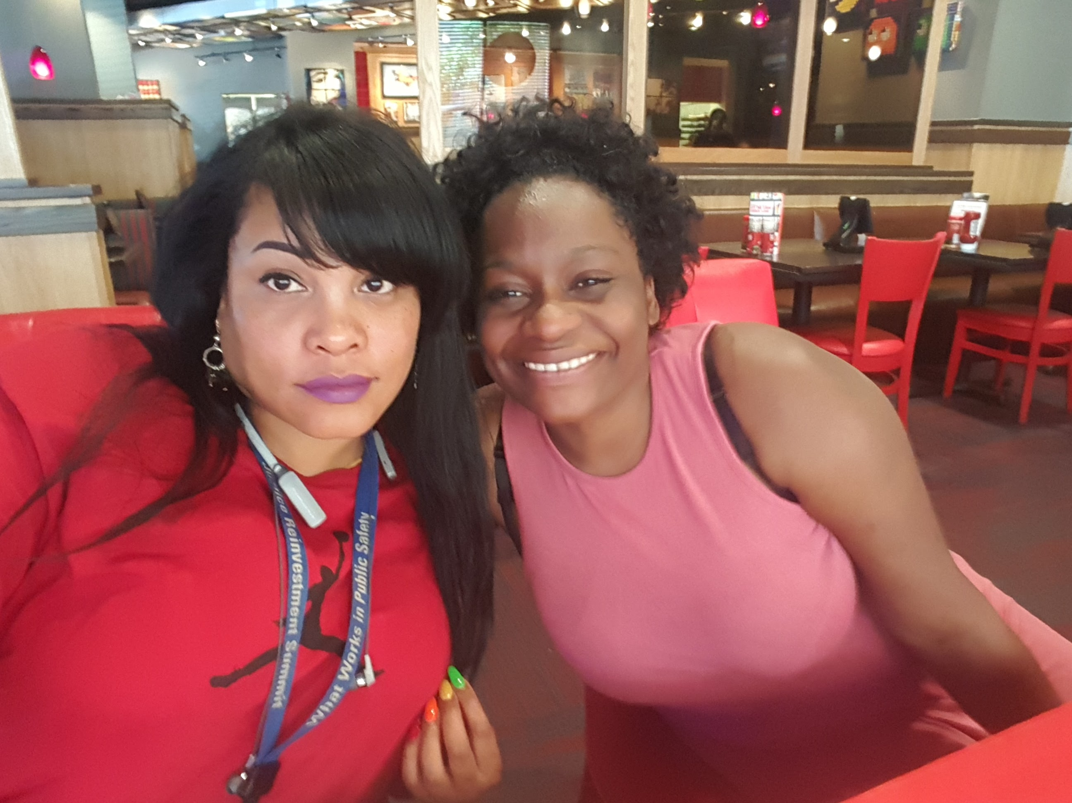
Can Peer Support Help People change?
Notes:
chris

Slide 14
The Hard Part is Inspiring Participants to believe change is possible

Slide 15
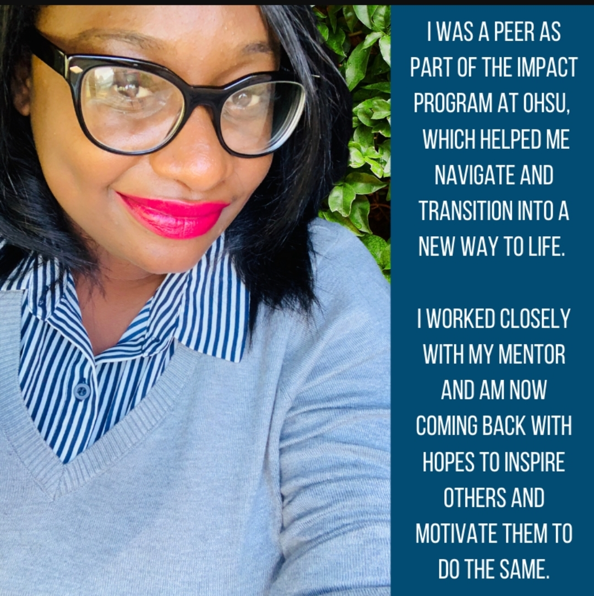
And When They Believe…..
Notes:
Today Amee is a Regional Manager at the youth 4th Dimension Recovery Center and a Lead Intake Coordinator at Brown Hopes Black Resilience Program Everyone's outcome is not the same but with hope anything is possible

Slide 16
Policy is a part of Peer work too
If you not at the Table, You WILL BE ON THE MENU
Those closest to the problem are closest to the solution but often furthest from the resources

Slide 17
Review/
Questions

Slide 18
