Slide 1
SUD Services and State Medicaid Policymaking: Advocacy Through Evidence
Michael Gluck, PhD, MPP
Vice President
michael.gluck@academyhealth.org
Susan Kennedy, MPP, MSW
Director, Evidence-Based State Health Policy Institute
susan.kennedy@academyhealth.org
AcademyHealth
June 5, 2023

Slide 2
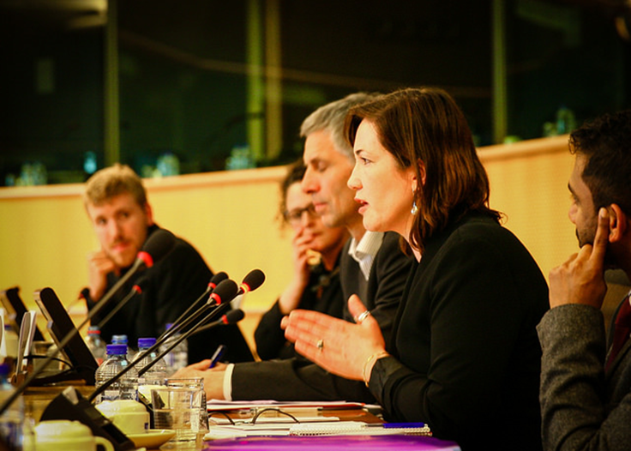
This session is about how you can help Medicaid better serve people with SUD
Medicaid can be the foundation for comprehensive SUD care and support.
The devil is in the details of state policy.
Policymakers need real-world evidence to
guide decisions.
You are in a position to provide that evidence.
Helping you do that is today’s focus.

Slide 3

Today’s Plan
Why this session and why us?
Medicaid 101 through an SUD lens
Who makes Medicaid policy?
What do they need to know and how can you help?
Your questions and Medicaid challenges?

Slide 4


VISION
AcademyHealth envisions a future where individuals and communities are made healthier
by the use of evidence in decision-making.
MISSION
Together with its members, AcademyHealth works to improve health and the performance of the health system by supporting the production and use of evidence to inform policy and practice.

Slide 5
A Brief Tour of Medicaid
Notes:
Drag your picture and Send to Back

Slide 6

Medicaid and Its Role in Assuring SUD Care
Who?
^{Medicaid eligibility}
What?
^{Medicaid benefits/services}
How?
^{Delivery of Medicaid services}
How?
Medicaid financing, managed care, and waivers

Slide 7
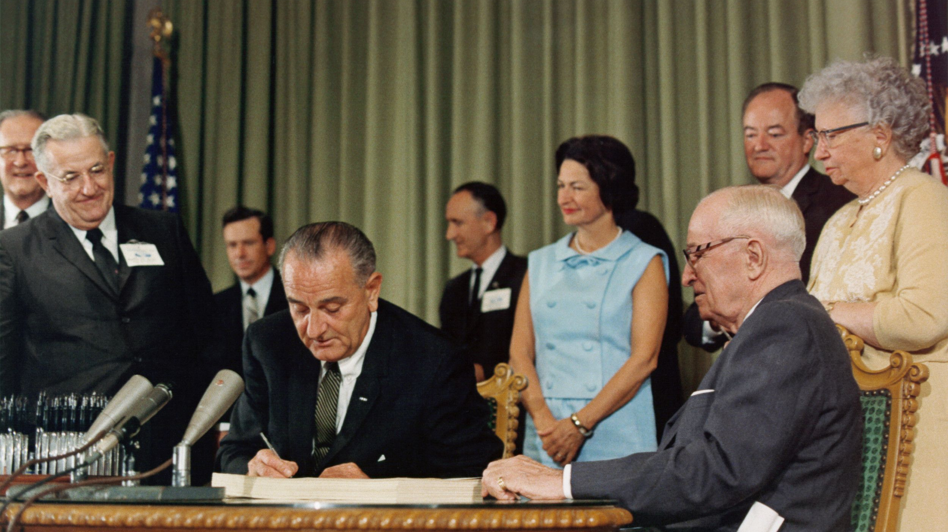
Medicaid was intended to forestall national health insurance
“The inclusion of Medicaid in the
1965 law evolved when Mr. Wilbur
Mills asked me what his answer
should be to the inevitable question
he thought he would be asked
during the legislative debate: ‘Isn’t
Medicare an ‘entering wedge’ to a
broader program of nationwide
‘compulsory’ insurance coverage
of everyone?’ I suggested that if he
included some plan to cover the key
groups of poor people, he would
have a possible answer to this
criticism. ”
--Wilbur Cohen, former HEW
Secretary
Source, Cohen WJ, ”Reflections on the enactment of Medicare and Medicaid.”
Health Care Financ Rev 1985 Dec; 1985(Suppl): 3-11

Slide 8
Medicaid has traditionally covered categories of people with lower incomes
Children
Pregnant women
Parents of dependent children
Elderly
People with disabilities
The ACA expanded Medicaid to low-income adults (at states’ option)
Excluded: non-citizens except certain categories

Slide 9
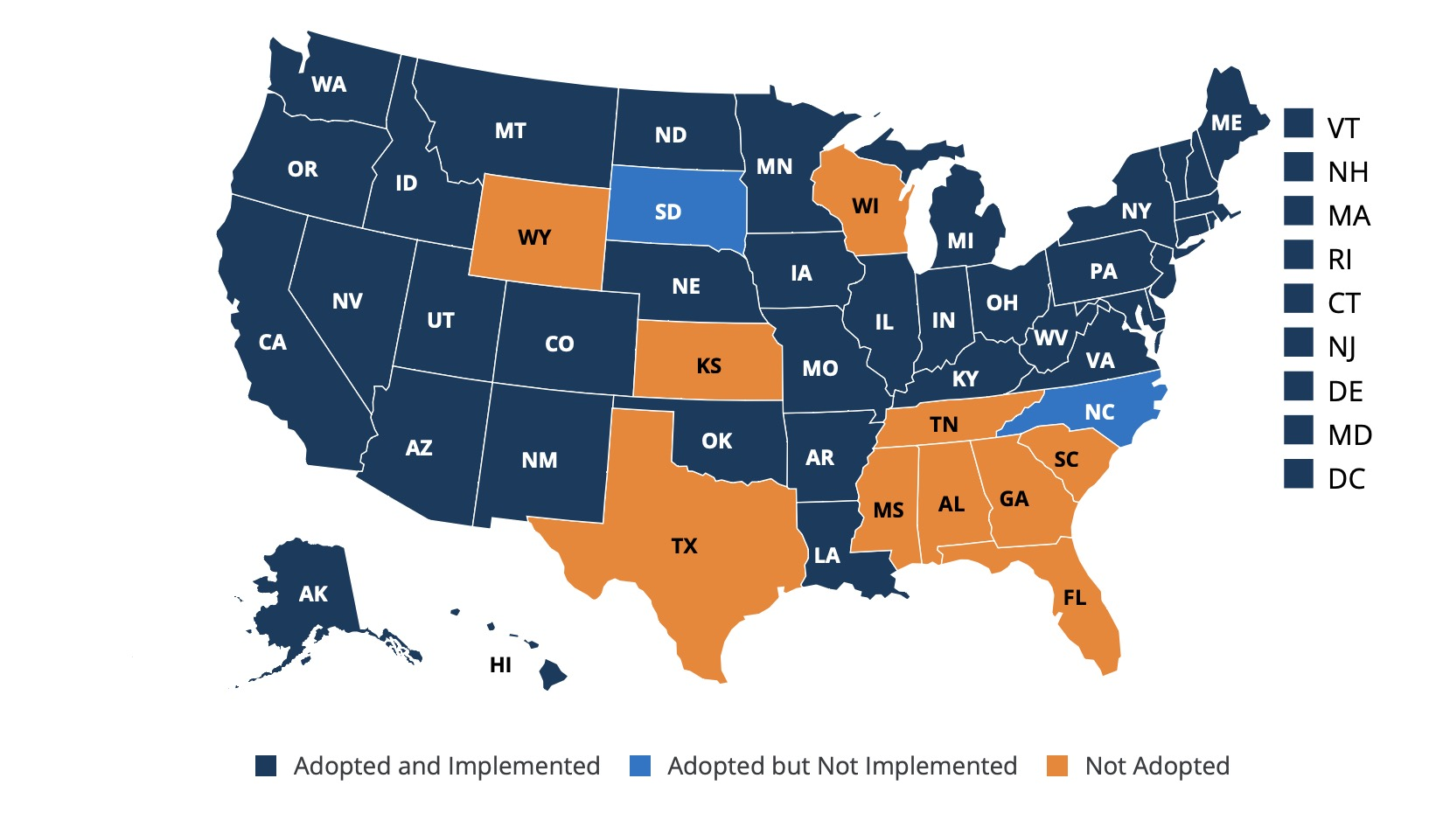
Ten states have not (yet) opted for ACA expansion
As of March 27, 2023
Source: Kaiser Family Foundation

Slide 10
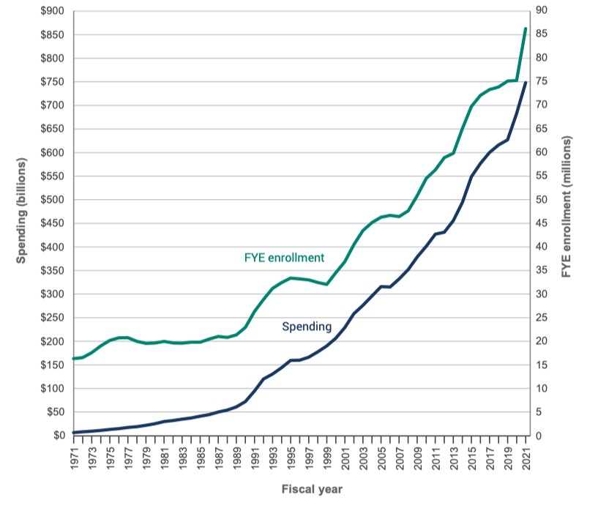
Medicaid covers 1 in every 4 Americans
Enrollment and spending have grown steadily over time
FYE enrollment =
average monthly
enrollment
Source: Macpac, MACStats: Medicaid and CHIP Data Book, December 2022

Slide 11
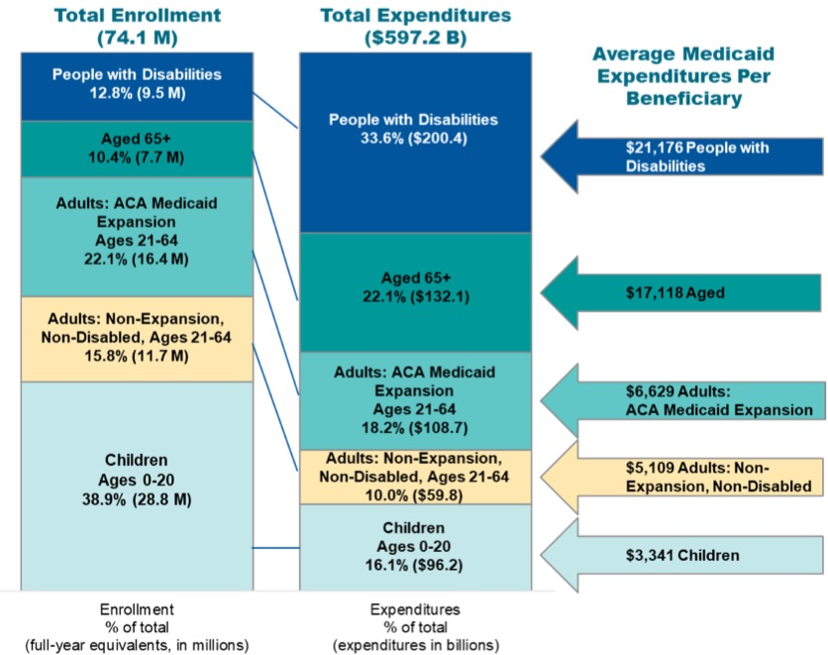
Medicaid Enrollment and Expenditures by Enrollment Group
For 2018-2019
Source: CMS, 2022 Medicaid and CHIP
Beneficiary Profile

Slide 12
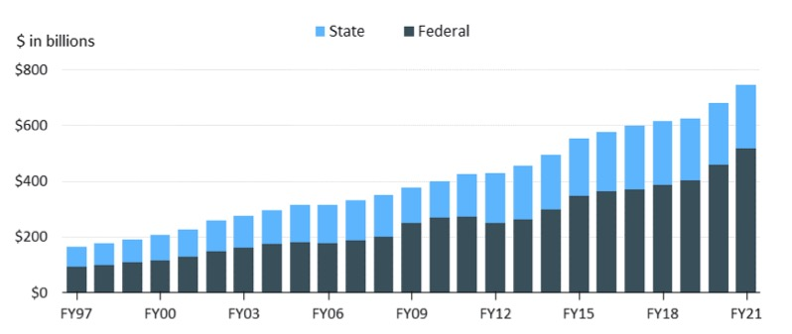
The Federal Government Paid 69 Percent of Medicaid
Costs in 2021
Beneficiaries also help pay through cost-sharing in some states

Slide 13
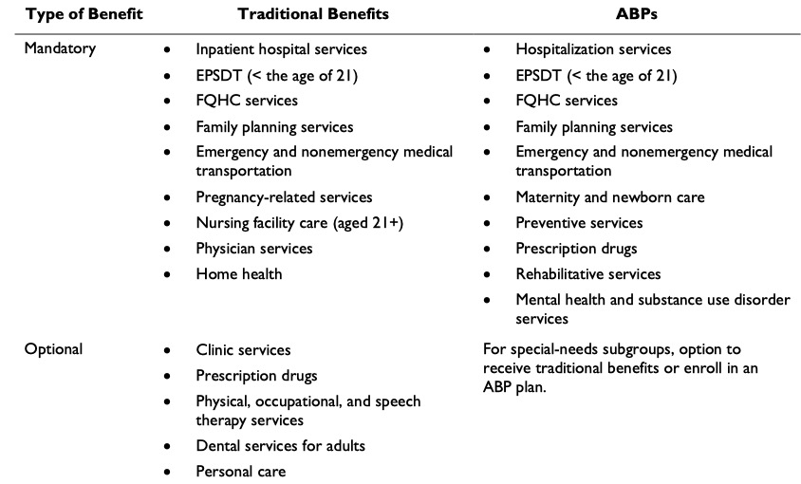
Two types of benefit packages, but specifics vary a lot by state
APBs must include mental health and SUD services
Key:
ABP = alternative benefit
package
EPSDT = early & periodic
screening, diagnostic, and
treatment services
FQHC = federally qualified
health center
Source: Congressional
Research Service,
Medicaid: An Overview,
R43357, February 8, 2023

Slide 14

Medicaid expansion increased treatment access
Uninsured rate for opioid-related hospitalizations fell from 13.4 percent to 2.9 percent one year after expansion
Number of Medicaid beneficiaries using treatment services in KY jumped 700 percent one year after expansion.
Expansion increased medication assistant treatment by 50 percent.

Slide 15


Few states cover the continuum of SUD services
In 2018,
38 states
covered peer support services
29 states
covered community supports
15 states
covered training and development
13 states
covered supported employment
4 states
covered tenancy support services
Source: Center for Budget and Policy Priorities. Policy Brief.
March 24, 2021

Slide 16
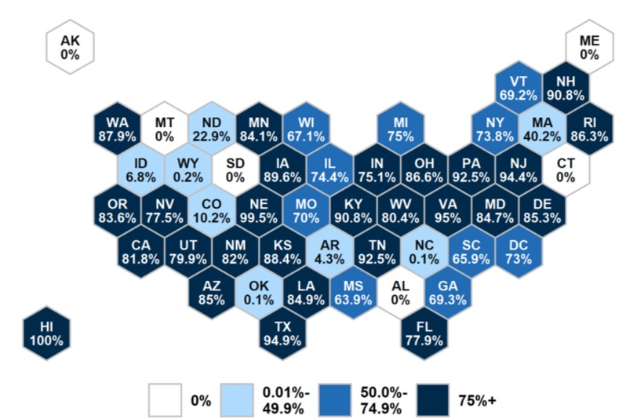
84 Percent of Beneficiaries Are In Managed Care
72 percent are in comprehensive plans, 12 percent in limited or primary care case management plans
Source: Congressional
Research Service,
Medicaid: An Overview,
R43357, February 8, 2023

Slide 17
49 States and DC have a total of 431 waivers to state plan requirements
Type | Purpose and examples | Financing requirements | Number of waivers | Number of states
§1115 research and demonstration waiver | Allows experimentation such as work requirements, housing, support for other social needs, targeting of benefits, enrollment caps. | Budget neutrality | 84 | 49 + DC
§1915(b) managed care/freedom of choice waiver | Allows mandatory managed care or limitations on enrollees’ choice of providers, outpatient treatment, case management. | Cost-effectiveness | 80 | 37
§1915(c) Home and community-based services (HCBS) waiver | Allows flexibility in benefits for persons with long term supports and services needs. Can be combined with §1115 and §1915(b) waivers | Cost neutrality | 263 | 47+DC

Slide 18

Medicaid can be the foundation for comprehensive, integrated care and support services for low-income people with SUD
Ability to cover the full continuum
of ASAM-recommended services
Multiple, flexible policy levers that can work in tandem
Potential to remedy racial and other
inequities in SUD access, experience
and outcomes

Slide 19
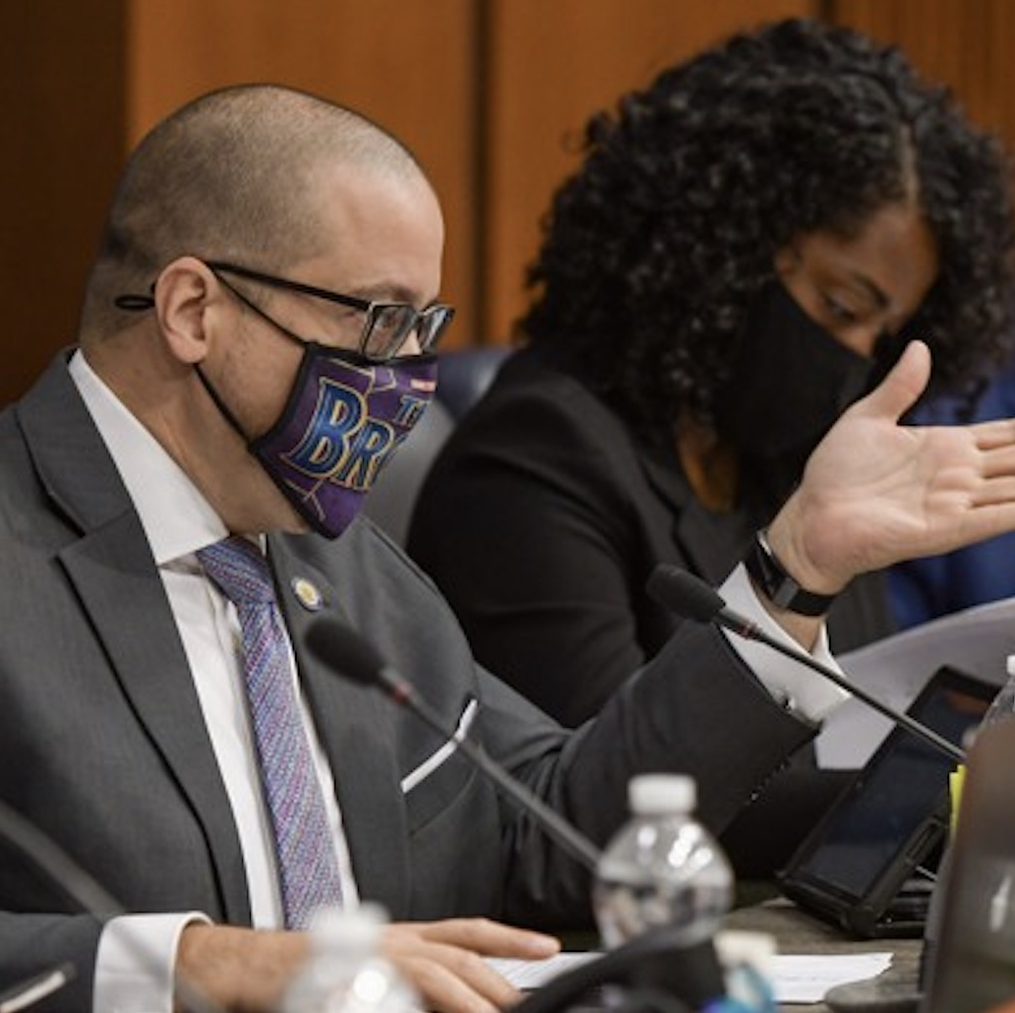

But there are constraints
1
State and territorial budgets
2
Administrative capacity
3
CMS regulations
4
Provider availability
5
Political feasibility
6
Evidence to inform policy

Slide 20
Who makes Medicaid policy?
Notes:
Drag your picture and Send to Back

Slide 21
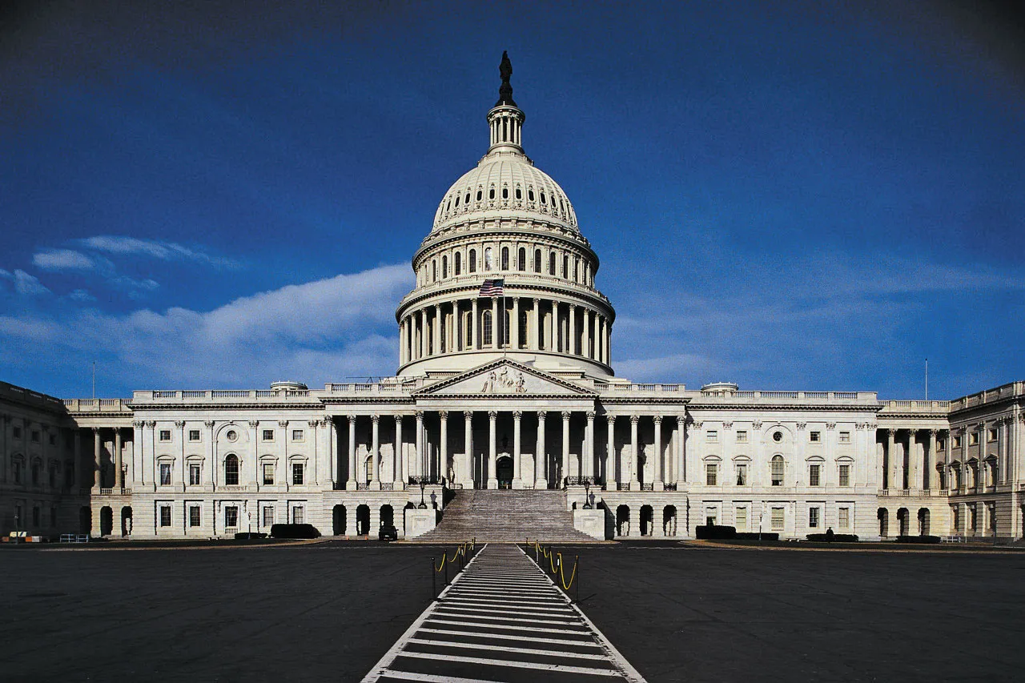

Many officials make Medicaid decisions that affect people with SUD
Federal policymakers
State policymakers
Members of Congress (eg meds for OUD)
CMS officials (eg plan waivers)
Federal judges (eg Olmstead/HCBS)
Governors
Legislators
Budget agencies
Medicaid Directors
Medicaid Medical Directors
Other agencies and commissions

Slide 22
Reaching Your Audience:
How to Effectively Message
Notes:
Drag your picture and Send to Back

Slide 23



Sharing your experience
Audiences
Messaging
Collateral and Channels

Slide 24

Identifying your audiences
Knowing your target and influencer audiences
  Sponsoring Bill Legislators
  Committee Leads
  Staff
State Agency Policymakers
Community Health Boards/ Centers
State Legislators
  State Agency Clinical Leads
  Providers
  Community Navigators
  Peers
  Care Coordinators

Slide 25


What You Say
Choosing the right word goes beyond its dictionary definition. Using ‘plain language’ and concrete examples can ensure accuracy and understanding.
What They Hear
Beyond connotation, our understanding is shaped by our experience, world view and perspective. Framing helps ensure your message resonates
as credible with a specific audience.
Notes:
Example of significance.

Slide 26
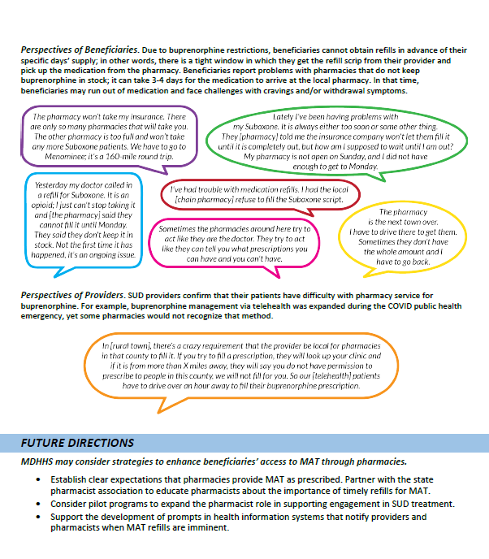
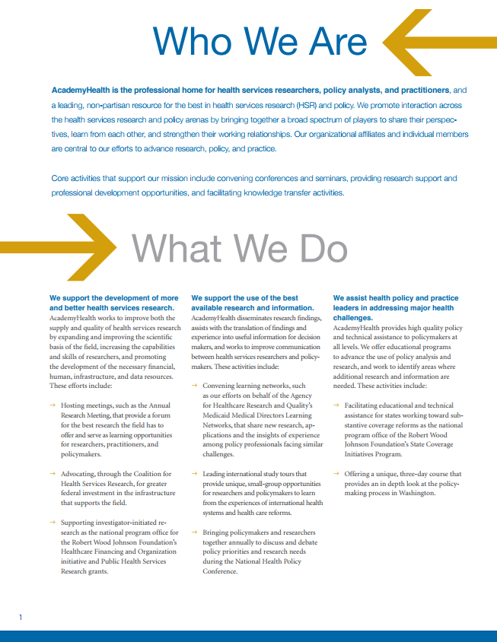
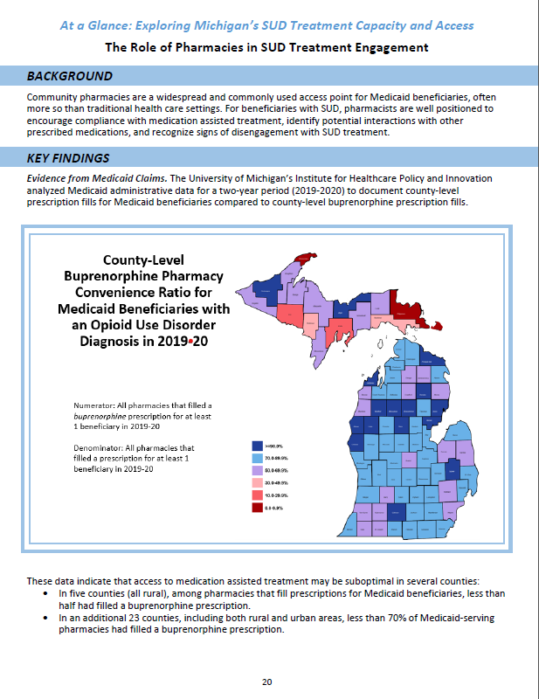
Leave Behinds
Notes:
Speaking of leave behinds – once you’ve got your message and channel picked out, think about attractive and succinct ways to present it via one-pagers, post cards or info graphics.

Slide 27

Peer Expert for Panels or Trainings
Insert photo on expert panel

Slide 28
Workshopping Issues in Your State
Notes:
Drag your picture and Send to Back

Slide 29
Thank You
Michael Gluck, PhD, MPP
Vice President
michael.gluck@academyhealth.org
Susan Kennedy, MPP, MSW
Director, Evidence-Based State Health Policy Institute
susan.kennedy@academyhealth.org
Notes:
Drag your picture and Send to Back

